Slide 1
PHY 712 Electrodynamics
11-11:50 AM MWF in Olin 103
Notes for Lecture 16:
Finish reading Chapter 6
Some details of Liénard-Wiechert results
Energy density and flux associated with electromagnetic fields
Time harmonic fields

Slide 2
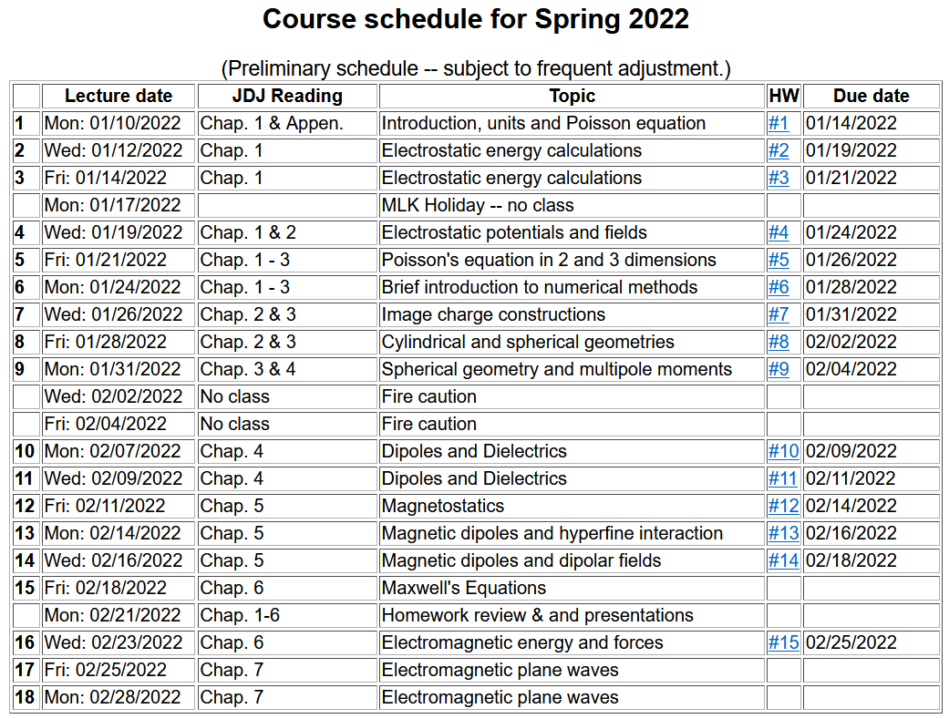

Slide 4
Spring break
Mid term grades due
Prepare presentations

Slide 5
Scheduling details
When would you like to make your presentations – expected to need two double class periods?
Week of March 21?
Week of April 25 (last week of class)?
Remaining topics to be covered in PHY 712
Chap. 7 – Plane waves and optical properties of materials
Chap. 8 – Wave guides
Chap. 9 – Radiation from time harmonic sources
Chap. 11 – Theory of special relativity
Chap. 14 – Synchrotron radiation and other special radiation effects

Slide 6
4 PM Olin 101

Slide 8
Solution of Maxwell’s equations in the Lorentz gauge – Review from previous lecture --
Liénard-Wiechert potentials and fields --
Determination of the scalar and vector potentials for a moving point particle (also see Landau and Lifshitz The Classical Theory of Fields, Chapter 8.)
Consider the fields produced by the following source: a point charge q moving on a trajectory R_{q}(t).
R_{q}(t)
q

Slide 9
Solution of Maxwell’s equations in the Lorentz gauge -- continued
We performing the integrations over first d³r’ and then dt’
making use of the fact that for any function of t’,
where the ``retarded time'' is defined to be

Slide 10
Comment about delta functions -- See Pg. 26 in Jackson
_{x→}

Slide 11
Solution of Maxwell’s equations in the Lorentz gauge -- continued
Resulting scalar and vector potentials:
Notation:

Slide 12
Solution of Maxwell’s equations in the Lorentz gauge -- continued
In order to find the electric and magnetic fields, we need to evaluate
The trick of evaluating these derivatives is that the retarded time t_{r} depends on position r and on itself. We can show the following results using the shorthand notation:
and

Slide 13
Some details --
Using notation:
➔

Slide 14
Solution of Maxwell’s equations in the Lorentz gauge -- continued

Slide 15
Back to general case --
Maxwell’s equations
Energy analysis of electromagnetic fields and sources

Slide 16
Energy analysis of electromagnetic fields and sources - continued

Slide 17
Energy analysis of electromagnetic fields and sources - continued

Slide 18
Momentum analysis of electromagnetic fields and sources

Slide 19
Summary -- By considering a complete system involving self-contained sources and fields, we examined the energy and force relationships and introduce energy and force equivalents of the electromagnetic fields

Slide 21
Comment on treatment of time-harmonic fields

Slide 22
Comment on treatment of time-harmonic fields -- continued
Equations in time domain in frequency domain
Note -- in all of these, the real part is taken at the end of the calculation.

Slide 23
Comment on treatment of time-harmonic fields -- continued

Slide 24
Summary and review
Maxwell’s equations

Slide 25
Maxwell’s equations

Slide 26
Analysis of Maxwell’s equations without sources -- continued:

Slide 27
Analysis of Maxwell’s equations without sources -- continued:
Both E and B fields are solutions to a wave equation:

Slide 28
Analysis of Maxwell’s equations without sources -- continued:
Note: ε, μ, n, k can all be complex; for the moment we will assume that they are all real (no dissipation).

Slide 29
Analysis of Maxwell’s equations without sources -- continued:

Slide 30
Analysis of Maxwell’s equations without sources -- continued:
Transverse Electric and Magnetic (TEM) waves

