Slide 1
PHY 712 Electrodynamics
11-11:50 AM MWF Olin 107
Class notes for Lecture 2:
    Reading: Chapter 1 (especially 1.11) in JDJ;
      Calculation of the electrostatic energy
      Evaluation of the electrostatic energy of an extended periodic system using Ewald summation methods
Notes:
This lecture details some special properties of the electrostatic energy of an extended system. It illustrates some special properties of the long range nature of the Coulomb interaction. Ewald summation methods may or may not be important for your particular field of study. However, it is at least important to be aware of the ideas.

Slide 2
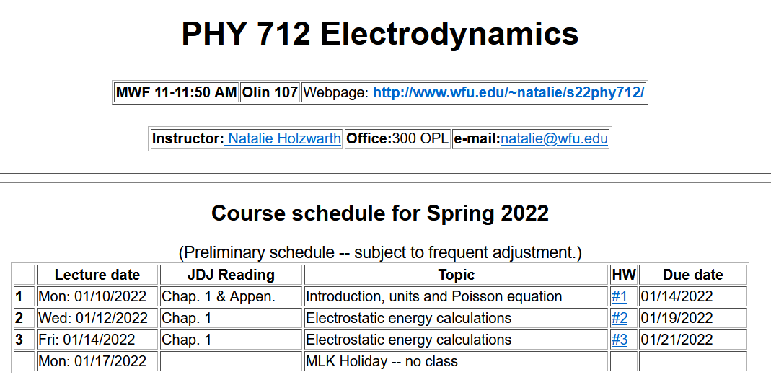
Notes:
The homework problem assigned this time exercises the ideas presented in this lecture.

Slide 3
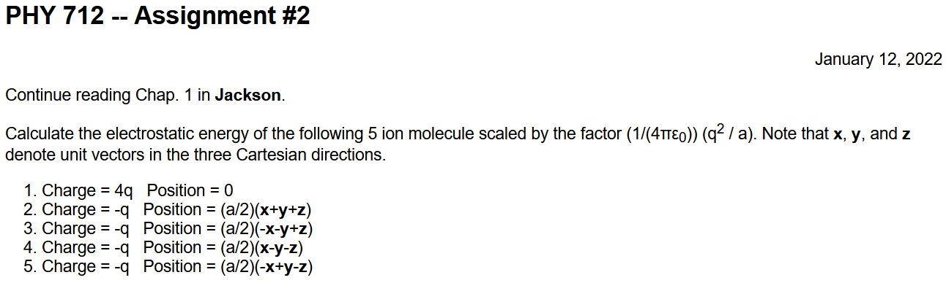

Slide 4
Comment on HW #1
Contribution from only the electron in its ground state

Slide 5
Calculation of the electrostatic energy of a system of charges --

Slide 6
Example finite charge system for which electrostatic energy W can be calculated in a straightforward way
2
3
Charge -e
1
5
4
Charge +e
6
(particles moves off to infinity)
Notes:
Summation for a finite number of particles is straightforward, but extension to an infinite system runs into difficulty.

Slide 7
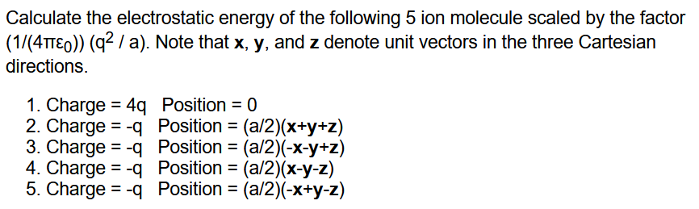
Homework problem #2

Slide 8
Now consider the case of an infinite periodic system --

Slide 9
Evaluation of the electrostatic energy for N point charges:
Ewald summation methods – exact results for periodic systems
Details to follow --
Notes:
In the Extra lecture notes this expression will be derived and illustrated.

Slide 10
Slight digression:
Comment on electrostatic energy evaluation --
When the discrete charge distribution becomes a continuous charge density: the electrostatic energy
becomes
Notice, in this case, it is not possible to exclude the ``self-interaction''.
Previous expression can be rewritten in terms of the electrostatic potential or field:
Notes:
We will see and use these expressions throughout the course. However, the so-called self energy often leads to difficulties….

Slide 11
Some details --

Slide 12
Summary --
Electrostatic energy

Slide 13
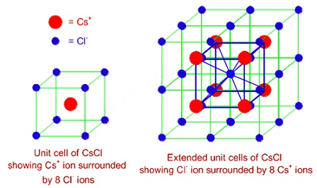
In general, the evaluation of the electrostatic energy of an extended system can be numerically tricky because of the long range nature of the Coulombic forces.bbbb
Now consider the electrostatic energy of a periodic crystal of CsCl

Slide 14
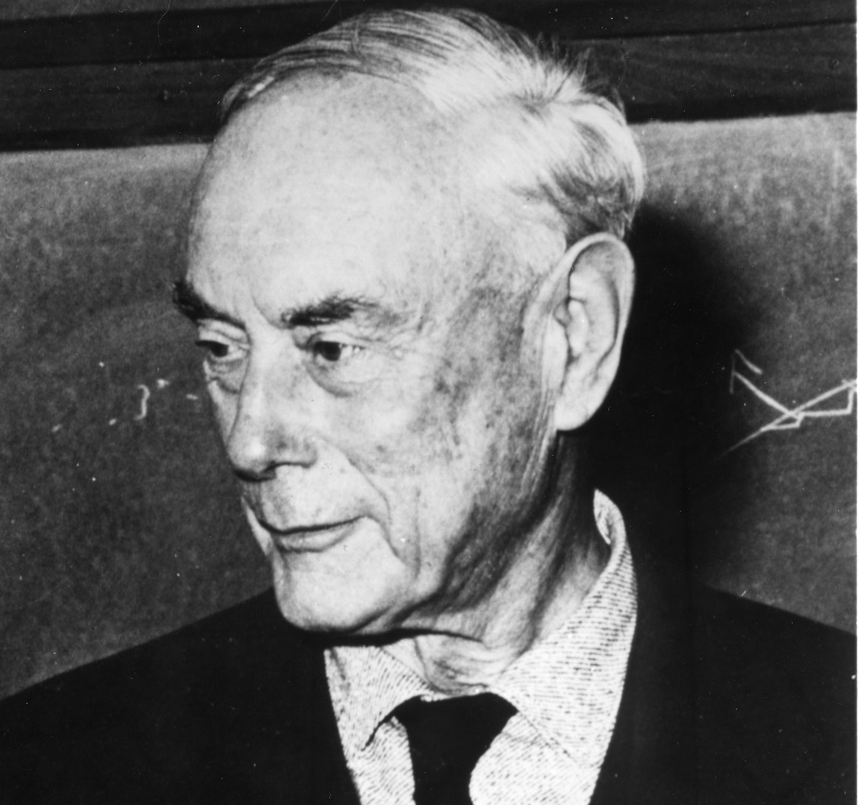
In general, the evaluation of the electrostatic energy of an extended system can be numerically tricky because of the long range nature of the Coulombic forces.
However, thanks to very clever mathematicians, it is possible to perform this sort of calculation for periodic systems.
Ewald, Paul Peter, 1888-1985
American crystallographer, emigrated from Germany

Slide 15
The Ewald summation algorithm is used to evaluate the
poorly convergent summations needed to evaluate the electrostatic energy of a periodic ionic solid.
As an example, we will consider the electrostatic energy of a periodic crystal of CsCl

