Slide 1
PHY 712 Electrodynamics
11-11:50 AM MWF Olin 103
Notes for Lecture 22:
    Continue reading Chap. 9
      Electromagnetic waves due to specific sources
      Dipole radiation examples
      Radiation from antennas

Slide 2
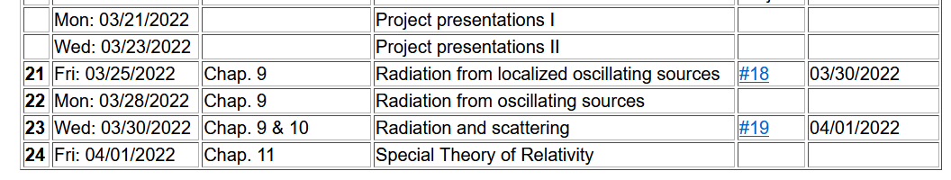

Slide 3
Important results from last time – EM waves from time harmonic sources – open isotropic boundaries

Slide 5
Example of dipole radiation source
Note that the continuity of charge and current must be satisfied. For the Fourier amplitudes, the relations are as bellow:
Jackson’s clever trick!

Slide 6
Example of dipole radiation source
From the analysis valid for kr>>1 and kR<<1:

Slide 7
Example of dipole radiation source -- exact results for r>>R:
Agrees with dipole approximation for kR<<1.

Slide 8
More details --
Correct when this term is negligible.
Notes:
An example of using the spherical harmonic expansion to analyze “exact” expressions for the scalar and vector potentials.

Slide 9
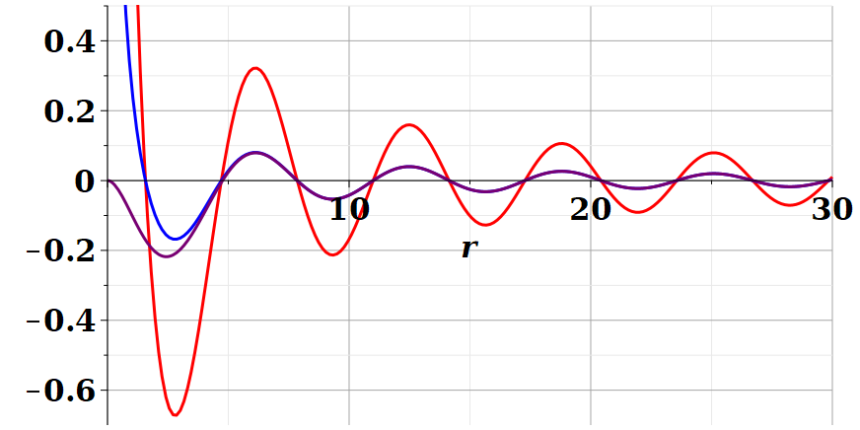
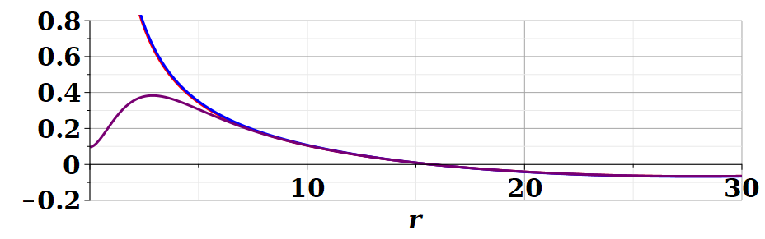
Example continued
For kR=1
Dipole approximation
Re(Ã(r,ω))
/R
exact
For kR=0.1
Re(Ã(r,ω))
/R
Notes:
Comparing the values of the vector potential calculated using the asymptotic expansion (r→infinity) with the exact evaluation. You see that the difference occurs only within the source extent.

Slide 10
Continued review of dipole results --

Slide 11
Review:
Electromagnetic waves from time harmonic sources – continued:
Notes:
In the long wavelength limit, the dipole approximation is numerically close to the physical situation.

Slide 12
Review:
Electromagnetic waves from time harmonic sources – continued:
Notes:
Continued analysis of vector and scalar potential fields following Jackson Section 9.2.

Slide 13
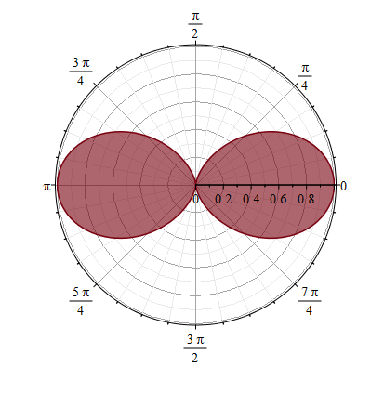
Properties of dipole radiation field for kr >>1:
z
Example:
r
θ
p
E
Note that vectors r, E, B are mutually orthogonal
y
x
B
Notes:
Geometric properties of dipolar fields.

Slide 14
Alternative approach
Notes:
Up to now, we have worked with the exact spherical harmonic expansion, evaluating the results in certain limits. Now consider analyzing the Green’s function integral directly without use of Bessel functions. You may recognize this treatment as the Born approximation encountered in quantum mechanical scattering theory.

Slide 15
For our example:
➔Results equivalent to Bessel function expansion in the limit kr → ∞.
Notes:
This approach is similar to the Bessel function expansion if more terms were used.

Slide 16
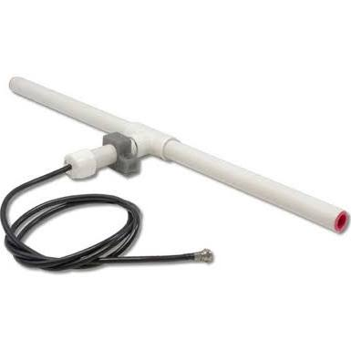
r
Other radiation sources using
``alternative approach’’
z
Linear center-fed antenna
θ
d/2
Notes:
Up to now, we have been thinking about sources on the atomic scale. The analysis also works for macroscopic sources such as antennas. This example which follows your textbook is called a center fed antenna.

Slide 17
Alternative approach – linear center-fed antenna continued
Notes:
Analyzing the vector potential in this “Born” approximation, we obtain an analytic result for the radiation distribution.

Slide 18
Alternative approach – linear center-fed antenna continued
Notes:
The radiation pattern is quite sensitive to the relationship between the antenna length d and the wavelength of the radiation.

Slide 19
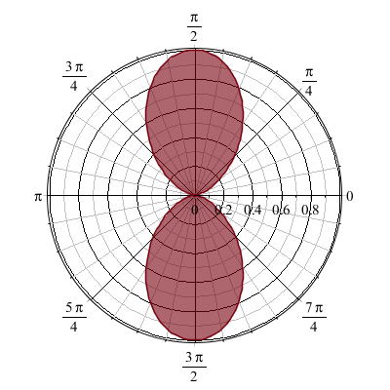
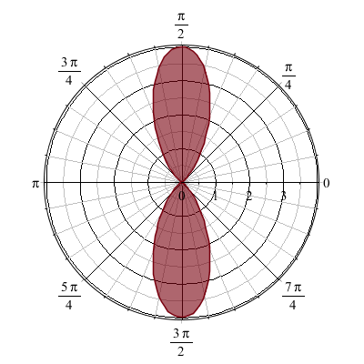
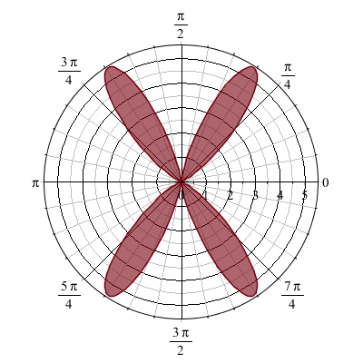
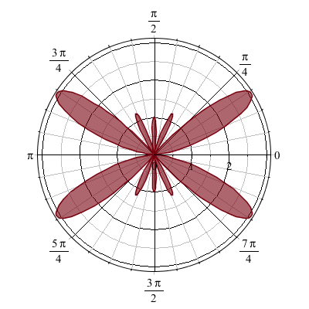
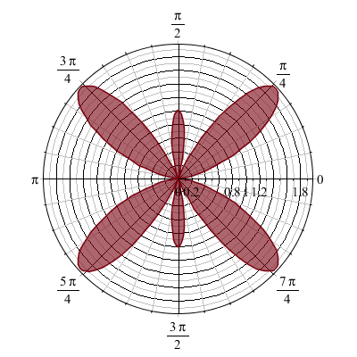
Alternative approach – linear center-fed antenna continued
kd=π 2π 3π 4π 5π
Notes:
Here are some polar plots of the radiation patterns for various cases.

Slide 20
Some details --
kd=π 2π 3π 4π 5π
Polar plot:
Angle indicates values of theta
Radius indicates value scaled to 1.
θ

Slide 21
Next time – we will consider the effects of multiple antennas (antenna arrays including interference effects) and radiation due to light scattering (from Chapter 10 of your textbook).

