Slide 1
PHY 712 Electrodynamics
11-11:50 AM MWF Online
Discussion for Lecture 24:
Start reading Chap. 11
      Equations in cgs (Gaussian) units
      Special theory of relativity
      Lorentz transformation relations
Notes:
In this lecture we will jump to Chapter 11 of Jackson and the special theory of relativity.

Slide 2
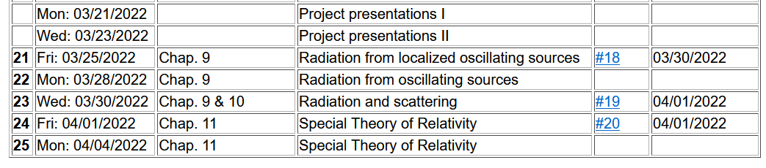
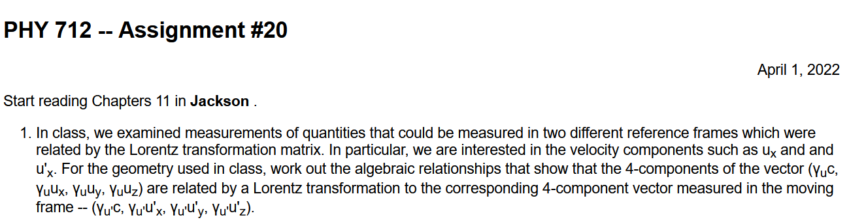

Slide 3
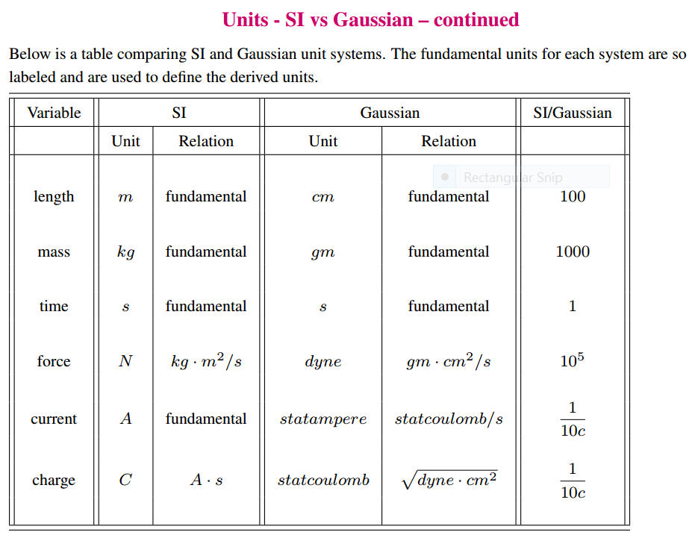
Notes:
Now – jumping to Chapter 11 of Jackson. Fortunately/unfortunately Jackson decided to use cgs Gaussian units starting in Chapter 11. Here is a table of comparison.

Slide 4
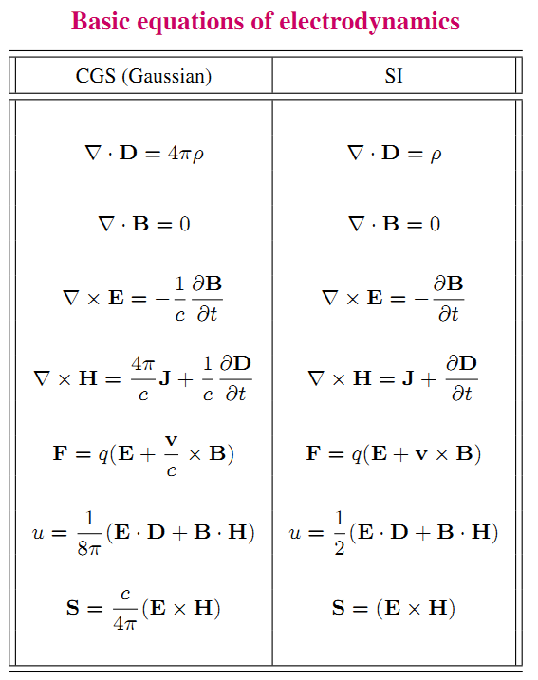
Notes:
More tables of comparison of the two unit schemes.

Slide 5
More relationships
Notes:
More relationships.

Slide 6
Notions of special relativity
The basic laws of physics are the same in all frames of reference (at rest or moving at constant velocity).
The speed of light in vacuum c is the same in all frames of reference.
y
y’
v
x
x’
y’
y
x’
x
Notes:
Now – jumping into the story of special relativity. The black frame corresponds to a (stationary) frame. The purple coordinate system is moving relative to it along the x axis at a speed of v. The red dot is measured differently in the two frames of reference.

Slide 7
Lorentz transformations
y
y’
v
x
x’
y’
y
x’
x
Notes:
The notation with beta and gamma is defined. The question is how the four parameters, ct, x,y,z measured in the stationary reference frame are related to the corresponding four variables ct’,x’y’,z’ measured in the moving frame and vice versa? The consensus is that the Lorentz transformation is the correct correspondence.

Slide 8
Lorentz transformations -- continued
Notes:
The Lorentz transformation expressed in matrix form. Also note that the four variables have an invariant.

Slide 9
Examples of other 4-vectors
applicable to the Lorentz transformation:
Notes:
Other 4 vectors that obey the Lorentz transformation --

Slide 10
The Doppler Effect
Notes:
Some details about the frequency/wavevector 4-vector and the Doppler effect for electromagnetic waves.

Slide 11
The Doppler Effect -- continued
y’
y
k’
v
k
x’
x
Notes:
Doppler effect continued.

Slide 12
Electromagnetic Doppler Effect (θ=0)
(details concerning velocities in the following slides.)
Sound Doppler Effect (θ=0)
Notes:
Discussion about the Doppler effect for electromagnetic waves and sound waves.

Slide 13
Lorentz transformation of the velocity
For an infinitesimal increment:
Notes:
Now consider the measurement of velocity in the two different reference frames.

Slide 14
Lorentz transformation of the velocity -- continued
Notes:
Evaluating the infinitesimals to determine the velocity relationships.

Slide 15
Summary of velocity relationships

Slide 16
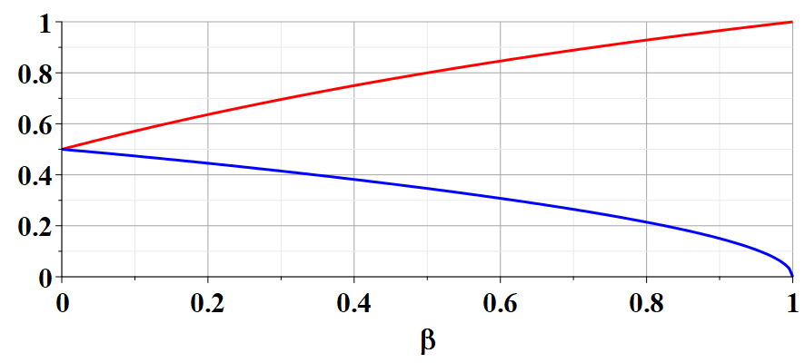
Example of velocity variation with β:
(u’_{x}/c= u’_{y}/c=0.5)
u_{x}/c
u_{y}/c
Notes:
Numerical evaluation of the velocity relationship.

Slide 17
Notes:
It is possible to take the derivatives of the velocities to get the accelerations. The proof of these results are left for you to fill in.

Slide 18
Comment –
The acceleration equations are obtained by taking the infinitesimal derivative of the velocity relationships and simplifying the expressions. (See Jackson Problem 11.5.)

Slide 19
Velocity transformations continued:
Velocity 4-vector:
Notes:
It is apparent that the velocity 4 vector itself does not obey the Lorentz transformation. These identities show that we can construct a related 4 vector that does obey the Lorentz transformation.

Slide 20
Some details:
Notes:
Some identities that can be proven…

Slide 21
Significance of 4-velocity vector:
Introduce the factor mc where m is the “rest” mass of the particle characterized by velocity u:
Properties of energy-moment 4-vector:
Notes:
When the dust clears, the related physical parameters are the energy-momentum 4 vector.

Slide 22
Properties of Energy-momentum 4-vector -- continued
Notes:
In order to relate the equations to the non-relativistic treatments, we must use the same zero of energy for both. The kinetic energy of a relativistic free particle is related to the energy E-mc².

Slide 23
Summary of relativistic energy relationships
Notes:
This slide gives some numerical relationships for a highly accelerated electron.

Slide 24
Special theory of relativity and Maxwell’s equations
Notes:
All of the previous equations represent relativistic mechanics. Now we want to relate the ideas to electromagnetic theory. We have said that Maxwell’s equations already are consistent with the theory of relativity. But we still have some work to do in order to relate the measured fields and sources in two different reference frames. The idea is to guess the correct 4 vectors.

Slide 25
More 4-vectors:
Notes:
Here are our guesses.

Slide 26
Lorentz transformations
Notes:
These 4 vectors obey the Lorentz transformations. Here we use the notation that repeated indices should be summed over the 4 components. In this case beta is the summed index. Next time we will see how the E and B fields are represented in terms of the Lorentz transformations.

Slide 27
Summary of results --

