Slide 1
PHY 712 Electrodynamics
11-11:50 AM MWF Olin 103
Notes for Lecture 26:
Finish Chap. 11 and begin Chap. 14
Electromagnetic field transformations & corresponding analysis of Liénard-Wiechert potentials for constant velocity sources
Radiation by moving charged particles
Notes:
In this lecture we will continue to discuss the electromagnetic fields produced by a moving charged particle using the Lienard-Wiechert potentials. First we need to make sure that we obtain consistent results with Lecture 25. Then we will start to discuss the results from more general trajectories.

Slide 2
Remember schedule change for Friday 4/8/2022 –
11:30-12 Graduate student luncheon
12-12:50 PHY 712
1-1:50 PHY 742

Slide 3
Comment: Some of you have been looking at textbooks (such as Zangwill) and sources available on the internet and finding different equations from those presented in these lecture notes and in Jackson. That is a good thing in general, however please be aware that there are different units (SI for example) and different conventions for 4-vectors (some using different ordering of space and time, some using imaginary (i) for the time-like portion). Since we are using Jackson for now, it will good to make sure that you are OK with those equations as well.

Slide 4
4 PM Olin 101

Slide 5
Solution of Maxwell’s equations in the Lorentz gauge – review
using SI units for now --
Liènard-Wiechert potentials and fields --
Determination of the scalar and vector potentials for a moving point particle (also see Landau and Lifshitz The Classical Theory of Fields, Chapter 8.)
Consider the fields produced by the following source: a point charge q moving on a trajectory R_{q}(t).
R_{q}(t)
q

Slide 6
Solution of Maxwell’s equations in the Lorentz gauge -- continued
We performing the integrations over first d³r’ and then dt’
making use of the fact that for any function of t’,
where the ``retarded time'' is defined to be

Slide 7
Solution of Maxwell’s equations in the Lorentz gauge -- continued
Resulting scalar and vector potentials:
Notation:

Slide 8
Solution of Maxwell’s equations in the Lorentz gauge -- continued
In order to find the electric and magnetic fields, we need to evaluate
The trick of evaluating these derivatives is that the retarded time t_{r} depends on position r and on itself. We can show the following results using the shorthand notation:
and

Slide 9
Solution of Maxwell’s equations in the Lorentz gauge -- continued

Slide 10
Convert to cgs Gaussian units:
Note that this analysis is carried out in a single frame of reference. Now we resume our discussion about transforming values between two different inertial frames of reference.

Slide 11
Field strength tensor
Transformation of field strength tensor
Notes:
Lecture 25 introduced the field strength tensor.

Slide 12
Inverse transformation of field strength tensor
Notes:
Review of the Lorentz transformation for the field strength tensor --

Slide 13
Example:
y
y’
v
b
q
x
x’
z
z’
Notes:
This is the example that we have been studying from Lecture 26.

Slide 14
Example:
y
y’
v
b
q
x
x’
z
z’
Notes:
Using the fields from the moving frame, we can write the expressions for the fields in the stationary frame.

Slide 15
Example:
y
y’
v
b
q
x
x’
z
z’
Expression in terms of consistent coordinates
Notes:
Here the fields measured in the stationary frame are expressed in terms of the time t measured in the stationary frame.

Slide 16
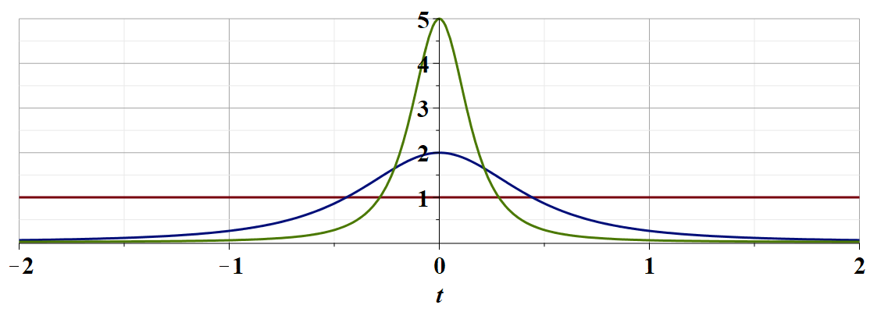
γ_{v}=5
γ_{v}=2
γ_{v}=1
c
Notes:
This is a plot shown in Lecture 25 of E_{y} as a function of time.

Slide 17
Examination of this system from the viewpoint of the
the Liénard-Wiechert potentials –(Gaussian units)
Notes:
Now we consider how we may arrive at the same result without changing reference frames by analyzing the EM fields produced by a moving charge using the Lienard-Wiechert analysis.

Slide 18
Question – Why would you want to use the Liénard-Wiechert potentials?
They are extremely complicated. It is best to avoid them at all costs?
The Lorentz transformations were bad enough?
There are some circumstances for which the Lorentz transformations do not simplify the analysis?

Slide 19
Analysis using a single reference frame --
Radiation from a moving charged particle
z
r-R_{q}(t)
q
r
R_{q}(t)
y
x
Notes:
Here we consider a charged particle (charge q) moving along the red trajectory. The vector r indicates the point at which we will evaluate the fields. The retarded time t_{r} is defined here.

Slide 20
Examination of this system from the viewpoint of the
the Liénard-Wiechert potentials –(Gaussian units)
Note that for our example there are no acceleration terms.
Notes:
In our case, the trajectory of the moving particle is described as constant velocity along the x-axis while the fields are measured at the fixed point b along the y axis.

Slide 21
Why take this example?
Complete waste of time since we already know the answer.
If we get the same answer as we did using the Lorentz transformation, we will feel more confident in applying this approach to study electromagnetic fields resulting from more complicated trajectories.
Note that it might be advisable to derive the details of the analysis for yourselves.

Slide 22
Some details

Slide 23
Some details continued:
Notes:
When the dust clears, we do verify the E and B fields obtained using the Lorentz transformation. Hurray!

Slide 24
EM fields from a moving charged particle
z
r-R_{q}(t)
q
r
R_{q}(t)
y
x
Notes:
With this success, we are motivated to apply this approach to more general particle trajectories.

Slide 25
Liénard-Wiechert fields (cgs Gaussian units):
Notation:
Notes:
Here we review the equations from the Lienard-Wiechert analysis. We particularly notice that for the fields very far from the particle positions, the dominant terms are those which involve the acceleration of the particle.

Slide 26
Electric field far from source:
Notes:
These acceleration terms are given here. These are the terms that we will focus on. Here we define a unit vector Rhat. Jackson calls this vector n. In principle, this unit vector varies in time, but at large enough distances from the source, it is an approximately constant unit vector.

Slide 27
Poynting vector:
Notes:
In addition to calculating the fields themselves, we will be interested in calculating the Poynting vector due to the fields in the radiation zone.

Slide 28
Power radiated
Notes:
After some algebra, we arrive at the expression for the power radiated per unit solid angle. We will examine this result more in detail next time, but for now, we will consider the result in the non-relativistic limit when beta is nearly 0.

Slide 29
Radiation from a moving charged particle
z
.
v
r-R_{q}(t_{r})=R
q
Θ
r
R_{q}(t)
y
x
Notes:
This slide attempts to show the geometry of the trajectory and fields.

Slide 30
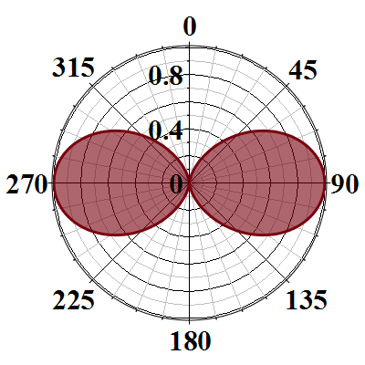
Radiation power in non-relativistic case -- continued
Blue arrow indicates the particle acceleration direction
Notes:
Here we illustrate the non-relativistic power distribution, showing that the radiation intensity is concentrated in the directions perpendicular to the particle acceleration. Next time we will see how relativistic effects change this radiation pattern.

Slide 31
What do you think will happen when the particle velocities become larger with respect to the speed of light in vacuum?
The radiation pattern will be essentially the same.
The radiation pattern will be quite different.

