Slide 1
PHY 712 Electrodynamics
11-11:50 AM MWF Olin 103
Notes for Lecture 29:
Continue reading Chap. 14 –
Radiation by moving charges
Recap of results for synchrotron radiation from land based sources
Synchrotron radiation from astronomical sources
Compton scattering – for next time
Notes:
In this lecture, we will continue discussing the material presented in Chap. 14 of Jackson’s textbook on the subject of radiation from moving charged particles.

Slide 2
Physics Colloquium this week --
Location: Olin 101
Time: Thursday, April 14, 2022 at 4 PM
Annelise Brigham — “Mechanical Properties of Electrospun PCL:Fibrinogen Fibers” — Mentor: Prof. Guthold
Rich Pope — “The Effects of LDL on the Mechanical Properties of Single Fibrin Fibers” — Mentor: Prof. Guthold
Will Caulkins — “Characterization of a Novel Diffractive Optical Element for 3-Dimensional Tracking of Fluorescent Particles” — Mentor: Prof. Bonin
Jash Desai — “Convolutional Neural Nets and Applications to 3D Imaging ” — Mentor: Prof. Bonin
Zach Scofield — “Symmetric Two-Point Function for a Massive, Minimally Coupled Scalar Field in Two-Dimensional Schwarzschild de-Sitter Spacetime” — Mentor: Prof. Anderson

Slide 3
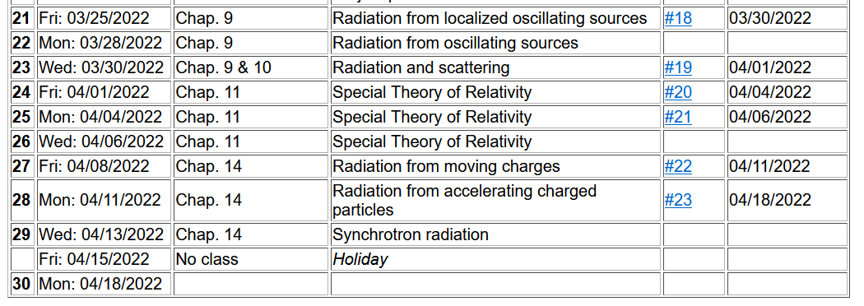

Slide 4
Comment about units
e measured in Statcoulombs
Length measured in cm
Energy measured in ergs
e measured in Coulombs
Length measured in m
Energy measured in joules
Main results from synchrotron radiation spectra from man made sources --

Slide 5
z
r
.
θ
β
y
β
Top view:
x
ρ
y
x
Notes:
Setup of the coordinate system to analyze the particle trajectory. Here rho denotes the circular radius and v denotes the particle speed (assumed to be constant).

Slide 6
z
r
.
θ
β
y
β
x
Notes:
For this analysis we will assume that the radiation is detected in the x-z plane. The angle theta is defined with respect to the x axis. Two polarization vectors denoted with epsilonparallel and epsilonperpendicular (both perpendicular to r) are defined.

Slide 7
z
r
.
θ
β
y
β
x
Notes:
Here the two amplitudes C for parallel and perpendicular polarizations are defined in terms of the trajectory parameters.

Slide 8
Notes:
Following Jackson’s derivations, we arrive at the expression given on the slide that is equivalent to Jackson’s Eq. 14.79. The two terms represent the two different polarization contributions. Both terms are expressed in terms of Bessel function of the third kind of order 1/3 or 2/3.

Slide 9
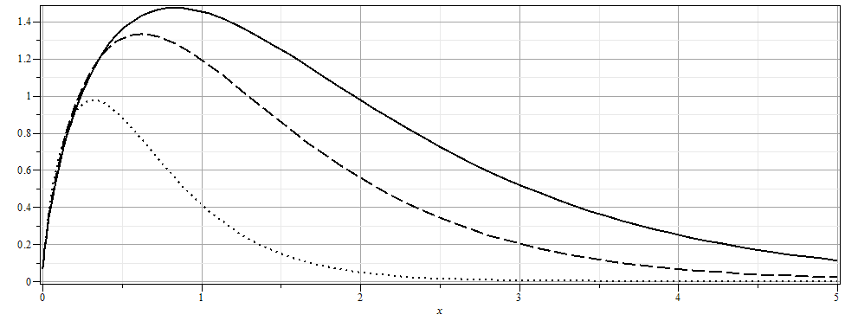
Notes:
From the expression, we can plot the intensity as a function of the scaled frequency scaled by the critical frequency defined on the previous slide for various angles theta.

Slide 10
More details
Notes:
More plots. The fact that the frequency scales with the critical frequency means that by designing facilities with different radii and gamma factors, the spectral range can be controlled.

Slide 11
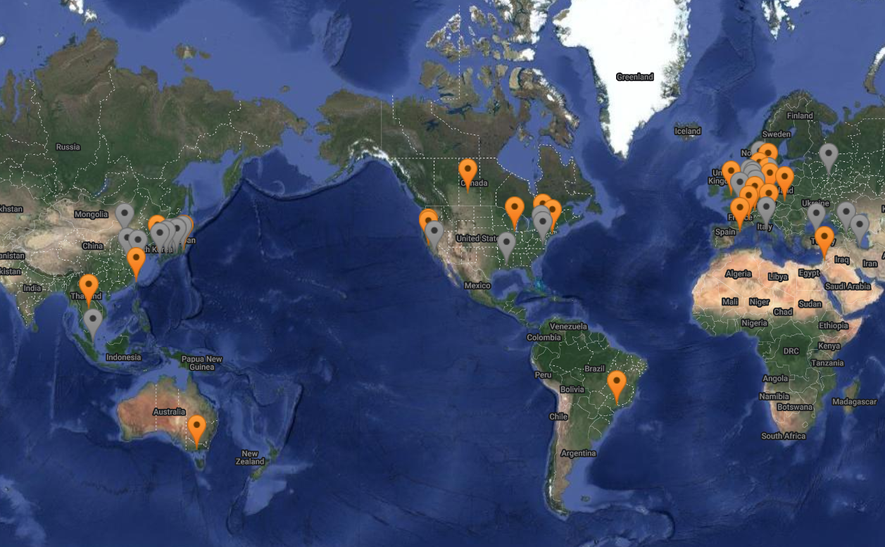
https://lightsources.org/lightsources-of-the-world/

Slide 12
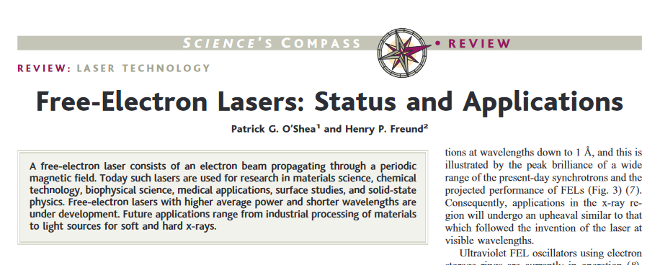
Comment on light source facilities and the newer free electron laser technology
DOI: 10.1126/science.1055718

Slide 13
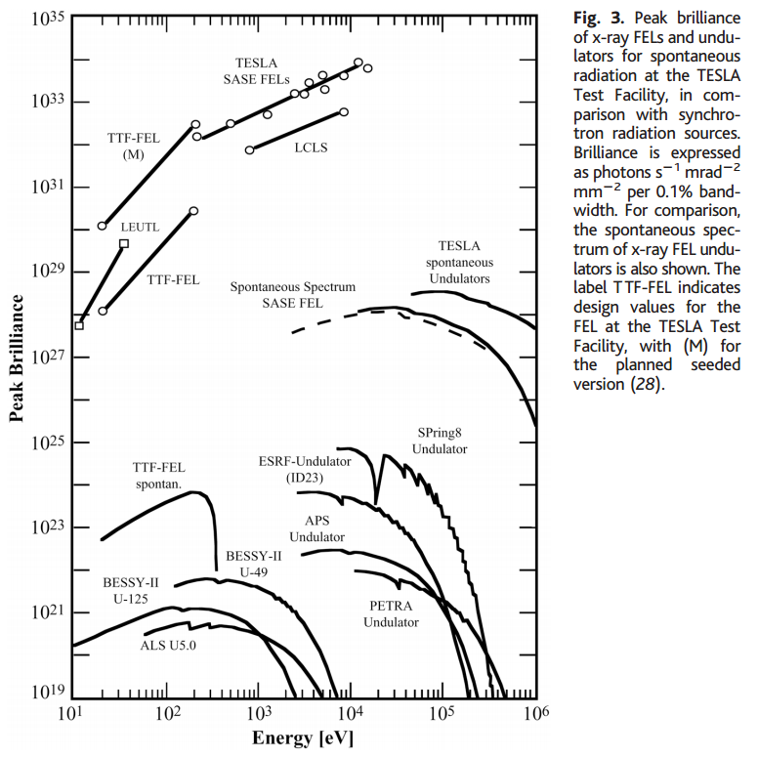
Notes:
Data from a review article on Free Electron Lasers

Slide 14
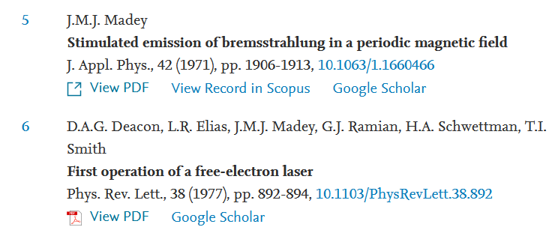
Additional references on Free Electron Lasers
https://doi.org/10.1016/j.xinn.2021.100097

Slide 15
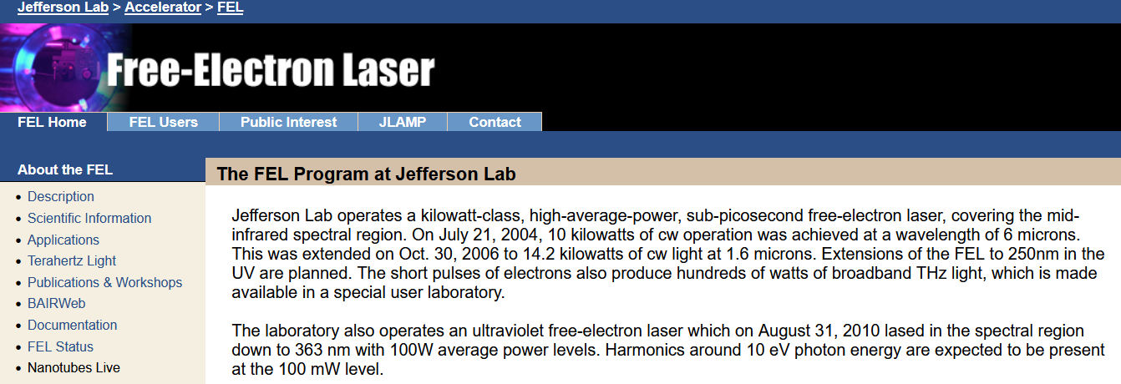
Components of the FEL
Electrons moving in circular paths
Self-amplified spontaneous emission (SASE)
+++
Often designed for the X-ray range
Jefferson Free Electron Laser Lab in VA is designed in the microwave←→infrared range

Slide 16
The above analysis applies to a class of man-made facilities dedicated to producing intense radiation in the continuous spectrum. For more specific information on man-made synchrotron sources, the following web page is useful: http://www.als.lbl.gov/als/synchrotron_sources.html.
Synchrotron radiation is also produced by astronomical sources as analyzed by Julian Schwinger –

Slide 17
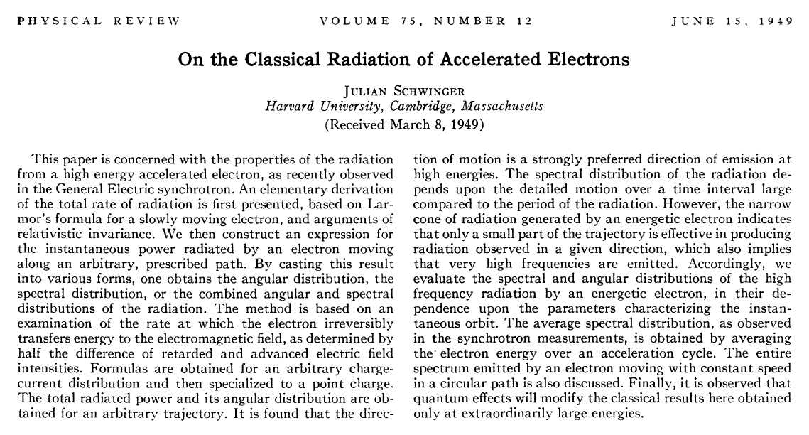
DOI:https://doi.org/10.1103/PhysRev.75.1912

Slide 18
z
Recalling general results of analysis --
r
.
θ
β
y
β
x
Notes:
Here the two amplitudes C for parallel and perpendicular polarizations are defined in terms of the trajectory parameters.

Slide 19
Useful identity involving Bessel functions
Notes:
Some of the identities repeated from last time.

Slide 20
Some details for last step --
Notes:
Some of the identities repeated from last time.

Slide 21
Astronomical synchrotron radiation -- continued:
Notes:
More details.

Slide 22
Astronomical synchrotron radiation -- continued:
In both of the expressions, the sum over m includes both negative and positive values. However, only the positive values of ω and therefore positive values of m are of interest. Using the identity: the
result becomes:
These results were derived by Julian Schwinger (Phys. Rev. 75, 1912-1925 (1949)). The discrete case is similar to the result quoted in Problem 14.15 in Jackson's text.
Notes:
Comment on the relevance of the results.

Slide 23
Back to fundamental processes – Thompson and Compton scattering (see section 14.8 in Jackson)
Some details of scattering of electromagnetic waves incident on a particle of charge q and mass m_{q}
r
k₀
θ
ε₂
ε₀
φ
ε₁
Notes:
For next time.

