Slide 1
PHY 712 Electrodynamics
11-11:50 AM MWF Olin 103
Discussion for Lecture 31:
Start reading Chap. 15 –
Radiation from collisions of charged particles
Overview
X-ray tube
Radiation from Rutherford scattering
Other collision models
Notes:
In this lecture we will discuss some examples of radiation due to charged particles colliding. It is a complicated topic which quite a few famous physicists have worked on.

Slide 2
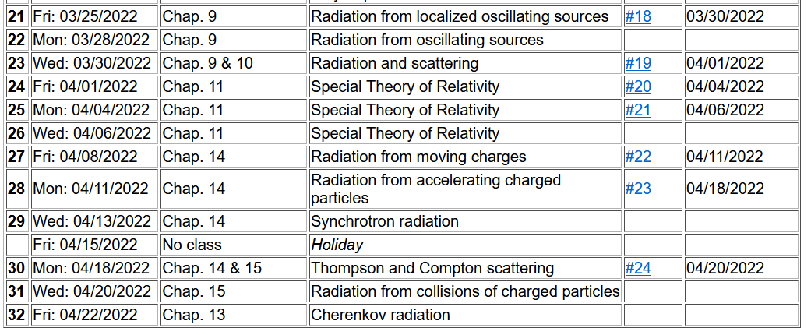
Notes:
This is the revised schedule, subject to your input.

Slide 3
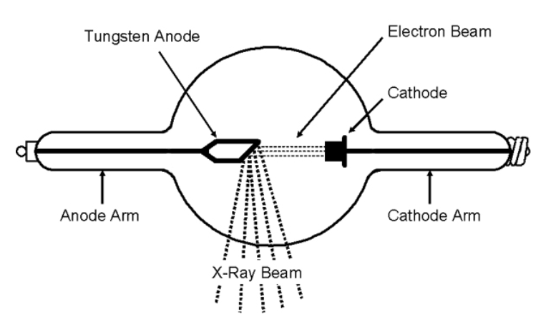
Generation of X-rays in a Coolidge tube
https://www.orau.org/ptp/collection/xraytubescoolidge/coolidgeinformation.htm
Invented in 1913. Associated with the German word “bremsstrahlung” – meaning breaking radiation.

Slide 4
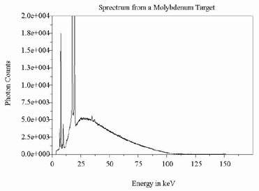
http://www.ndt-ed.org/EducationResources/CommunityCollege/Radiography/Physics/xrays.htm
Quantum effects – due to the release of core electrons

Slide 5
Radiation during collisions of charged particles
β
−β(t)
Δβ
r
θ
β(t)
β(t+Δt)
φ
Δβ
Notes:
Starting from the intensity analysis for radiation due to a charged particle moving in a trajectory with beta representing its velocity/c. We will consider the velocity changing due to a collision process and analyze the radiation at small frequencies.

Slide 6
Results from previous analyses:
Note that in the following slides we are taking the limit ω→0
but keeping the notation of the differential intensity….
Note that ε is perpendicular to r.

Slide 7
Radiation during collisions -- continued
In the limit β→0, this is the same as the non-relativistic case.
Notes:
For beta<<1, we can neglect the denominator of the expression and obtain the non-relativistic expression. It is also convenient to analyze the relativistic case when the change in velocity is small.

Slide 8
Radiation during collisions -- continued
β
r
θ
φ
Δβ
polarization in r and β plane
polarization perpendicular to r and β plane
Notes:
It is convenient to consider two different polarizations of the radiation – parallel (meaning in the plane of the observation point r and the initial velocity of the particle) and perpendicular (meaning perpendicular to that plane).

Slide 9
Some details:
β
(using geometry of Fig. 15.2 in Jackson)
r
θ
φ
Δβ
Note: This is a wild assumption!
Notes:
Showing the detailed geometry of the scattering process.

Slide 10
Consistent with
radiation from charged particles.
Convenient geometry
Wild guess
Notes:
Evaluating the vectors.

Slide 11
z
Radiation during collisions -- continued
β
r
θ
y
φ
Δβ
x
Notes:
It is possible to analytically integrate over all solid angles.

Slide 12
Notes:
Some details of the analysis. With all of these considerations, we still need to estimate delta beta.

Slide 13
Need to consider the mechanics of collision; it is convenient to parameterize in terms of momentum --
Estimation of Δβ
q
Δβ
q
β(t)
β(t+Δt)
mass of particle having charge q
What are the conditions for the validity of this result?

Slide 14
What are possible sources for the momentum transfer Q?

Slide 15
Estimation of Δβ or Q -- for the case of Rutherford scattering
q
Δβ
q
β(t)
β(t+Δt)
Ze
p’
θ’
Q
p
Notes:
Delta beta will depend on the particular system. As an example, consider the case of Rutherford scattering.. Here are some of the equations we used in classical mechanics class.

Slide 16
Case of Rutherford scattering -- continued
q
p(t+Δt)
θ’
Q
Ze
p(t)
Does the algebra work out?
Notes:
It is convenient to express the results in terms of the momentum transfer Q.

Slide 17
Case of Rutherford scattering -- continued
q
p(t+Δt)
θ’
Q
Ze
p(t)
Notes:
It is of interest to estimate the probability of the radiation occurring which depends on the product of the radiation intensity for a given momentum transfer and the cross section as a function of momentum transfer.

Slide 18
How do the limits of Q occur?
Jackson suggests that these come from the limits of validity of the analysis.
Seems like cheating?
Perhaps fair?
Notes:
But we are not done. Thinking of the case of the charged particle moving through the target material, there will be a range of momentum transfers that should be integrated as indicated here. Note that we have assumed that the frequency of the radiation is very small. Here we consider how frequency might ener this analysis.

Slide 19
Comment on frequency dependence --
Here τ is the effective collision time.

Slide 20
How to estimate the collision time?
Jackson uses the following analysis in terms of the impact parameter b:

Slide 21
λ= “fudge factor” of order unity
Notes:
Hans Bethe considered this problem and also introduced a “correction” for quantum effects.

Slide 22
What could be the origin of the fudge factor?
What do you take away from this analysis
Disgust?
Admiration?
Motivation to avoid charged particles?

