Slide 1
PHY 712 Electrodynamics
11-11:50 AM MWF Olin 103
Notes for Lecture 34:
Review – Part I
Motivation of final exam and how to optimize the experience
Some comments on effective use of Maple or Mathematica
Some important mathematical tools

Slide 2
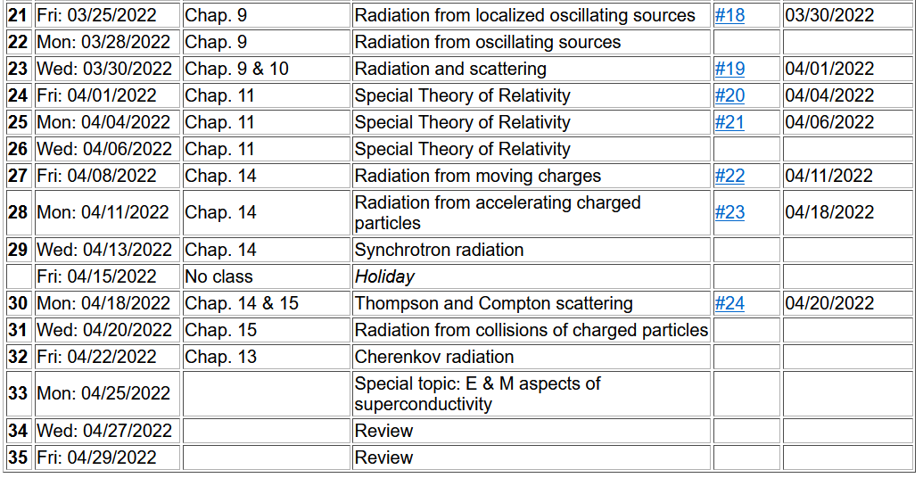
Important dates: Final exams available Apr. 29; due May 9
Outstanding work due May 9

Slide 4
Motivation for giving/taking final exam
Opportunity to review/solidify knowledge in the topic
Opportunity to practice problem solving techniques appropriate to the topic
Assessment of performance. Accordingly, the work you turn in must be your own (of course).
You are encouraged to consult with your instructor (but no one else!) if any questions arise about the exam questions
Extra credit awarded if you find errors/inconsistencies/ambiguities in the exam questions

Slide 5
Instructions on exam:
Note: This is a ``take-home'' exam which can be turned in any time before 5 PM Monday, May 9, 2022. In addition to each worked problem, please attach ALL Maple (or Mathematica, Matlab, Wolfram, etc.), work sheets as well as a full list of resources used to complete these problems. It is assumed that all work on the exam is performed under the guidelines of the honor code. In particular, if you have any questions about the material, you may consult with the instructor but no one else. For grading purposes, each question in multi-part problems are worth equal weight. Credit will be assigned on the basis of both the logical steps of the solution and on the correct answer.

Slide 6
More advice about exam –
It is important that the instructor is able to read your work and understand your reasoning.
Since you will be using Maple or Mathematica or ?? to evaluate some of your results, consider integrating them into your exam paper or perhaps paste snips into your favorite word processor.
Your exam paper does not need to be a work of art, but it does need to be readable. If you prefer to submit your exam paper electronically, that will be fine. (I may print it myself.)

Slide 7
Example solution using Maple --
Text mode
Math mode

Slide 9
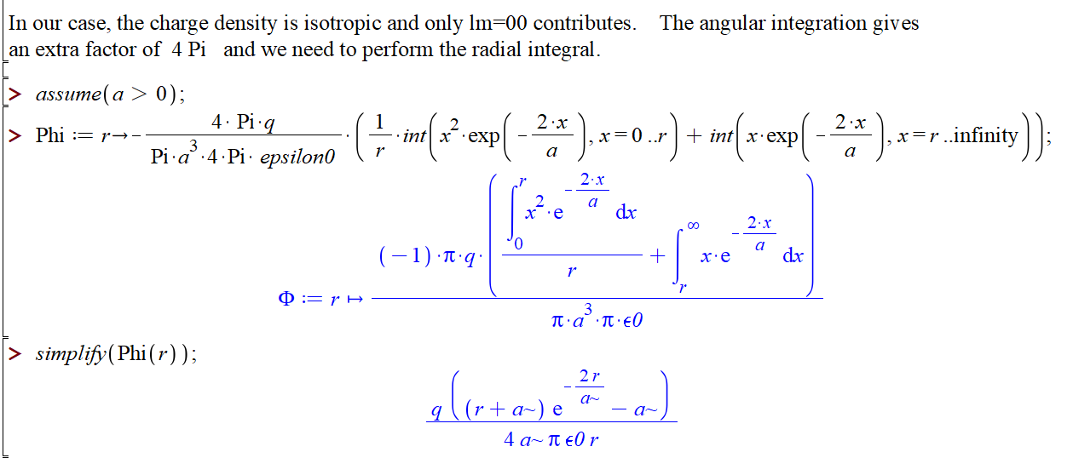
HW #9 continued --

Slide 10
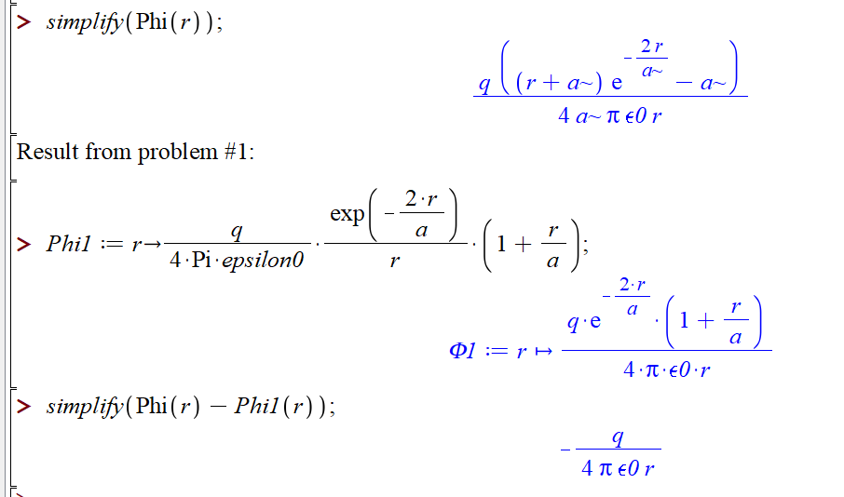
HW #9 continued --

Slide 11
More advice – accumulated trusted equations/mathematical relationships and know how to use them
Jackson
pg. 783

Slide 12
Jackson pg. 783

Slide 13
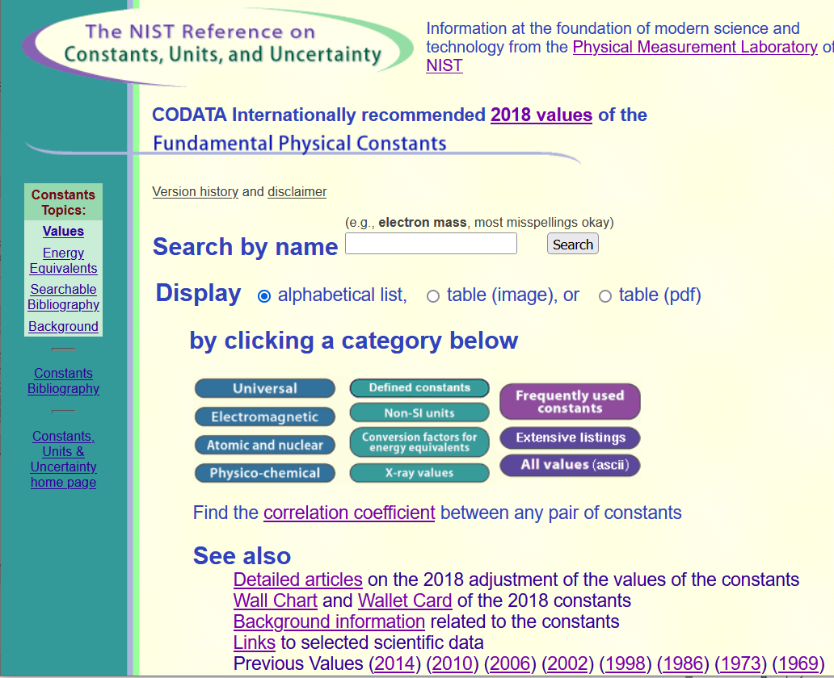
Source for standard measurements –
https://physics.nist.gov/cuu/Constants/index.html

Slide 14
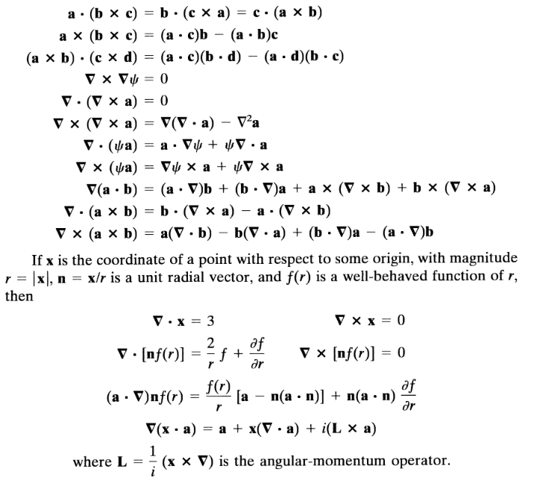
Vector relations

Slide 15
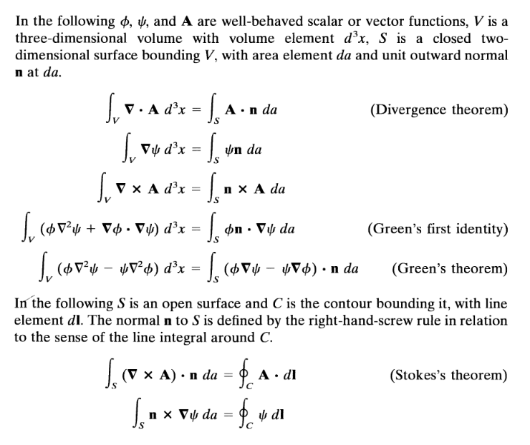

Slide 18
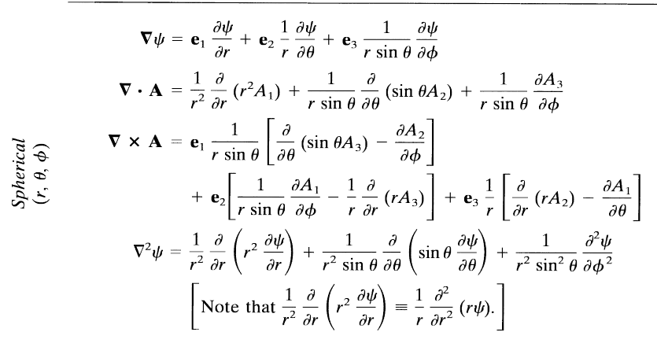

Slide 19
Comment on cartesian unit vectors versus local (cylindrical or spherical) unit vectors

Slide 20
Special functions -- many are described in Jackson
Additional source -- https://dlmf.nist.gov/

Slide 22
More relationships

Slide 23
elementary charge: e=1.6021766208 x 10⁻¹⁹ C
=4.80320467299766 x 10⁻¹⁰ statC

Slide 24
Energy and power (SI units)

Slide 28
In your “bag” of tricks:
Direct (analytic or numerical) solution of differential equations
Solution by expanding in appropriate orthogonal functions
Green’s function techniques

Slide 29
How to choose most effective solution method --
In general, Green’s functions methods work well when source is contained in a finite region of space

Slide 31
Electromagnetic waves from time harmonic sources

Slide 32
Electromagnetic waves from time harmonic sources – continued:

Slide 33
Electromagnetic waves from time harmonic sources – continued:

Slide 34
Electromagnetic waves from time harmonic sources – continued:

Slide 35
Electromagnetic waves from time harmonic sources – continued:

Slide 36
Example of dipole radiation source

Slide 37
Example of dipole radiation source -- continued
Relationship to pure dipole approximation (exact when kR➔0)

Slide 38
Electromagnetic waves from time harmonic sources – for dipole radiation --:

Slide 39
Radiation from a moving charged particle
z
.
v
r-R_{q}(t_{r})=R
q
Θ
r
R_{q}(t)
y
x

Slide 40
Liènard-Wiechert potentials –(Gaussian units)

Slide 41
Electric and magnetic fields far from source:

Slide 42
Poynting vector:

