Slide 1
PHY 712 Electrodynamics
11-11:50 AM MWF Olin 103
Notes for Lecture 35:
Review

Slide 2
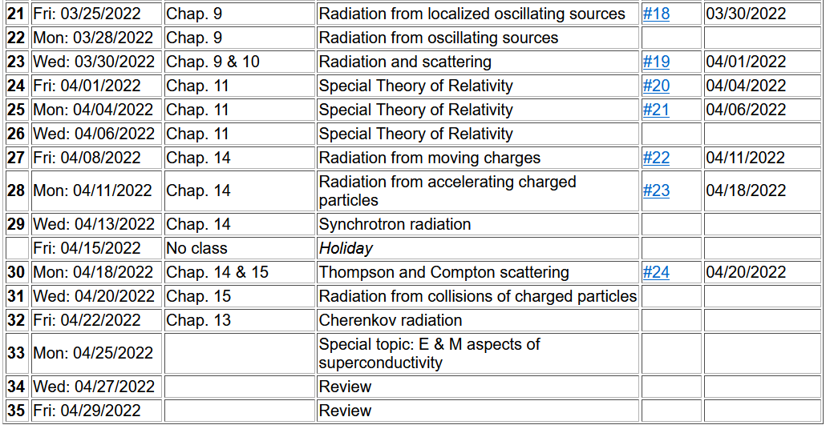
Important dates: Final exams available Apr. 29; due May 9
Outstanding work due May 9

Slide 3
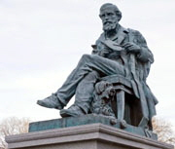
Full electrodynamics with time varying fields and sources
Maxwell’s equations
"From a long view of the history of mankind - seen from, say, ten thousand years from now - there can be little doubt that the most significant event of the 19th century will be judged as Maxwell's discovery of the laws of electrodynamics"
Richard P Feynman
Image of statue of James Clerk-Maxwell
(1831-1879) in Edinburgh
http://www.clerkmaxwellfoundation.org/

Slide 4
Maxwell’s equations

Slide 5
Reminder: Keep track of unit systems.
Formulas in Jackson are in SI units for Chapters 1-10
in cgs Gaussian for Chapters 11++

