Slide 1
PHY 712 Electrodynamics
11-11:50 AM MWF Olin 103
Class notes for Lecture 3:
    Reading: Chapter 1 (especially 1.11) in JDJ;
      Continued discussion/derivation of Ewald summation methods
      Example for CsCl

Slide 2
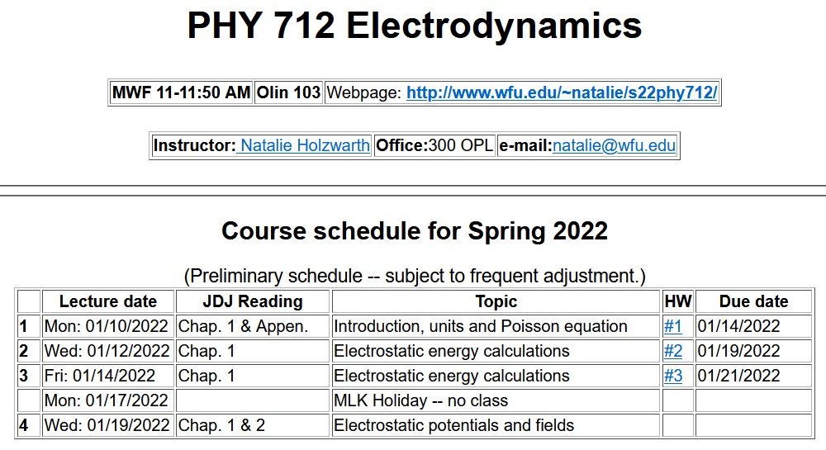
3

Slide 3
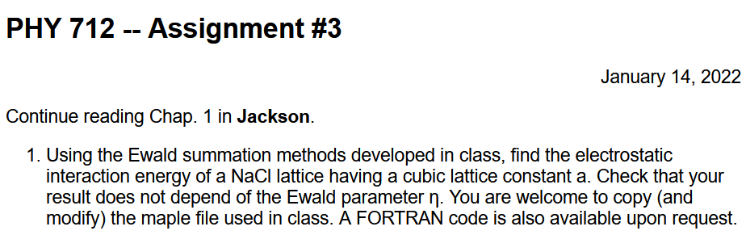

Slide 4
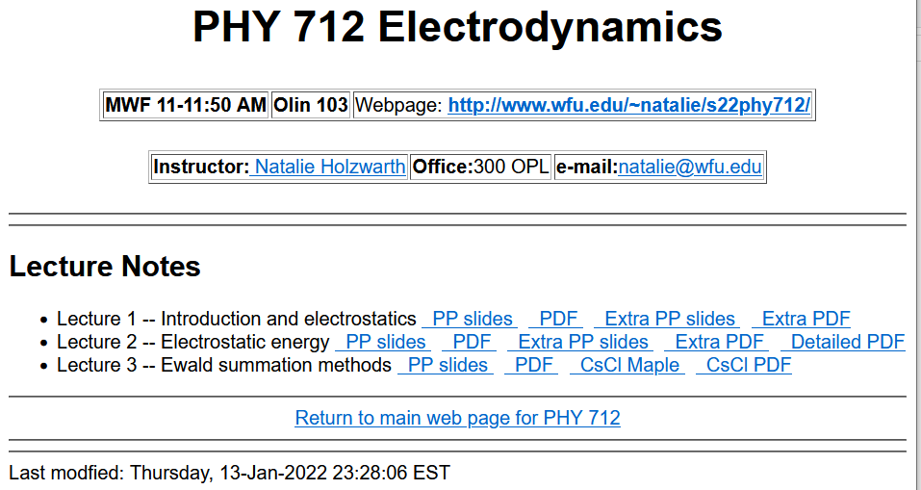
The details are presented in the pdf file – Extranotes2.pdf

Slide 5
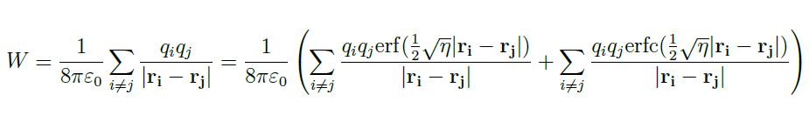
Last time, we argued that we need to carry out the following summation of all pairs of ions using Ewald’s very clever trick with the erf and erfc functions:
Must be evaluated in “reciprocal” space
Can be converged as is (in real space)
In order to make progress, we need to systematically enumerate all of the ion positions in the system

Slide 6
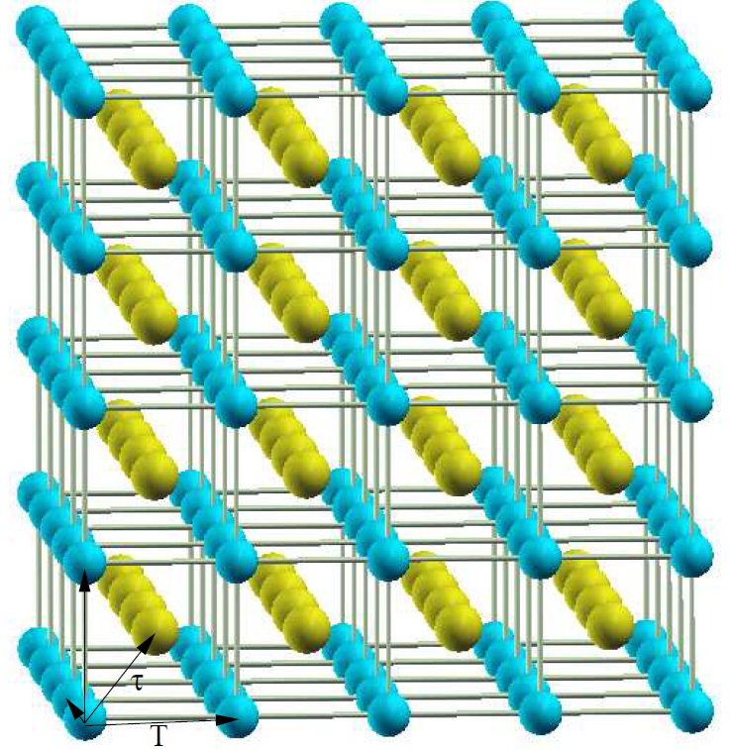
Using CsCl as our example system
Cs
Cl
Notice that a unit cell contains one Cl and one Cs

Slide 7
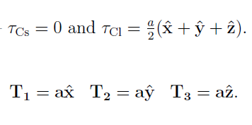

For CsCl --
a
Note that in general --

Slide 8
Note – this works for CsCl and more generally

Slide 9
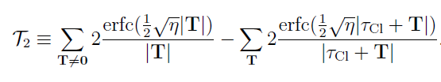
For CsCl:
q_{Cs}=e
q_{Cl}=-e

Slide 10

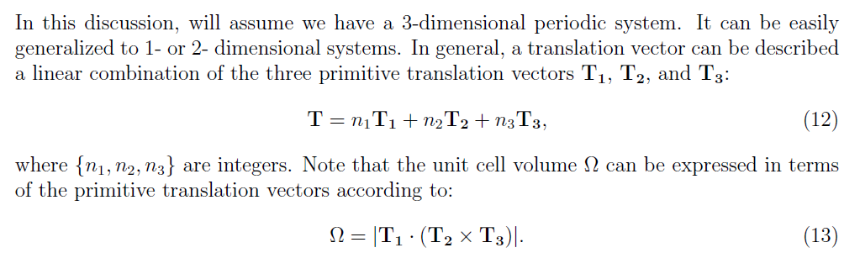
For evaluating the summation in reciprocal space, additional considerations are needed --
It can be shown that --
Volume of unit cell
in real space

Slide 11
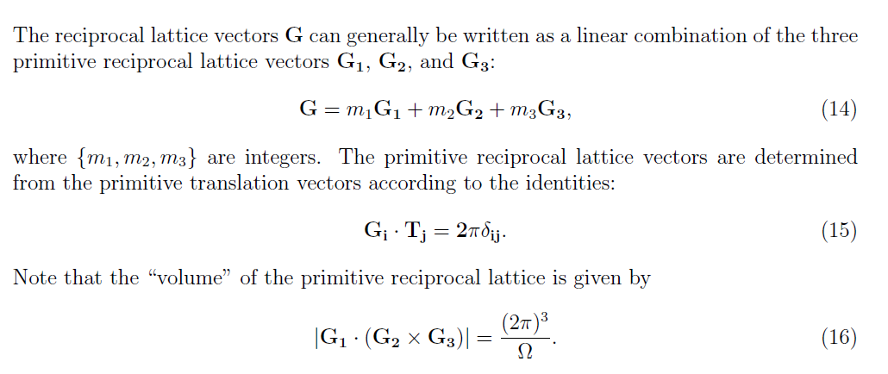
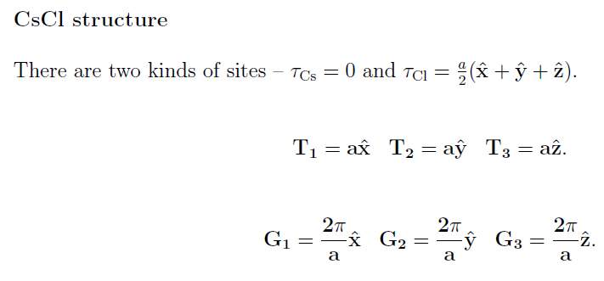
Example --

Slide 12
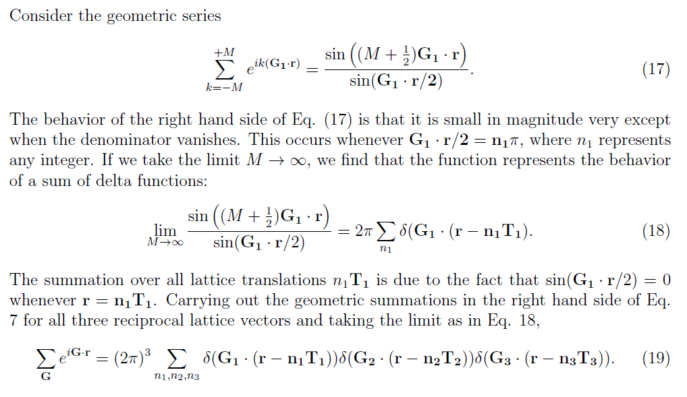
“Proof” of identity --

Slide 13
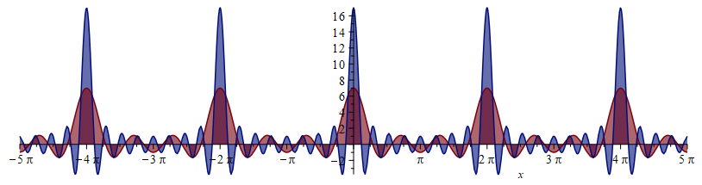
Some details --
Behavior of function for various values of M:
M=8
M=3

Slide 14
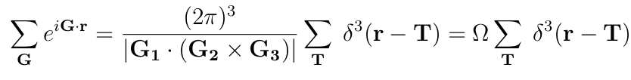
Final result --

Slide 16


divergent term
+ extreme cleverness

Slide 17
Divergent term

Slide 18
Problem – Electrostatic energy of a periodic non-neutral system is not defined!
Solution -- Add uniform compensating charge and find the electrostatic energy of periodic neutral system, carefully analyzing diverging terms to determine a convergent expression.

Slide 19
Some details --
➔divergent term cancels when combined with Ewald’s construction

Slide 20
For CsCl --
a

Slide 21
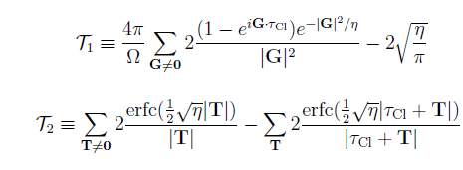
➔Can be evaluated using Maple or Mathematica or other programming language

