Slide 1
PHY 712 Electrodynamics
11-11:50 AM MWF in Olin 103
Class notes for Lecture 5:
Reading: Chapter 1 - 3 in JDJ
    Electrostatic potentials
    One, two, and three dimensions (Cartesian coordinates)
    Mean value theorem for the electrostatic potential
Notes:
In this lecture, we will continue to develop solution methods for solving electrostatic problems.

Slide 2
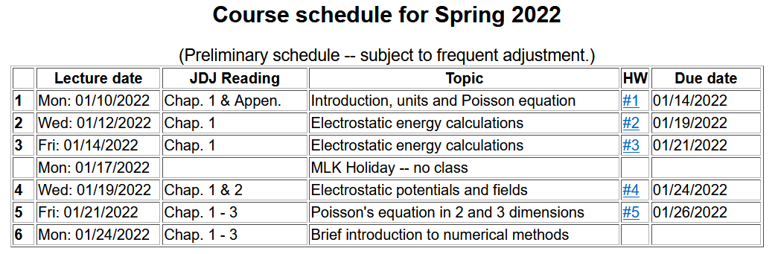
Notes:
Updated schedule

Slide 3
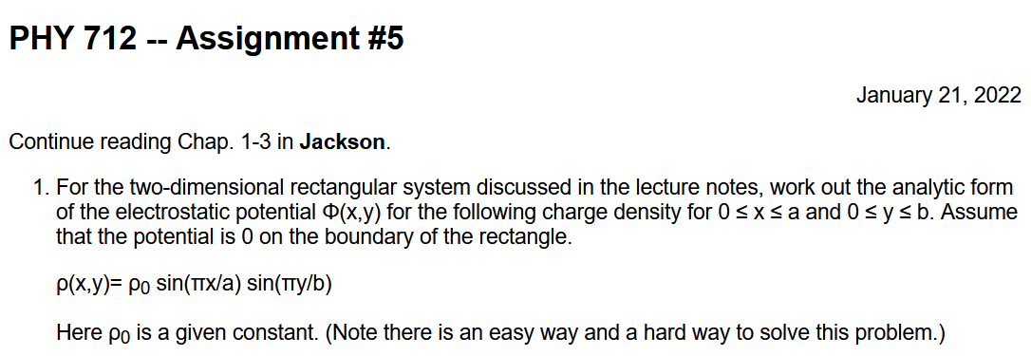

Slide 4
Poisson Equation
Notes:
Review of the general methods for solving the Poisson equation in various dimensions and geometries.

Slide 5
Poisson equation for one-dimensional system
Notes:
For one Cartesian dimension – reviewing previously discussed results.

Slide 7
Question
Why these extra terms?

Slide 8
General procedure for constructing Green’s function for one-dimensional system using 2 independent solutions of the homogeneous equations
Beautiful method; but only works in one dimension.
Notes:
Some details

Slide 9
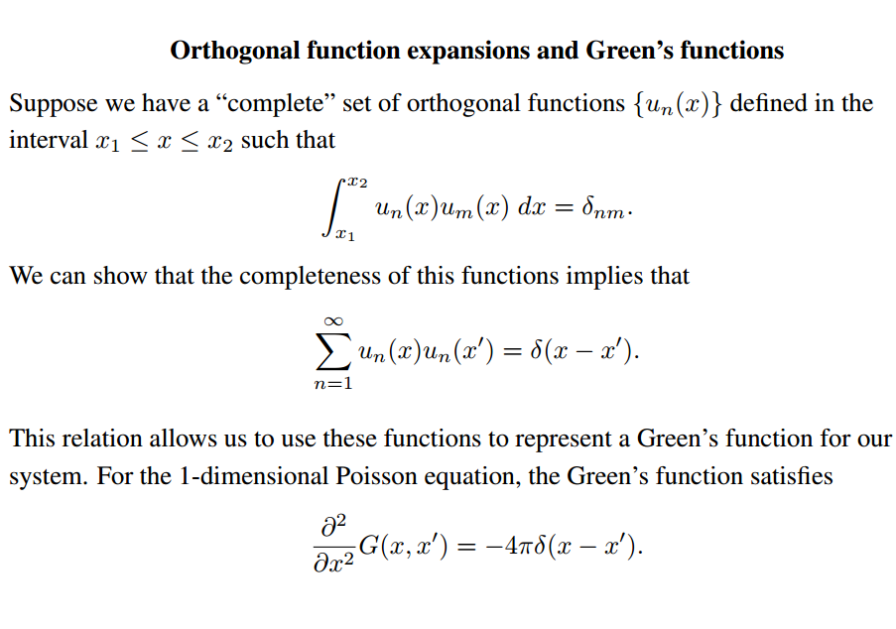
Notes:
Review of orthogonal function expansions.

Slide 10
Orthogonal function expansion -- continued
Notes:
Construction of Green’s function for one dimensional case.

Slide 11
Example
Note that this is a convenient choice, but not necessarily compatible with boundary values.
Notes:
Reviewing our “favorite” example.

Slide 12
Example -- continued
Notes:
Some details.

Slide 13
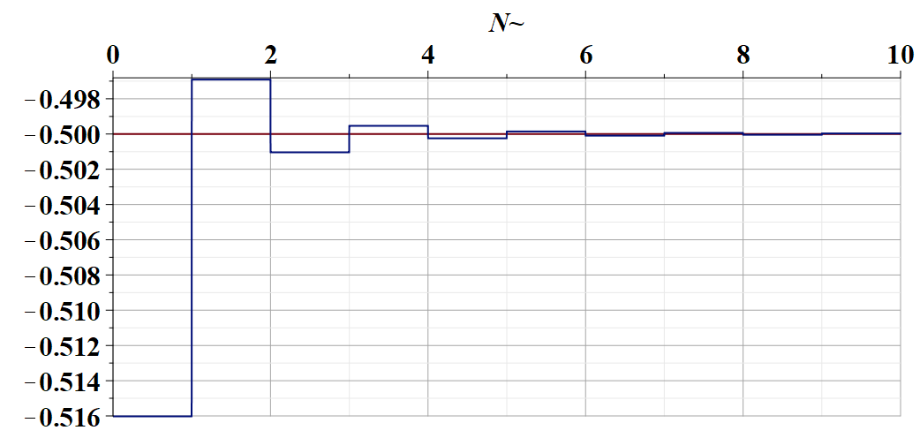
Some details --

Slide 14
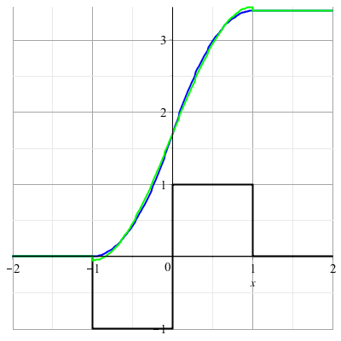
Example -- continued
Needed for boundary values.
Notes:
Summary.

Slide 15
Orthogonal function expansions in 2 and 3 dimensions – for cartesian coordinates:
(See Eq. 3.167 in Jackson for example.)
Notes:
Extension of the ideas to multiple dimensions.

Slide 16
Details of a two-dimensional example --
Example:
b
a
Two dimensional box with sides a and b with boundary conditions: Φ(0,y)=Φ(a,y)=Φ(x,0)=Φ(x,b)=0
Notes:
Analyzing in detail the two dimensional case.

Slide 17
Two dimensional example continued --
b
a
Notes:
Two dimensional case, using orthogonal functions in both x and y dimensions.

Slide 18
Example two-dimensional system continued --
Two dimensional box with sides a and b with boundary conditions: Φ(0,y)=Φ(a,y)=Φ(x,0)=Φ(x,b)=0
b
a
Don’t know this term
Know this term=0
➔In this case it is prudent to design G(r,r’) to vanishes on boundary and the surface integral is trivial.
Notes:
Specific example.

Slide 19
Your homework problem.
Worked out in textbook.
Notes:
Two examples.

Slide 20
Combined orthogonal function expansion and homogeneous solution construction of Green’s function
in 2 and 3 dimensions.
For the two and three dimensional cases, we can use this technique in one of the dimensions in order to reduce the number of summation terms. These ideas are discussed in Section 3.11 of Jackson.
Notes:
Now consider using orthogonal function expansion in the x dimension and the homogeneous solution construction in the y dimension.

Slide 21
Green’s function construction -- continued
Notes:
Some details.

Slide 22
Notes:
More details.

Slide 23
Example:
b
a
Two dimensional box with sides a and b with boundary conditions: Φ(0,y)=Φ(a,y)=Φ(x,0)=Φ(x,b)=0
Don’t know this term
Know this term
Notes:
More details.

Slide 24
Example:
b
a
Two dimensional box with sides a and b with boundary conditions: Φ(0,y)=Φ(a,y)=Φ(x,0)=Φ(x,b)=0
Notes:
Checking boundary values.

Slide 25

$$,$$
Notes:
More details.

Slide 26
Green’s function construction -- continued
b
a
Notes:
Resultant effective Green’s function for this case.

Slide 27
b
a
=0
Notes:
Checking boundary values.

Slide 28
(somewhat painful solution to homework problem)
Notes:
Application to previously discussed examples (also your homework examples).

Slide 29
Notes:
Application to previously discussed examples (also your homework examples).

Slide 30
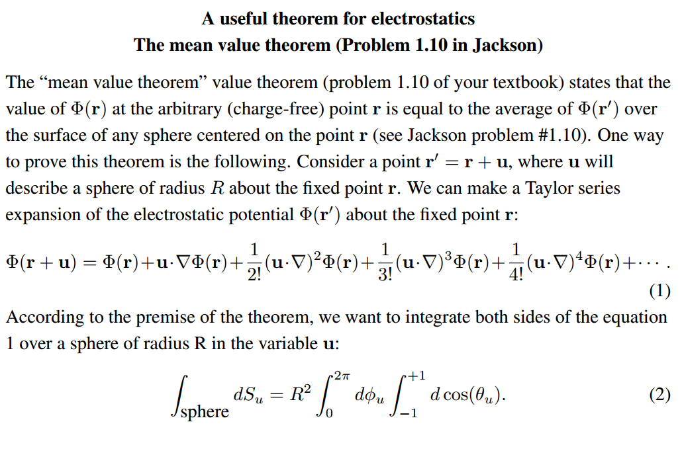
Notes:
Changing gears slightly -- discussion of the mean value theorem for electrostatics.

Slide 31
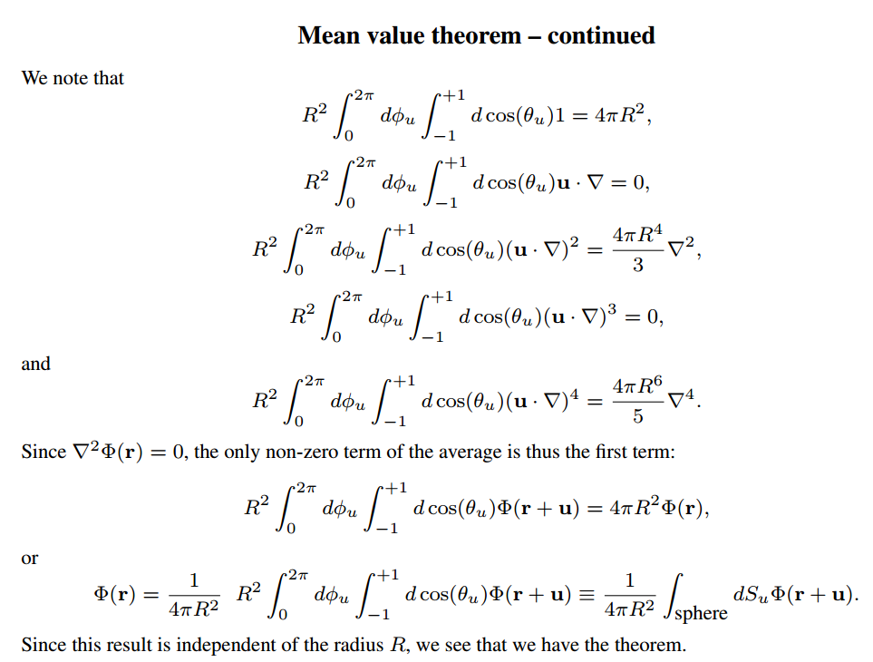
Notes:
Some details

Slide 32
Summary: Mean value theorem
Notes:
Summary of results.

