Slide 1
PHY 712 Electrodynamics
11-11:50 AM MWF in Olin 103
Class notes for Lecture 8:
Finish reading Chap. 2 and start Chap. 3
Solution of Poisson/Laplace equation for special geometries –
Cylindrical
Spherical

Slide 2
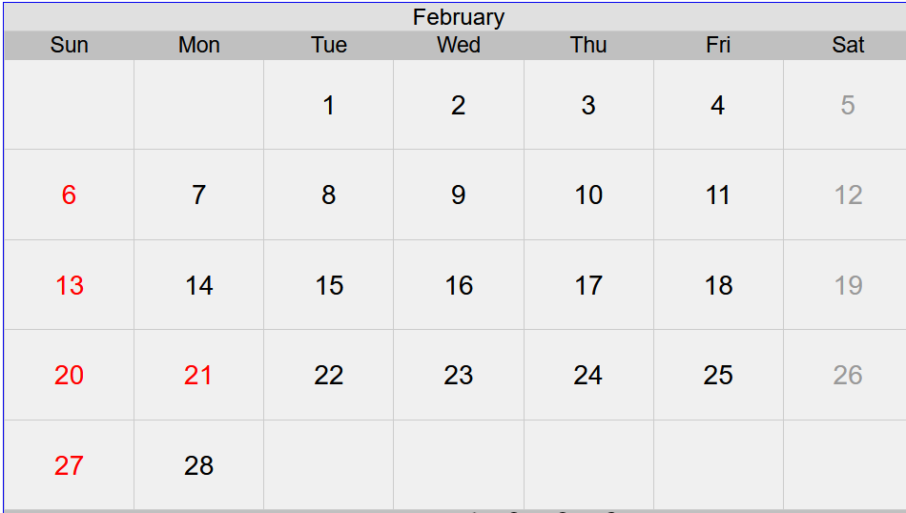
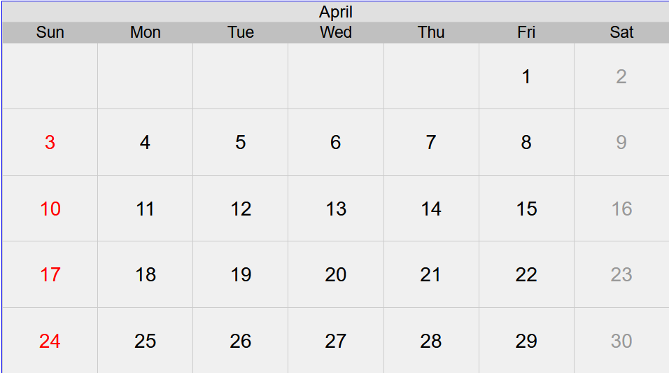
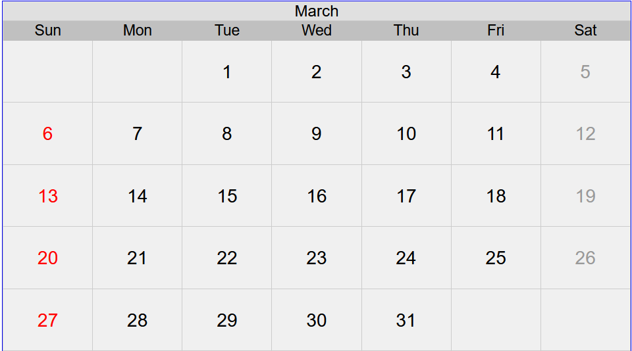
Scheduling ahead -- When to schedule mid-term?
⬅ Last class
⬅ Spring break – no class
⬅ APS meeting – no class

Slide 3
Possible scheduling options for PHY 712 and 742
Base mid-term grade entirely on HW and schedule both mid-term exams for the week of March 14
Stagger mid-term exams; one for the week of March 14 an the other for the week of Feb 28
Make HW grade count more and only have final exam
Other?

Slide 4
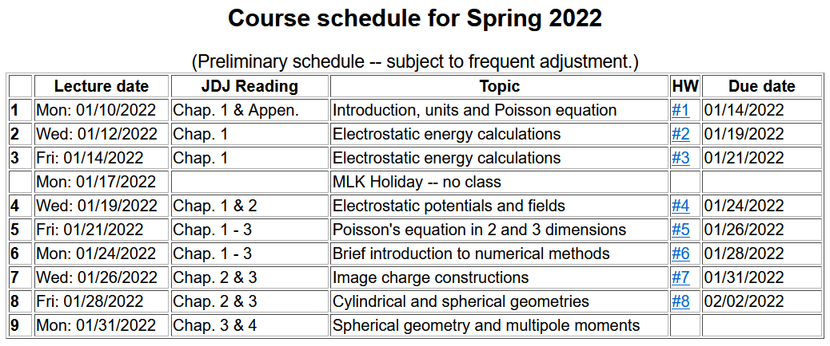

Slide 6
Solution of the Poisson/Laplace equation in various geometries ➔cylindrical geometry with no z-dependence (infinitely long wire, for example):
φ
ρ

Slide 7
Solution of the Poisson/Laplace equation in various geometries ➔cylindrical geometry with no z-dependence (infinitely long wire, for example):
φ
ρ

Slide 8
Solution of the Poisson/Laplace equation in various geometries -- cylindrical geometry with no z-dependence (infinitely long wire, for example):
φ
ρ
➔m=integer

Slide 9
Solution of the Poisson/Laplace equation in various geometries -- cylindrical geometry with no z-dependence (infinitely long wire, for example):
φ
ρ

Slide 10
Note that the previous example is similar to the construction for the 2-d cartesian case --

Slide 13
Comments and details
φ
r
Note that in this case, we have assumed that the surface integral contributions are trivial.

Slide 14
Example – uniform cylindrical shell:
z
Top view:
a
b
y
r
x

Slide 15
Question – Why only m=0 for this case?

Slide 16
Some details

Slide 17
Example continued -- m=0 only --
Top view:
a
b

Slide 18
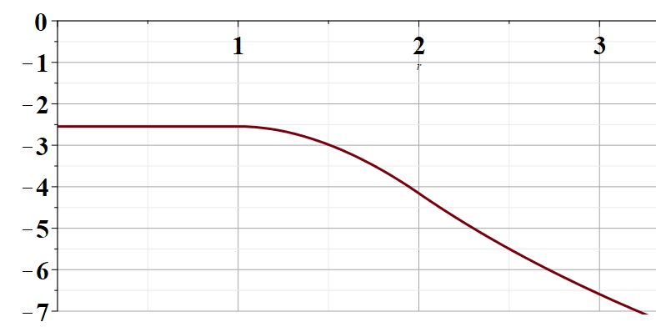
Example continued -- m=0 only --
a
b
r

Slide 19
Solution of the Poisson/Laplace equation in various geometries -- cylindrical geometry with z-dependence
φ
ρ
z

Slide 20
Cylindrical geometry continued:
φ
ρ
z

Slide 21
Cylindrical geometry continued:
φ
ρ
z

Slide 22
Solutions of Laplace equation inside cylindrical shape
Example with non-trivial boundary value at z=L
m=0
m=1
m=2
kρ

Slide 23
Solutions of Laplace equation inside cylindrical shape
Example with non-trivial boundary value at z=L

Slide 24
Solutions of Laplace equation inside cylindrical shape
Example with non-trivial boundary value at ρ=a
m=0
m=1
m=2
kρ

Slide 25
Solutions of Laplace equation inside cylindrical shape
Example with non-trivial boundary value at ρ=a

Slide 26
Green’s function for Dirchelet boundary value inside cylindar:

Slide 27
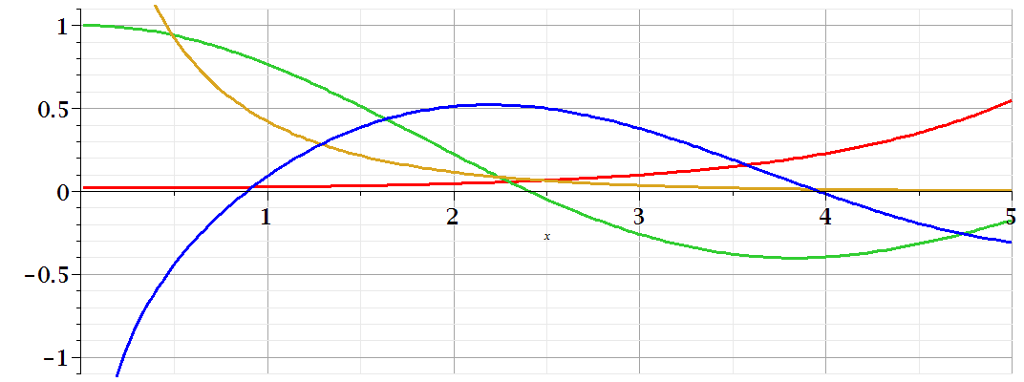
Comments on cylindrical Bessel functions
m=0
K₀
I₀/50
J₀
N₀

Slide 28
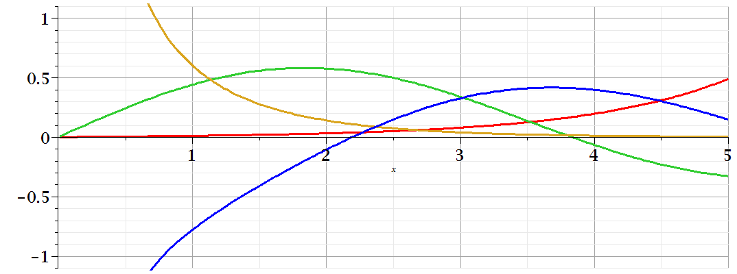
Comments on cylindrical Bessel functions
K₁
m=1
I₁/50
J₁
N₁

Slide 29
Some useful identities involving cylindrical Bessel functions

Slide 30
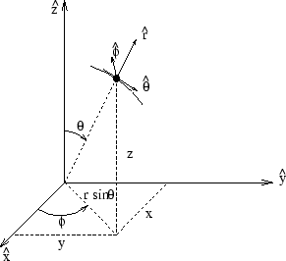
Poisson and Laplace equation in spherical polar coordinates
http://www.uic.edu/classes/eecs/eecs520/textbook/node32.html

Slide 31
Poisson and Laplace equation in spherical polar coordinates -- continued

Slide 32
Properties of spherical harmonic functions

Slide 33
Useful identity:

Slide 34
Example -- continued

Slide 35
Useful identity:

Slide 36
Useful identity:

Slide 37
Some spherical harmonic functions:

