Slide 1
PHY 742 Quantum Mechanics II
12-12:50 AM MWF Olin 107
Plan for Lecture 1
Structure of the course
Review of main concepts from Quantum Mechanics I
Preview of topics for Quantum Mechanics II
Topic for today – Approximations for stationary quantum systems
Reading: Chapter 12 in Carlson’s textbook

Slide 2
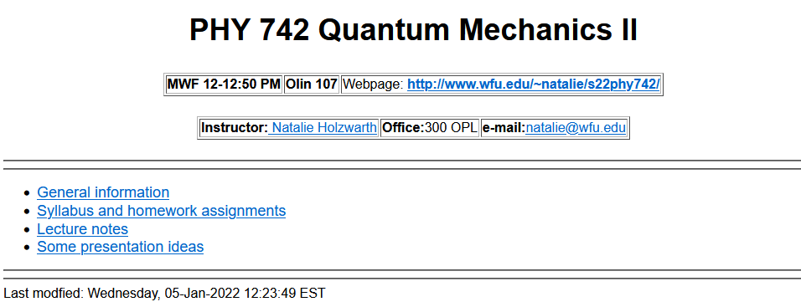
https://users.wfu.edu/natalie/s22phy742/

Slide 4
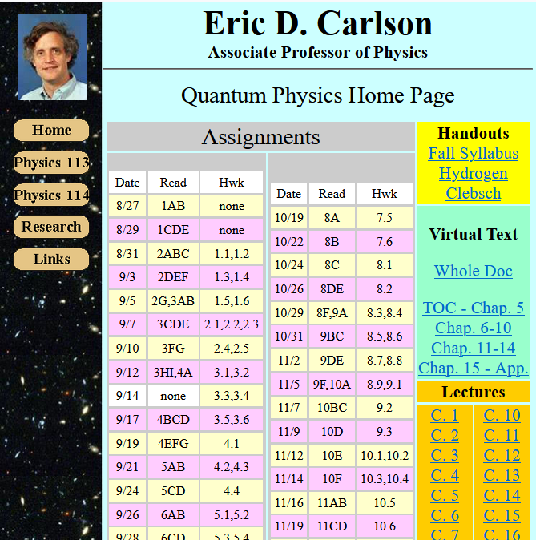
https://users.wfu.edu/ecarlson/quantum/index1.html

Slide 5
Tentative additional information –
Mon Jan 17 – MLK Holiday
Spring break March 5-13
Mid term grades due March 7
APS March meeting March 14-18 (no class)
Fri April 15 – Good Friday Holiday
Thurs Apr 21 – Student wellness day (no class)
Wed Apr 27 – Last day of class
Apr 29-May 6 – Final exams
Particular for QM II:
Where/how to share supplemental texts?
Presentations -- how to interface with PHY 712?

Slide 6
Summary of topics covered in Quantum Mechanics I
Topic | Chapters in EC Text
Fundamentals and formalism of QM | 1,3,4,11
Solution of S. E. for simple 1-dim potentials | 2
Quantum mechanics of harmonic oscillator | 5
Various symmetries | 6
Angular momentum | 7
Addition and rotation of angular momentum including spin | 8
Hydrogen atom | 7
Electromagnetic forces | 9
Multiple independent particles | 10

Slide 7
Topics for Quantum Mechanics II
Single particle analysis
Time independent perturbation methods – EC Chap. 12, 13
Scattering of a particle from a spherical potential – EC Chap. 14
Single electron states of a multi-well potential ➔ molecules and solids – EC Chap. 2,6
Feynman path integral formalism – EC Chap. 11 C
Time dependent perturbation methods – EC Chap. 15
Relativistic effects and the Dirac Equation – EC Chap. 16
Multiple particle analysis
Quantization of the electromagnetic fields – EC Chap. 17
Photons and atoms – EC Chap. 18
Multi particle systems; Bose and Fermi particles – review EC Chap. 10
Multi electron atoms and materials
Hartree-Fock approximation
Density functional approximation

Slide 8
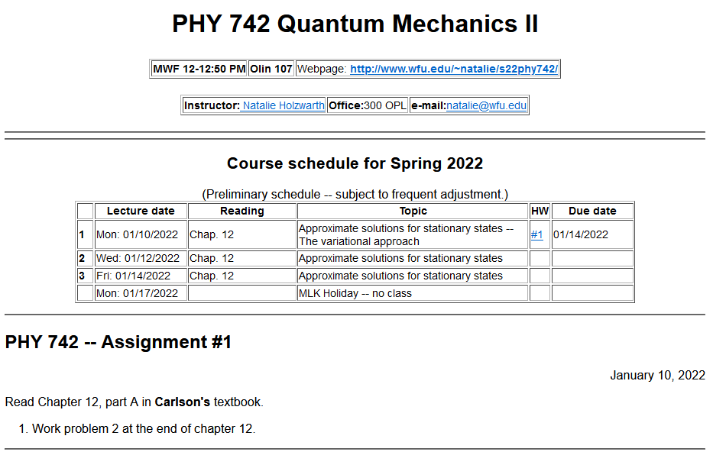

Slide 9
Variational methods for estimating the lowest energy eigenstate of a quantum mechanical system
Energy eigenvalue
Hermitian operator representing the Hamiltonian of the system

Slide 11
Significance of this inequality --
The inequality motivates a class of estimation methods known as variational methods to converge to the ground state energy E₀ and the corresponding ground state probability amplitude.

Slide 13
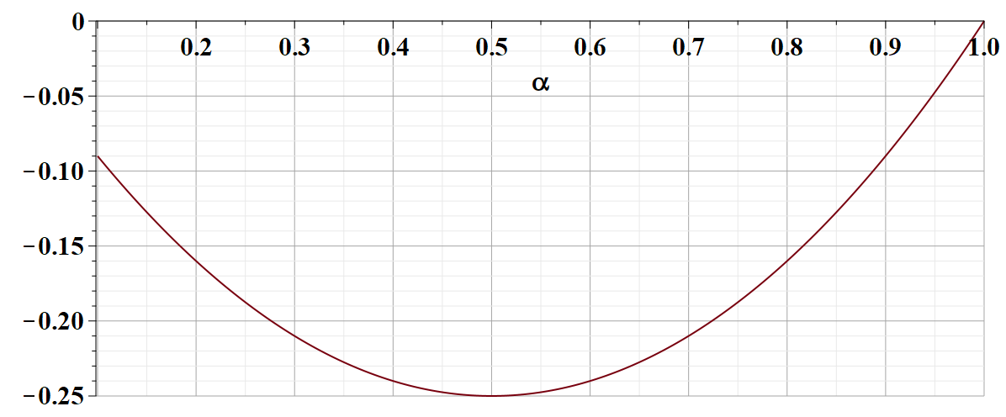
What is the significance of this result?

Slide 14
Review -- Quantum mechanics of the hydrogen atom
z
r_{e}
R_{N}
y
x

Slide 15
Quantum mechanics of the hydrogen atom
z
In center of mass coordinates
r
y
x

Slide 20
Example of normalized radial functions R_{nl}(r):

Slide 21
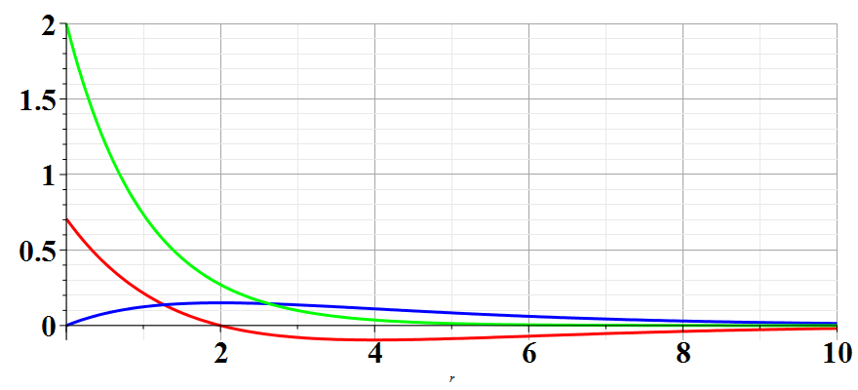
Hydrogen radial wavefunctions
R₁₀
R₂₀
R₂₁

Slide 22
Note that for the variational method, if we are so lucky as to use the correct shape function for our trial, we find the exact solution – in this case for the ground state of a hydrogen atom when we used an exponential form.
On the other hand, the variational method is still quite powerful even if we do not use the correct shape function for our trial. This is illustrated in the following example when we use a Gaussian shape function.

Slide 23
Note that this is your homework problem.

Slide 24
Example --
Unlike the case of a H atom, this Hamiltonian cannot be solved analytically.

Slide 25
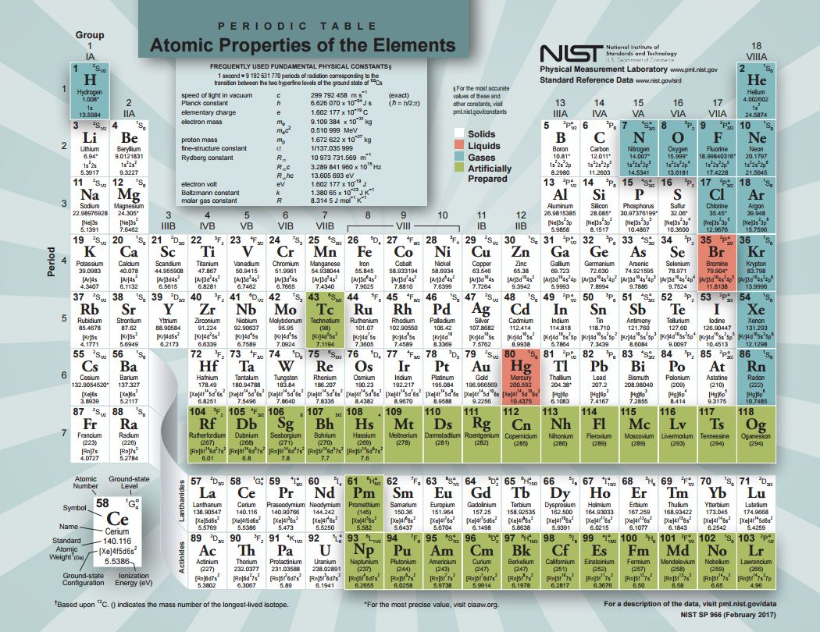

Slide 26
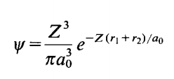
Back to estimate of wavefunction for He atom
Trial function for this case:
Here Z is a variational parameter

Slide 27
Some details

Slide 28
More details
=0

Slide 29
More details

Slide 30
More details
Useful identity:

Slide 31
More details
Consistent with earlier slides --

