Slide 1
PHY 742 Quantum Mechanics II
1-1:50 PM MWF Olin 103
Plan for Lecture 10
Path integral approach to quantum analysis
Ref: Chapter 11 A-C of Professor Carlson’s text
    Some background/motivation
    Review of classical action
    Quantum action for a free particle
    Path integral vs Schrödinger formulation of QM
    Examples

Slide 2
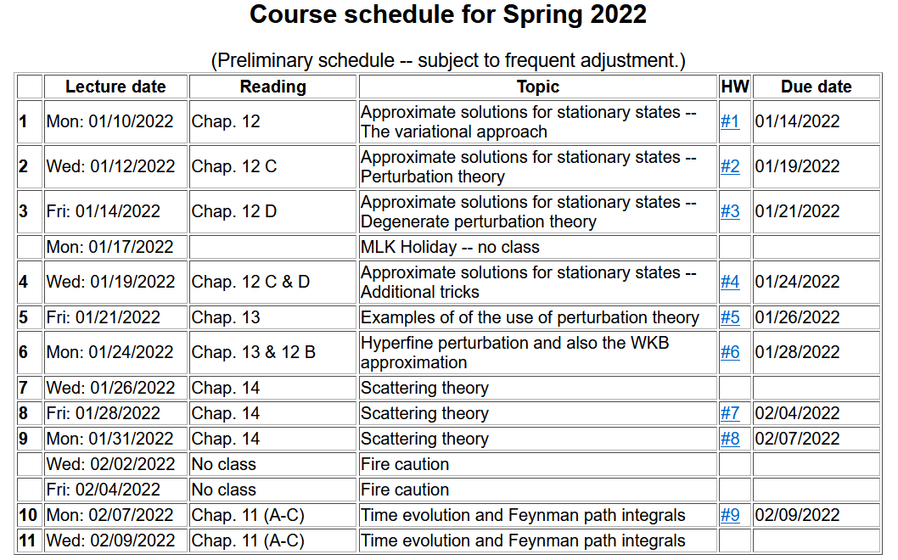

Slide 3
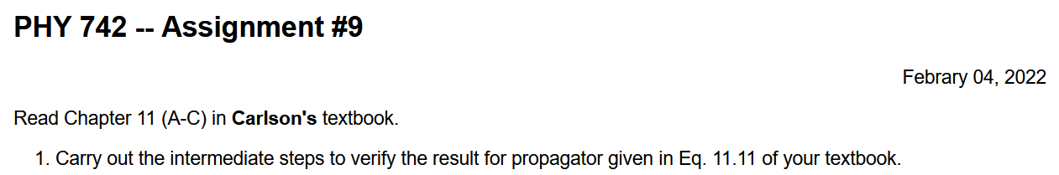

Slide 4
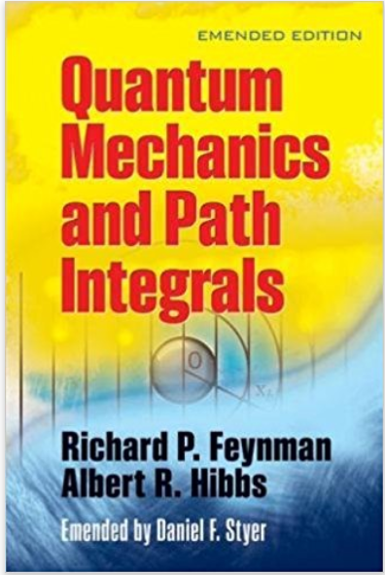
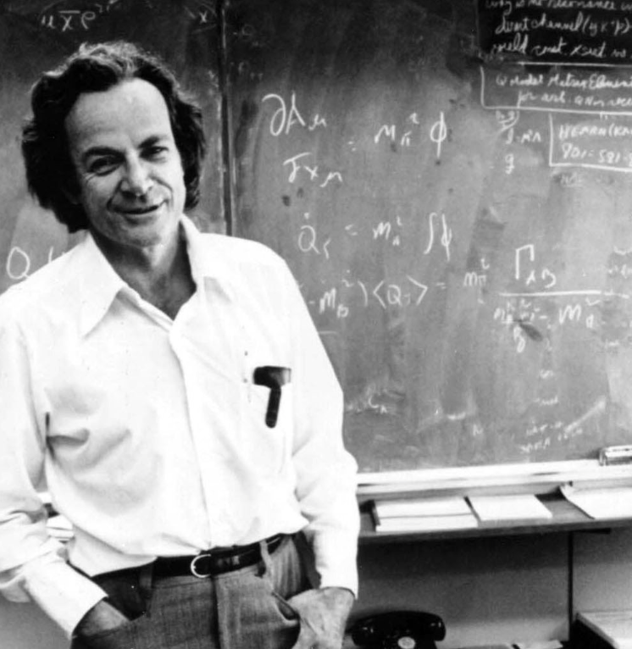
Dover reprinted version of classic text.

Slide 5
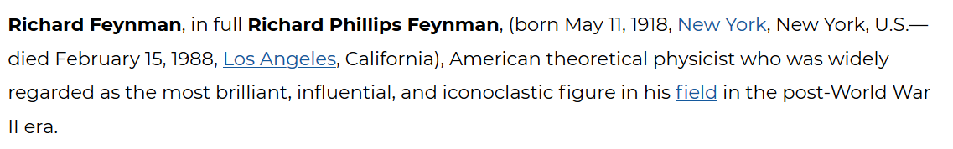
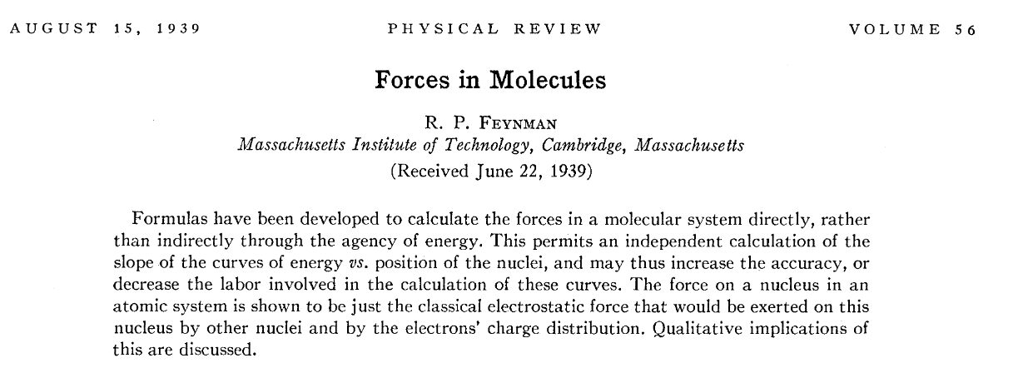
From: https://www.britannica.com/biography/Richard-Feynman
Undergraduate project – Feynman-Hellman theorem

Slide 6
Ph. D. Thesis of R. P. Feynman –
“Principle of least action in Quantum Mechanics”, Princeton 1942.

Slide 7
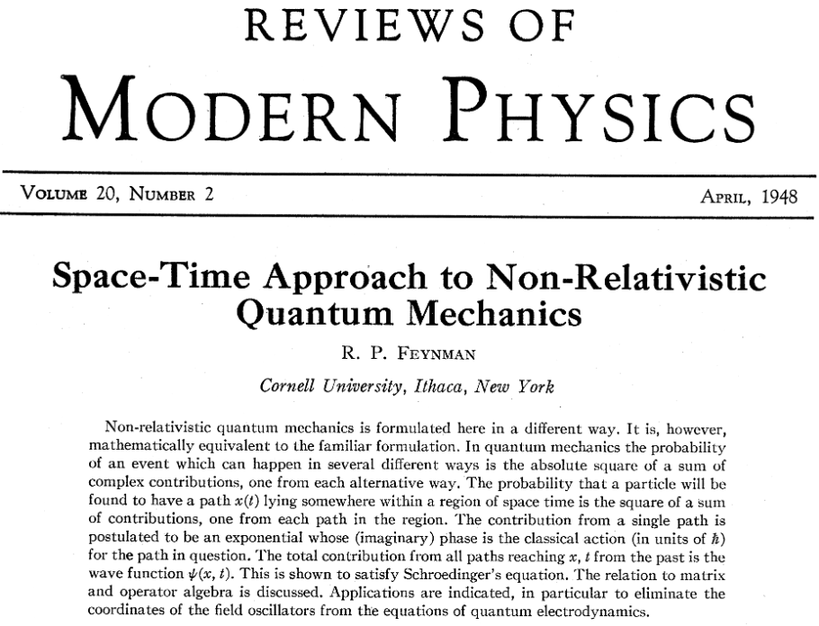

Slide 8
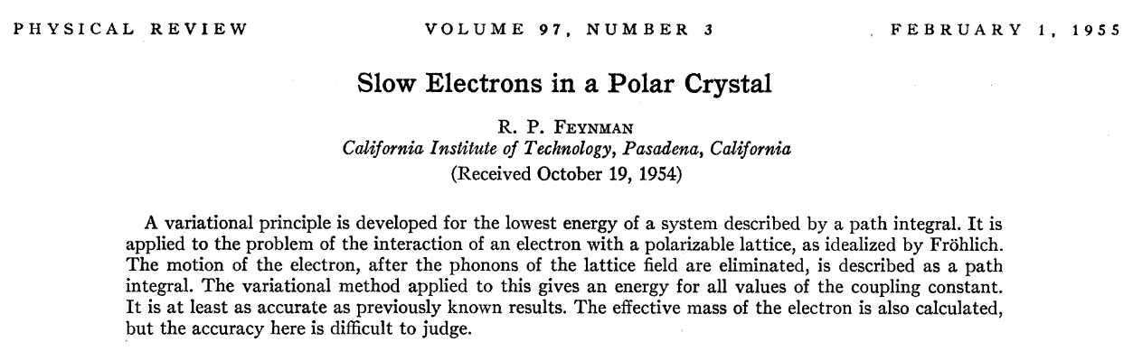
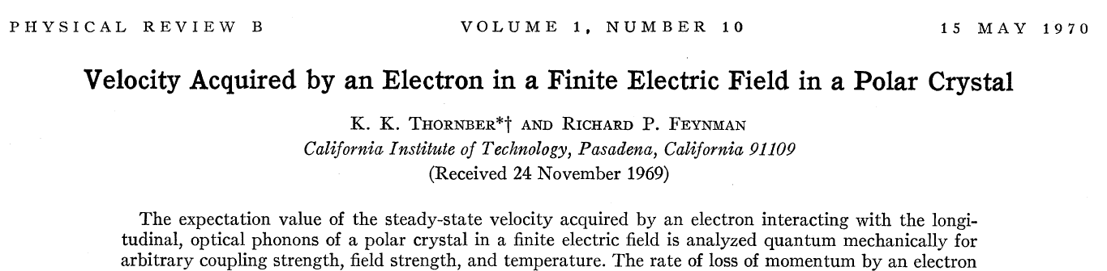

Slide 9
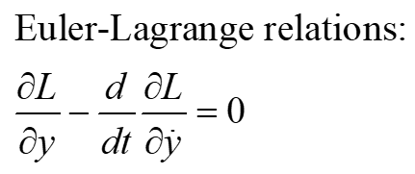
Review of classical Lagrangian mechanics:
y
Potential energy
(t_{i,},y_{i})
Kinetic energy
(t_{f,},y_{f})
t

Slide 10
Feynman’s idea
In classical mechanics, the action is optimized for the physical path.
In Feynman’s notion of path integrals, the probability amplitude is obtained from constructive interference of all possible actions.
y
(t_{i,},y_{i})
(t_{f,},y_{f})
t

Slide 11
In order to develop Feynman’s idea, we need to think about the time evolution of quantum systems. Ref. 11 A & B in Professor Carlson’s text

Slide 12
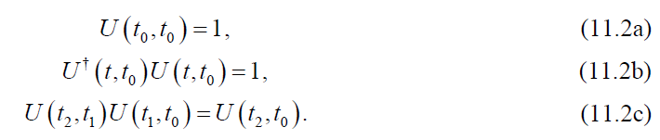
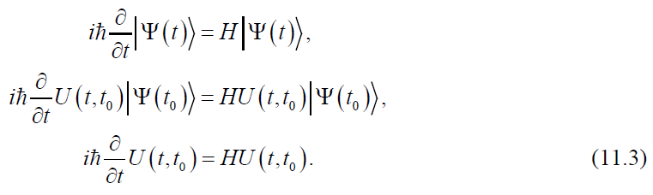
Now consider the time evolution operator -- U(t,t₀)
➔

Slide 13


From these properties, we can conclude that for a time independent H(r):
This can be evaluated in terms of the eigenstates:
Now consider the example where H(r) represents the Hamiltonian of a free particle –
for simplicity, we will take assume the motion is only in the x direction

Slide 14


Slide 15
Summary -- the time evolution of a free quantum particle

Slide 16
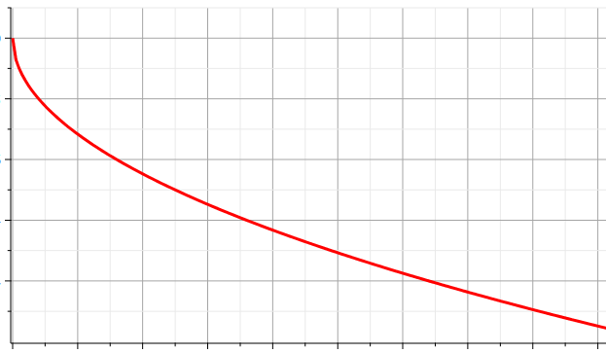
Application of Feynman’s path integral idea to the free particle in one dimension -- need scheme to evaluate all possible paths --
Use discretization to evaluate paths
(t_{i},x_{i})
x₁
x
x₂
x₃
x₄
ε
(t_{f},x_{f})
t

Slide 17
Application of Feynman’s path integral -- continued

Slide 18
Application of Feynman’s path integral -- continued

Slide 19
Application of Feynman’s path integral -- continued

Slide 20
Application of Feynman’s path integral -- continued

Slide 21
Application of Feynman’s path integral – continued
Reconciling the constants --

Slide 22
Feynman’s path integral
How is the path integral formulation related to the Schrödinger equation?

Slide 23
How is the path integral formulation related to the Schrödinger equation?

Slide 24
How is the path integral formulation related to the Schrödinger equation -- continued

Slide 25
How is the path integral formulation related to the Schrödinger equation -- continued

Slide 26
How is the path integral formulation related to the Schrödinger equation -- continued

Slide 27
Summary of results –
Feynman path integral can be used to evaluate the time propagation of a quantum system based on evaluations of the action function.
Next time – some examples.

