Slide 1
PHY 742 Quantum Mechanics II
12-12:50 PM MWF Olin 103
Plan for Lecture 11
Path integral approach to quantum analysis
Ref: Chapter 11C of Professor Carlson’s text
Review of path integral formulation and example for free particle
Role of classical trajectory
Examples

Slide 2
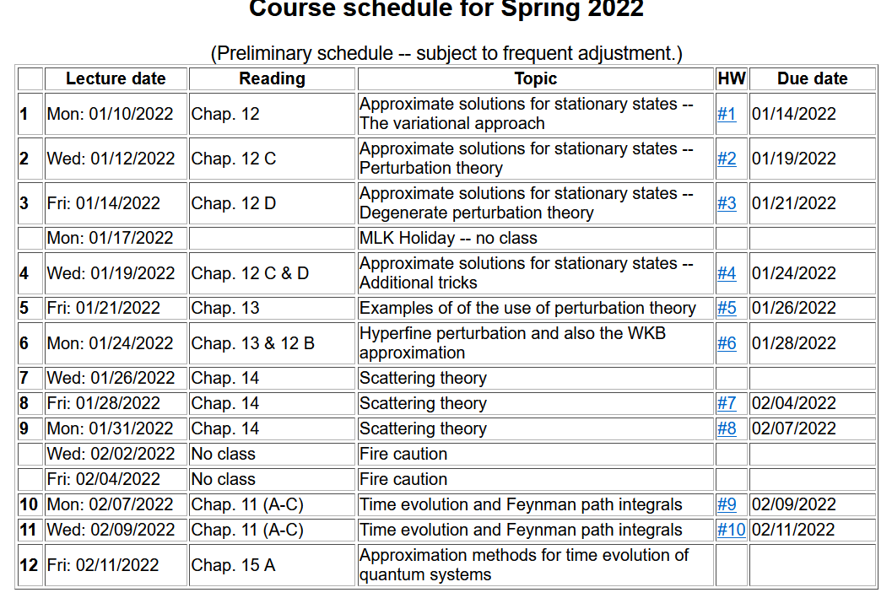

Slide 4
Feynman’s idea
x
(t_{i,},x_{i})
(t_{f,},x_{f})
t

Slide 6
Relationship of path integral to time evolution of probability amplitude:

Slide 7
Relationship of path integral to time evolution of probability amplitude:

Slide 8
Role of the “classical” trajectory
x
(t_{i,},x_{i})
(t_{f,},x_{f})
t

Slide 9
Role of the “classical” trajectory -- continued

Slide 10
Role of the “classical” trajectory -- example of free particle -- continued
Applying Feynman’s idea

Slide 11
Recap – For free particle, classical path gives exact result!
Feynman showed that the classical trajectory approximation is valid for all Lagrangians which depend on its variables up through quadratic order.

Slide 12
Importance of classical trajectory in analysis of path integrals

Slide 13
Kernel for the one-dimensional harmonic oscillator

Slide 14
Kernel for the one-dimensional harmonic oscillator -- continued
Note that the two results are consistent.

Slide 15
How is this useful?

Slide 16
Examples of using path integrals in research

Slide 17
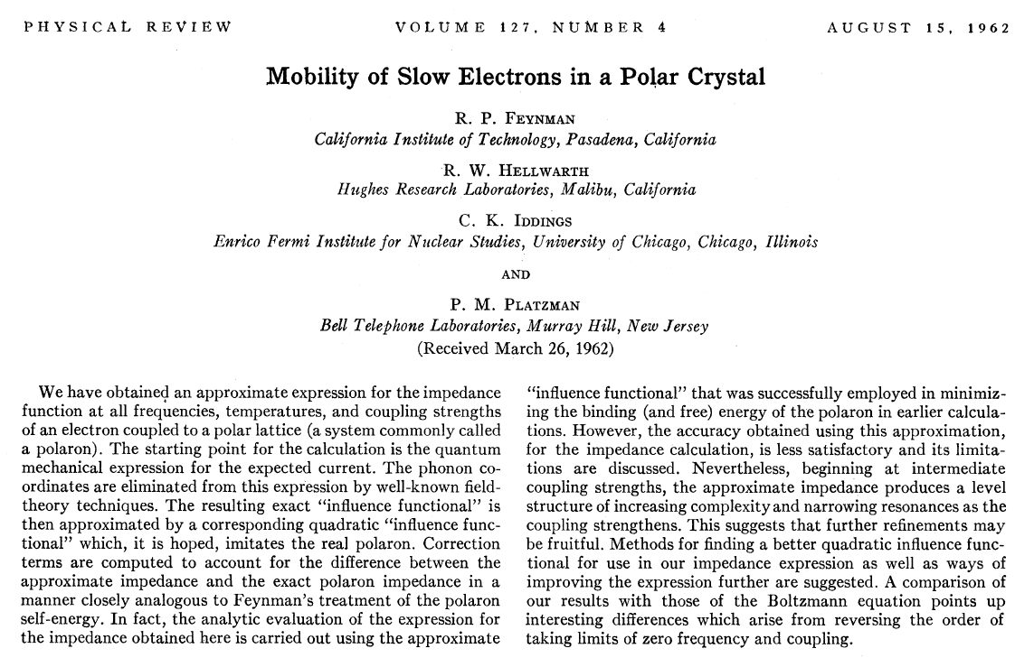
Examples of using path integrals in research

Slide 18
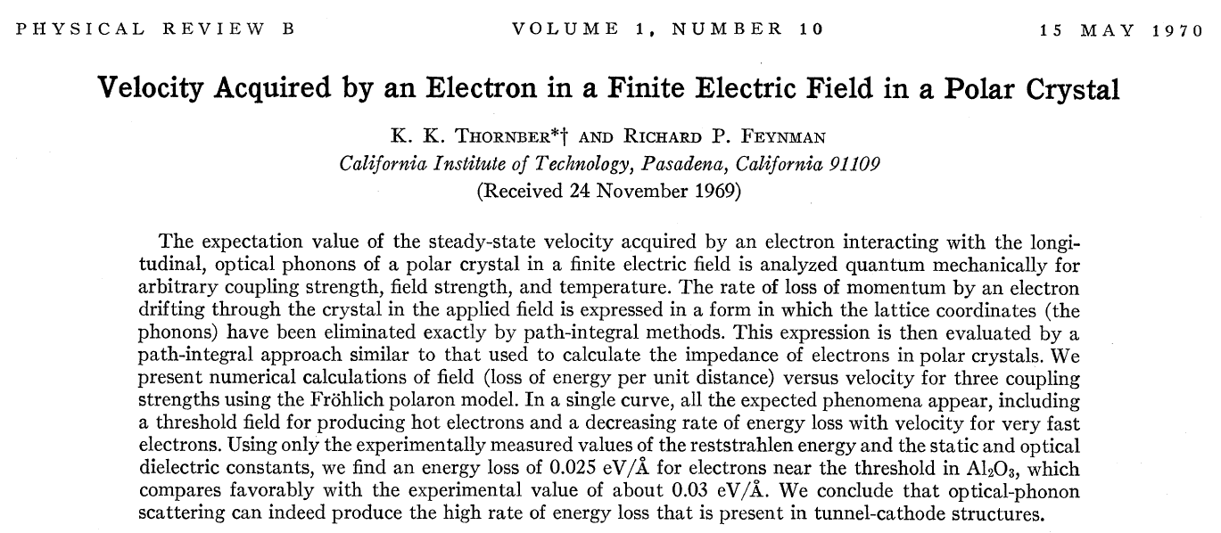
Examples of using path integrals in research

Slide 19
Model Hamiltonian
Phonons
Electron moving
in an electric field
Electron-phonon interactions

Slide 20
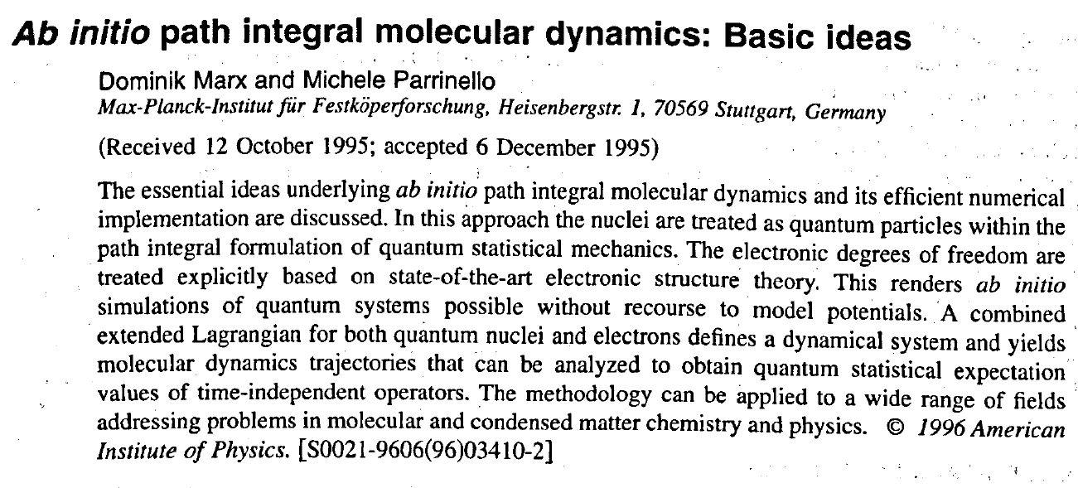
More recent extensions -- https://doi.org/10.1063/1.471221

