Slide 1
PHY 742 Quantum Mechanics II
12-12:50 AM MWF Olin 103
Plan for Lecture 12
Time dependent perturbation theory
Ref: Chapter 15
Introduction
Sudden approximation
Time harmonic perturbations

Slide 2
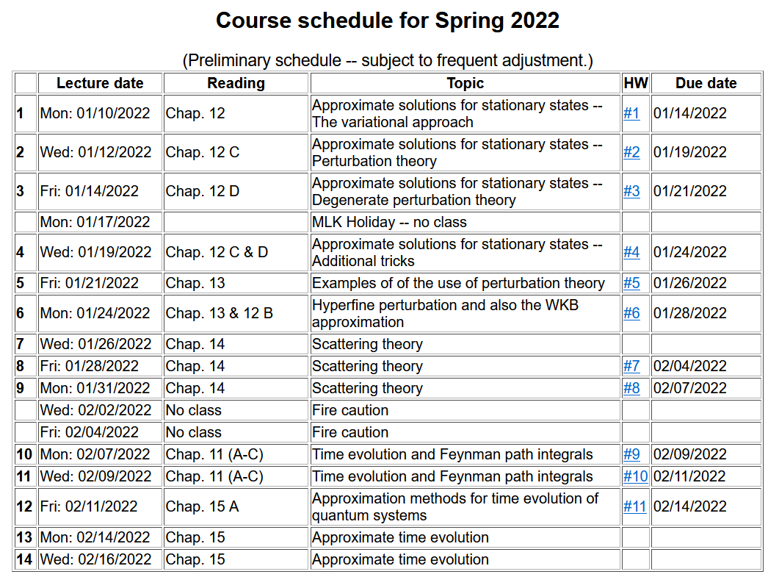

Slide 4
Time dependence in quantum mechanics

Slide 5
Sudden approximation
This method is useful when there is an abrupt change in the Hamiltonian of the system
This can happen when we have a nuclear process occur which is “sudden” for the electronic states. It is also a reasonable approximation for some X-ray absorption processes in which an electron is suddenly removed from the core of an atom.

Slide 6
Sudden approximation -- continued

Slide 7
More details --

Slide 8
More details continued --

Slide 9
Similar to HW #11
Example of a H-like ion initially with Z^{A}=2,
transforming to one with Z^{B}=1.

Slide 10
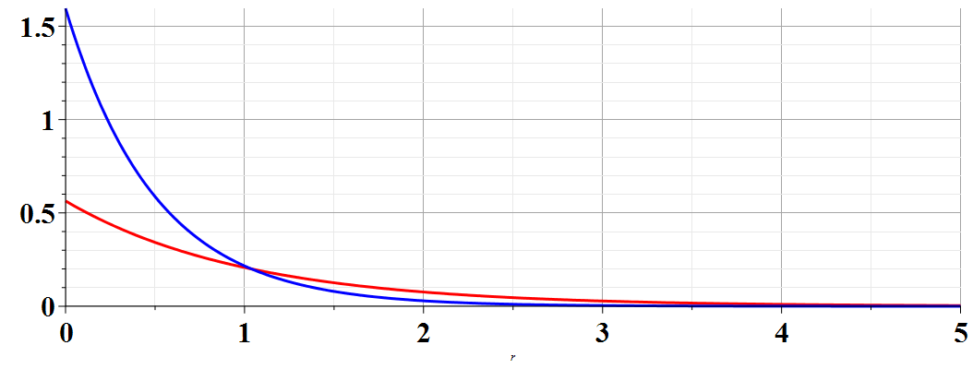
Example of a H-like ion initially with Z^{A}=2,
transforming to one with Z^{B}=1.
Similar to HW #11
A
Z^{A}=2
B
Z^{B}=1
➔Probability of H-like ion remaining in ground state:

Slide 11
Comment –
This example relates to the relatively slow response of an electronic state when a nuclear transformation occurs
Another example occurs when a multi-electron system responds to the sudden removal of a core electron --
We will discuss this case when we consider multi-electron systems.
➔

Slide 12
Another example -- Harmonic oscillator with time varying frequency

Slide 13
Range of validity of sudden approximation

Slide 14
Treatment of time-dependent perturbations

Slide 15
Treatment of time-dependent perturbations -- continued

Slide 16
Treatment of time-dependent perturbations -- continued

Slide 17
Treatment of time-dependent perturbations -- continued

Slide 18
Treatment of time-dependent perturbations -- continued

Slide 20
Treatment of time-dependent perturbations -- continued
largest T
larger T
small T

Slide 21
Estimating the rate of transitions I → f
Fermi “Golden” rule

Slide 22
Example
H atom in presence of electric field

Slide 23
Example
H atom in presence of electric field

Slide 25
Summary of results for resonant transitions for H-like ion 1s→2p₀

Slide 26
Digression: Notion of oscillator strength for transition between states l→n:
sum rule for oscillator strength

Slide 27
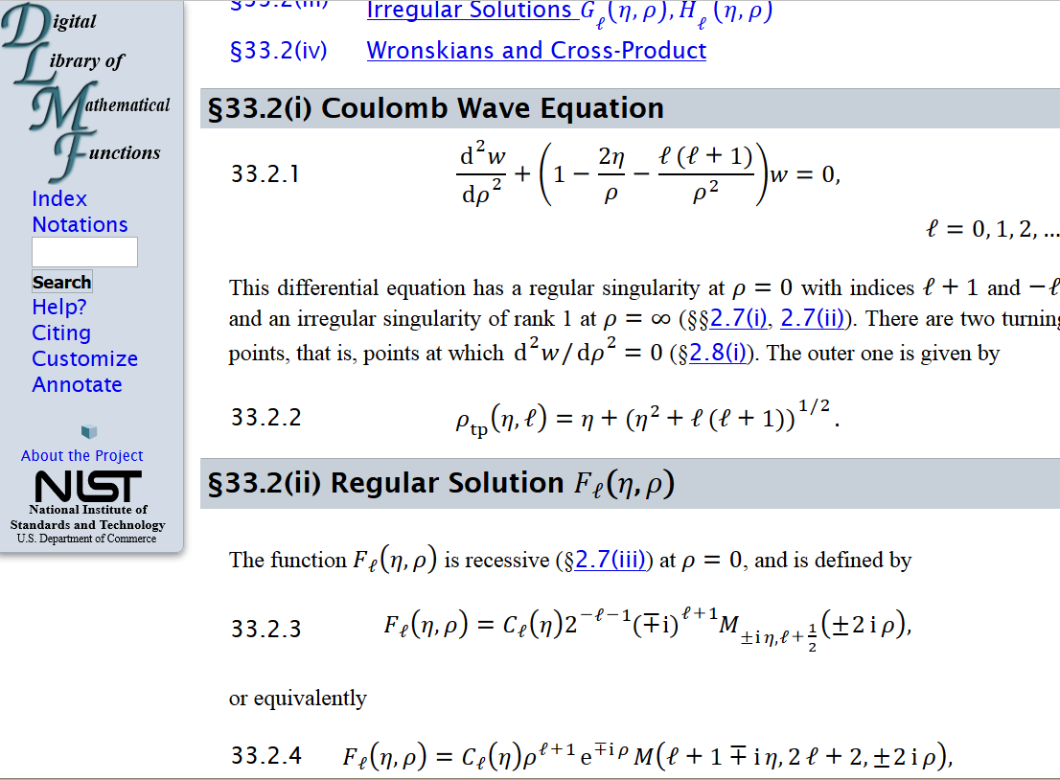
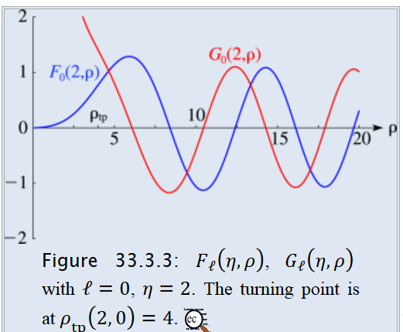
Absorption of radiation in the case of photo emission
From: http://dlmf.nist.gov/33.2

Slide 28
Absorption of radiation in the case of photo emission
approximating final state as a plane wave (Born approximation)
Note: In a more accurate treatment, one should modify the static electric field in order to account for electrodynamics …

Slide 29
For a H-like ion in a beam of photons with flux S, it is convenient to define a cross section:
(Details: Merzbacher, Quantum Mechanics, third ed. (1998)

