Slide 1
PHY 742 Quantum Mechanics II
12-12:50 AM MWF Olin 103
Plan for Lecture 13
Time dependent perturbation theory
Ref: Chapter 15
Review of basic equations
Time harmonic perturbations
Fermi Golden Rule

Slide 2
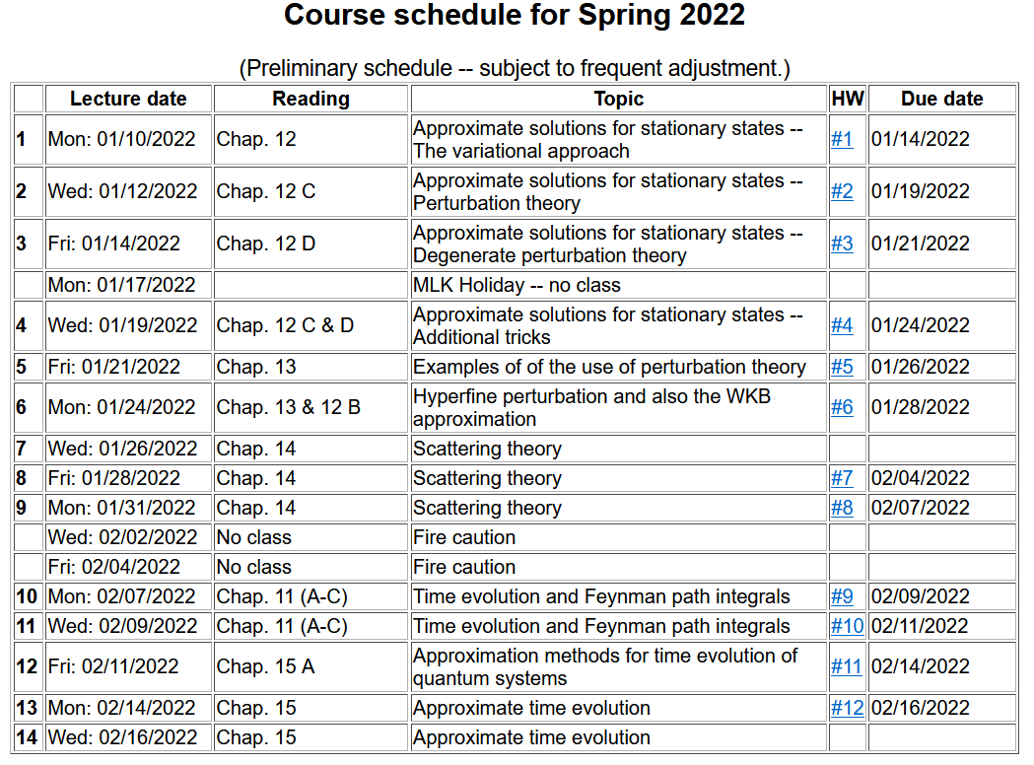

Slide 4
Review of basic equations for time-dependent perturbations

Slide 5
Treatment of time-dependent perturbations -- continued

Slide 6
Treatment of time-dependent perturbations -- continued

Slide 7
Recap --

Slide 8
Example – particle of mass m in a one-dimensional infinite well of length a --
➔Perturbation depends both on spatial matrix element and on time matrix element.

Slide 9
Continued -- Example – particle of mass m in a one-dimensional infinite well of length a --

Slide 10
Treatment of time-dependent perturbations -- continued

Slide 11
Treatment of time-dependent perturbations -- continued

Slide 13
Treatment of time-dependent perturbations -- continued
largest T
larger T
small T

Slide 14
Estimating the rate of transitions I → f
Fermi “Golden” rule

Slide 15
Example – Zero order system in the presence of an electromagnetic field

Slide 16
Example – Zero order system in the presence of an electromagnetic field -- continued

Slide 17
Example – Zero order system in the presence of an electromagnetic field -- continued

Slide 18
Example – Zero order system in the presence of an electromagnetic field -- continued

Slide 19
Example – Zero order system in the presence of an electromagnetic field -- continued
Fermi golden rule:

Slide 20
Example -- H-like atom in presence of electric field

Slide 22
Summary of results for resonant transitions for H-like ion 1s→2p₀

Slide 23
Digression: Notion of oscillator strength for transition between states l→n:
sum rule for oscillator strength

Slide 24
Digression – “selection rules” for transitions between spherically symmetric states in due to interaction with an electromagnetic field in the dipole approximation --

Slide 25
Example when the final state is in the continuum spectrum
Exact solutions for continuum states of H-like ions are related to confluent hypergeometric functions

Slide 26
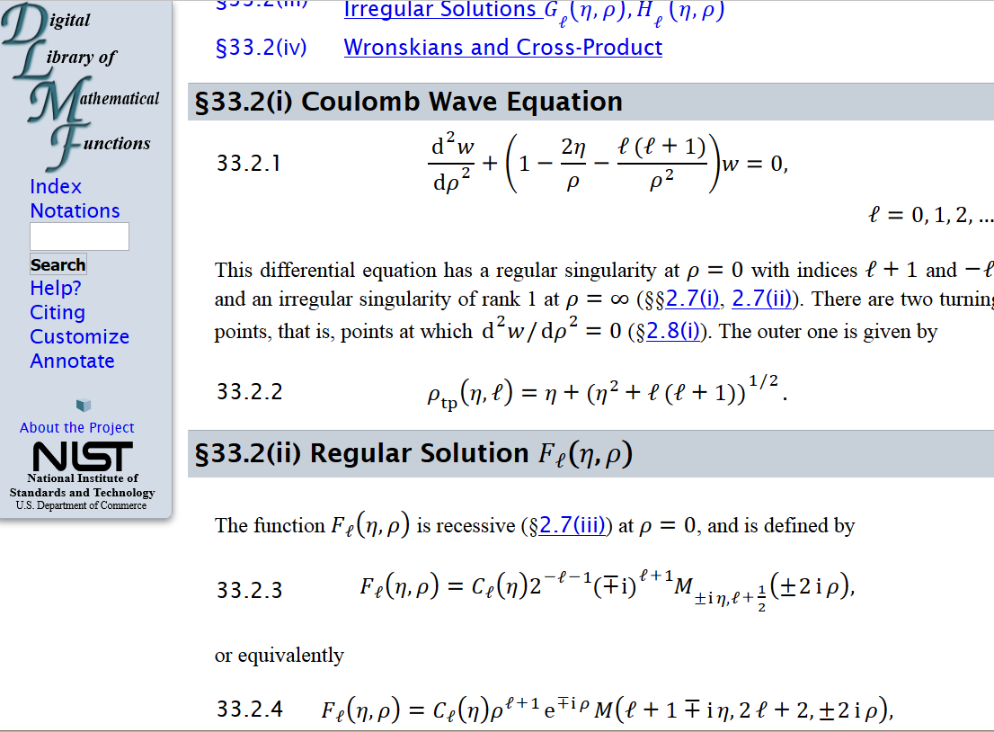
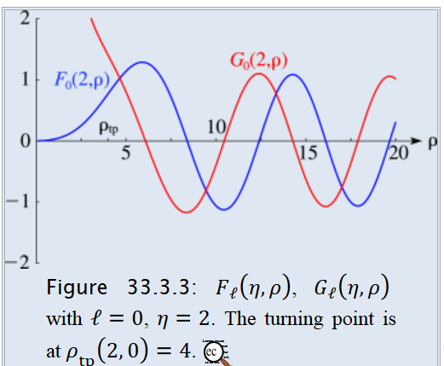
Absorption of radiation in the case of photo emission
From: http://dlmf.nist.gov/33.2

Slide 27
Absorption of radiation in the case of photo emission
approximating final state as a plane wave (Born approximation)
To be continued …

