Slide 1
PHY 742 Quantum Mechanics II
12-12:50 PM MWF Olin 103
Plan for Lecture 14
Time dependent perturbation theory
Ref: Chapter 15 in E. Carlson’s textbook
Time harmonic responances & Fermi’s Golden Rule
Transitions between bound states
Transitions between bound and continuum states

Slide 2
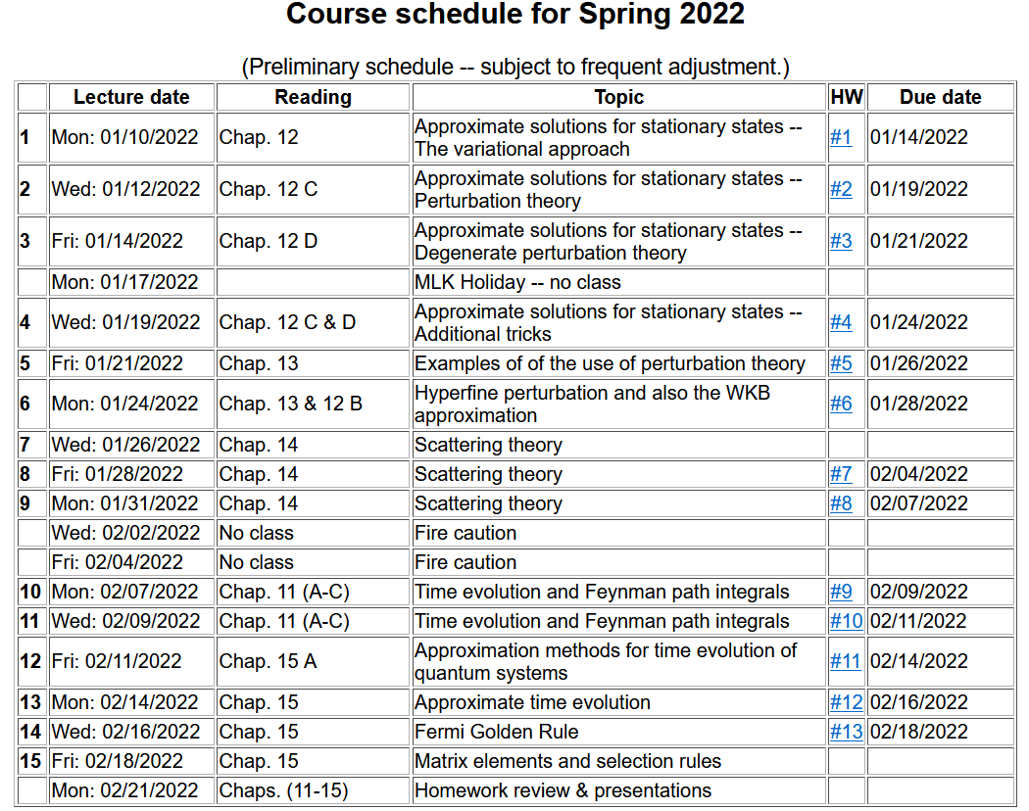

Slide 4
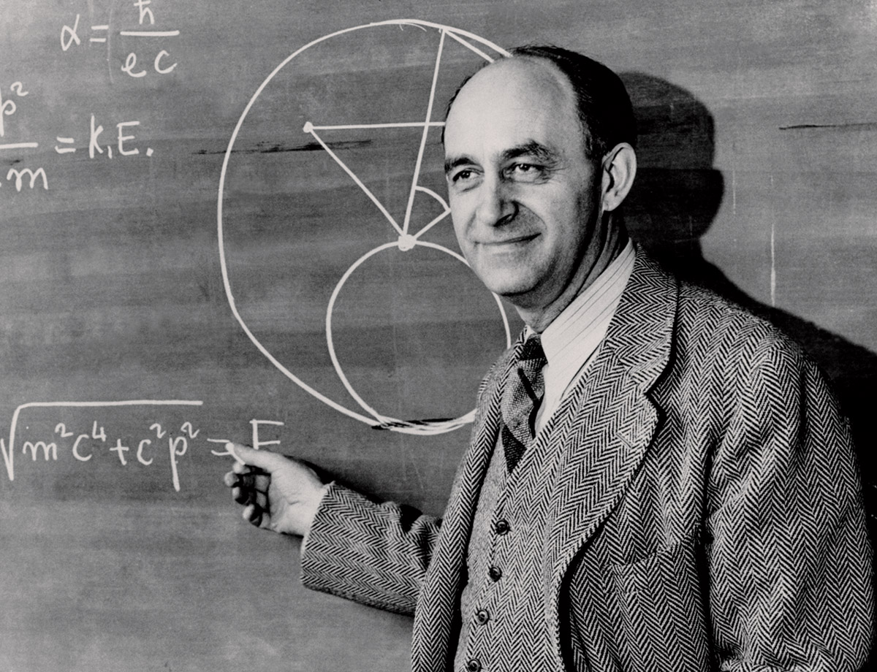
Famous Italian & American physicist
Enrico Fermi 1901-1954
Fermi Golden rule for time harmonic resonant transitions

Slide 5
Estimating the rate of transitions I → f
Transition between discrete and continuum states
Transition between two discrete states
Fermi “Golden” rule

Slide 6
Example – Zero order system in the presence of an electromagnetic field
In most cases, either term will be active, but generally not both.

Slide 7
Example – Zero order system in the presence of an electromagnetic field -- continued

Slide 8
Example – Zero order system in the presence of an electromagnetic field -- continued

Slide 9
Example – Zero order system in the presence of an electromagnetic field -- continued
Similar to your HW problem….

Slide 10
Example -- H-like atom in presence of electric field

Slide 11
Digression on matrix elements --
3j symbols

Slide 13
Back to calculation of matrix element:

Slide 14
Summary of results for resonant transitions for H-like ion 1s→2p₀

Slide 15
More general problem -- which transitions can occur?g
On Friday, we will discuss “selection rules” for transitions between spherically symmetric states in due to interaction with an electromagnetic field in the dipole approximation --

Slide 16
Summary of results of 1st order theory for a time harmonic perturbation of the form:
Fermi golden rule:
Treatment of the case when the initial state is bound and the final state is in the continuum spectrum --

Slide 17
Absorption of radiation in the case of photoemission of a H-like atom
It is convenient to approximate the final state as a plane wave (Born approximation)
Transition rate:

Slide 18
Convenient coordinate system --
z
F
k
r
y
x

Slide 19
Approximate photoemission -- continued
z
F
k
r
y
x

Slide 20
Approximate photoemission -- continued

Slide 21
Approximate photoemission -- continued
Digression – In general, the full transition rate is determined by averaging over all initial states and summing over all final states.
In our case, there is only one initial state, but a continuum of final states.

Slide 22
Approximate photoemission -- continued
Note that there are multiple values of k for each

Slide 23
Digression – how can we count the number of plane waves?
L
L
L

Slide 24
Approximate photoemission -- continued

Slide 25
Summary of results --
z
F
k
r
y
x

