Slide 1
PHY 742 Quantum Mechanics II
12-12:50 PM MWF Olin 103
Plan for Lecture 15
Matrix elements and selection rules
Ref: Chapter 15 and others in E. Carlson’s textbook
Selection rules for electric dipole transitions between spherically symmetric states
Rotations of eigenstates of angular momentum
Other symmetry related issues

Slide 2
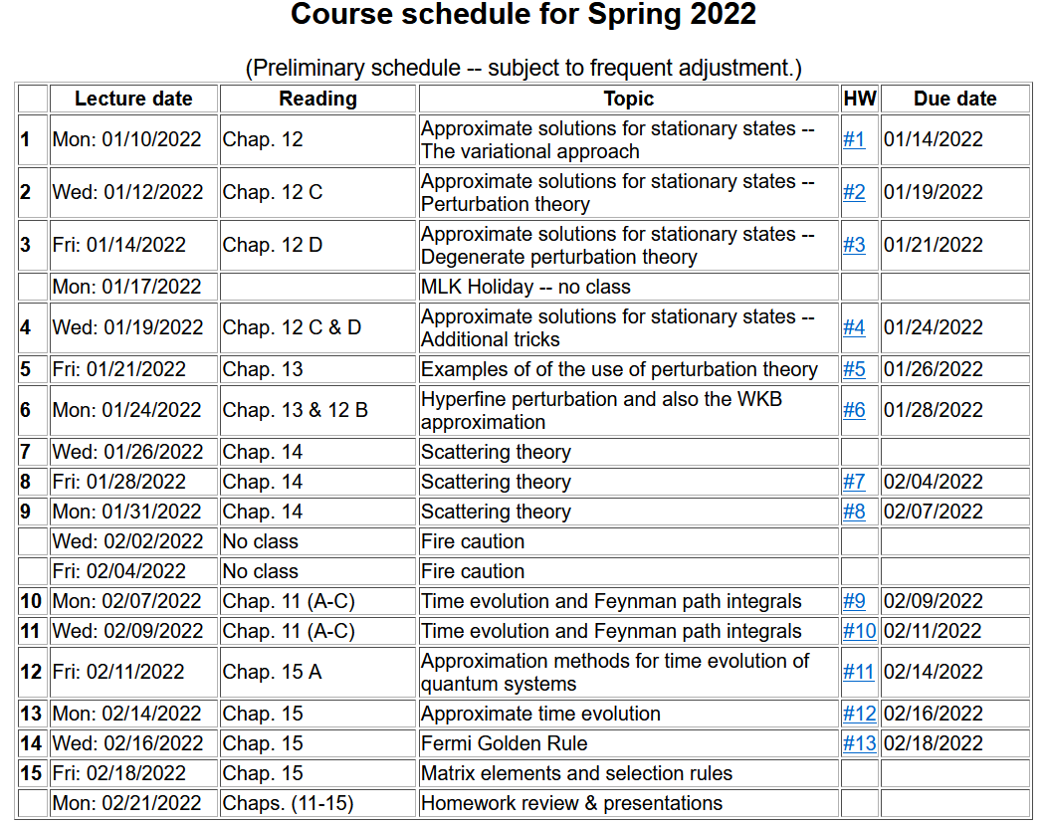

Slide 3
We will discuss “selection rules” for transitions between spherically symmetric states in due to interaction with an electromagnetic field in the dipole approximation --
E_{n}⁰

Slide 4
Digression on matrix elements --
3j symbols

Slide 7
More details given in Chapter VIII of your textbook -- for example, from Pg. 131:
Writing Clebsch-Gordan coefficients in terms of 3j symbols –
https://dlmf.nist.gov/search/search?q=Clebsch-Gordan

Slide 8
Gaunt coefficients in terms of Clebsch-Gordan coefficients (Pg. 139 of your textbook)

Slide 9
Summary of results for dipole transition matrix elements --
Depends on orientation of sample and polarization of EM field
Example -- Is the following transition between states of a H-like ion an “allowed” dipole transition?
(A) yes (B) no

Slide 10
Further abstraction of matrix element analysis using Group Theory
Group theory enables the determination of the “distilled essence” of the initial and final states and of the operator to determine which transitions are non-trivial

Slide 11
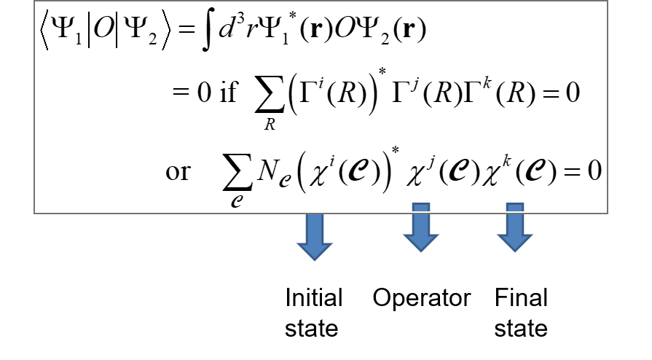
R here represents symmetry rotations* of the system
C represents “classes” of rotations of the system
*This can include the continuum of angles or discrete angles.

Slide 12
Example of the use of a character table for the case of discrete angles
C

Slide 13
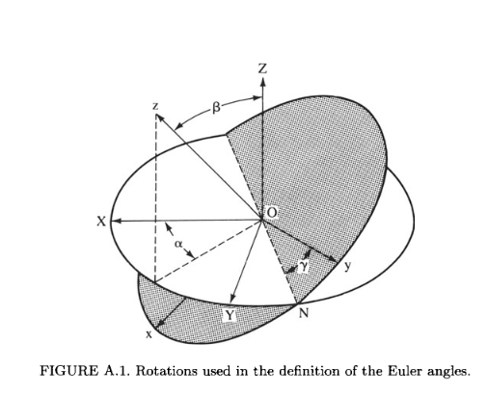
For the spherical coordinates, we have used a particular coordinate system, standardized to the orientation of the z-axis. What happens if we want to use another orientation?
Any rotation can be described by at most 3 successive rotations by α, β, and γ.

Slide 14
Note that, in Chap. 6, the notion of the rotation operator for angular moment L is presented as

Slide 15
What are the effects of rotation?

Slide 16
For example j=1/2:

