Slide 1
PHY 742 Quantum Mechanics II
12-12:50 AM MWF Olin 103
Plan for Lecture 16
The Dirac equation –
Relativistic treatment of spin ½ particles
Ref: Chapter 16 of Professor Carlson’s Textbook
    Some simple concepts of special theory of relativity
    Energy and momentum relationships
    Dirac equation for a free particle

Slide 2
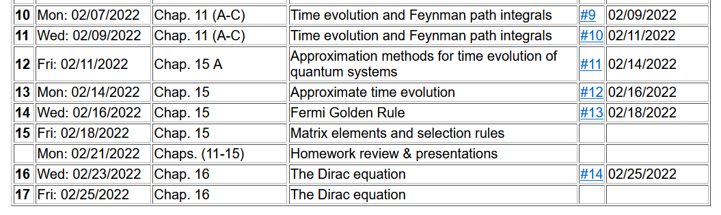

Slide 3
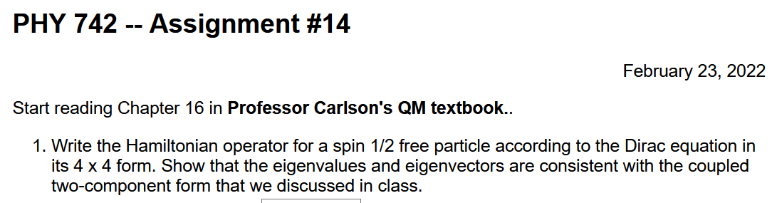

Slide 4
Notions of special relativity
The basic laws of physics are the same in all frames of reference (at rest or moving at constant velocity).
The speed of light in vacuum c is the same in all frames of reference.
y
y’
v
x
x’
y’
y
x’
x

Slide 5
Lorentz transformations
y
y’
v
x
x’
y’
y
x’
x

Slide 6
Lorentz transformations -- continued

Slide 7
Lorentz transformation of the velocity -- continued

Slide 8
Summary of velocity relationships

Slide 9
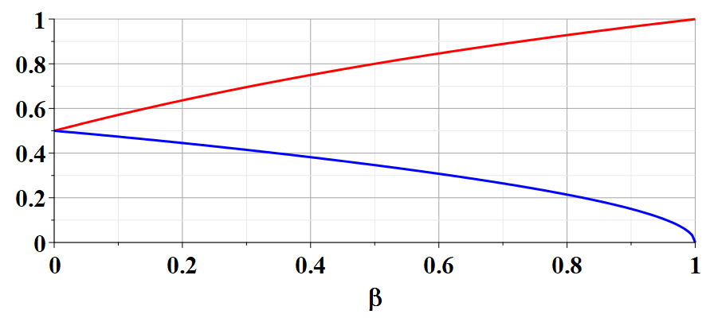
Example of velocity variation with β:
(u’_{x}/c= u’_{y}/c=0.5)
u_{x}/c
u_{y}/c

Slide 10
Velocity transformations continued:
Velocity 4-vector:

Slide 11
Some details:

Slide 12
Significance of 4-velocity vector:
Introduce the “rest” mass m of particle characterized by velocity u:
Properties of energy-moment 4-vector:

Slide 13
Properties of Energy-momentum 4-vector -- continued

Slide 14
Summary of relativistic energy relationships

Slide 15
How do these relationships effect quantum mechanics?
Focusing on treatment of Fermi particles
Non-relativistic mechanics
Relativistic mechanics

Slide 16
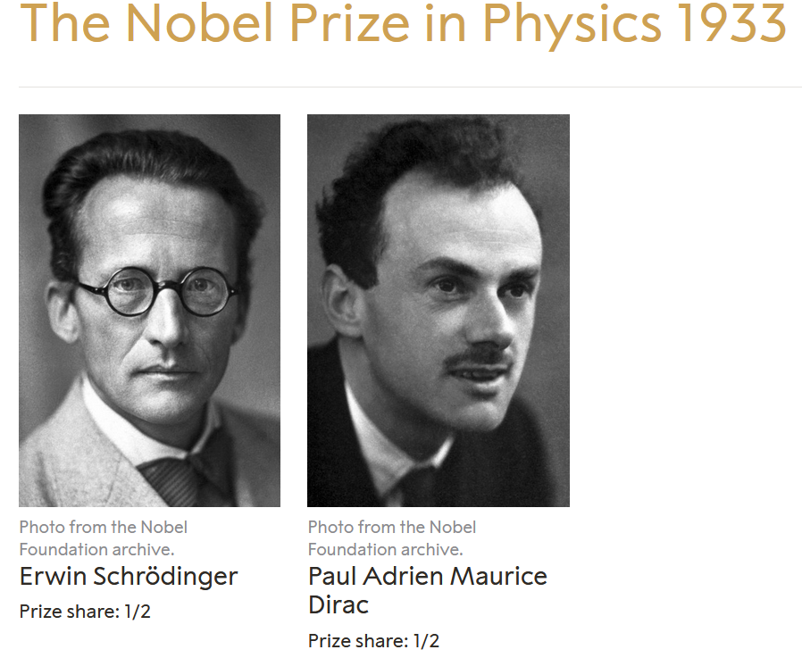
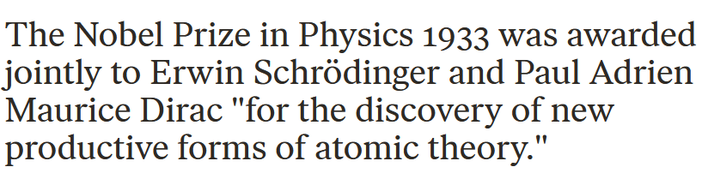
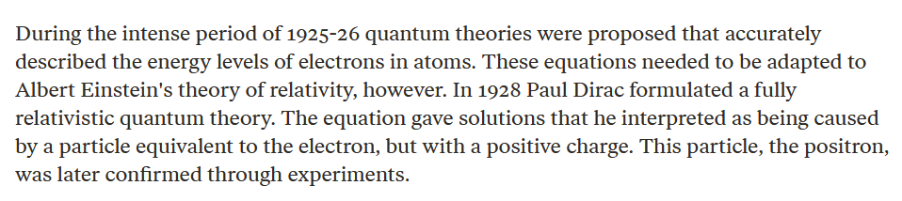
Dirac’s contribution --

Slide 17
Digression on Pauli matrices (see Eq. 7.17 in your textbook)

Slide 18
Relativistic relationships – continued
Ref: J. J. Sakurai, Advanced Quantum Mechanics
➔here, Ψ is a 2-component wavefunction

Slide 19
Relativistic relationships – continued
Ref: J. J. Sakurai, Advanced Quantum Mechanics

Slide 20
Relativistic relationships – continued
➔here, Ψ is a 4-component wavefunction

Slide 21
Four component wavefunction of free Fermi particle

Slide 24
What does this all mean?

