Slide 1
PHY 742 Quantum Mechanics
12-12:50 PM MWF Olin 103
Plan for Lecture 17:
    The Dirac equation
    Chap. 16 in Professor Carlson’s textbook:
    Dirac equation for a free particle
    Dirac equation for a hydrogen atom

Slide 2
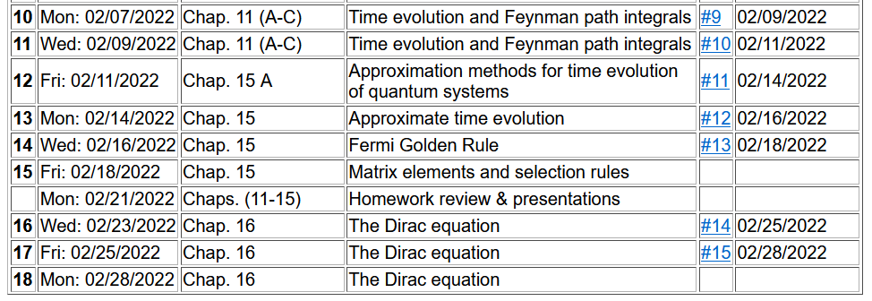
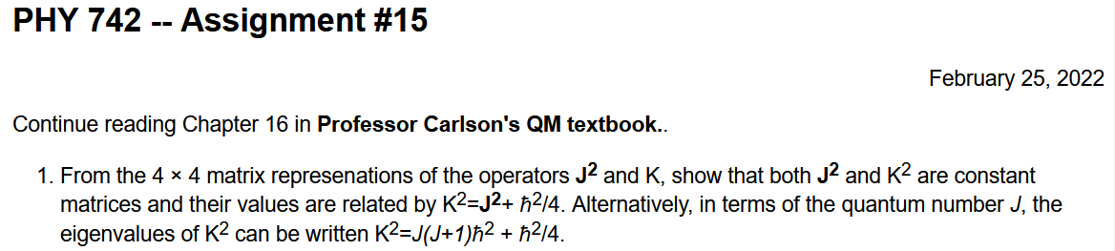

Slide 3
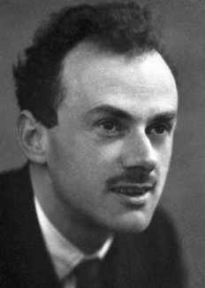
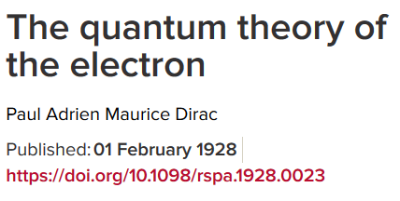

P. A. M Dirac 1902-1984
Won Nobel Prize in Physics in 1933
together with Erwin Schrödinger

Slide 4
Energy ⬅➔Momentum relationships in classical and quantum mechanics
Focusing on treatment of Fermi particles
Non-relativistic mechanics
Relativistic mechanics
Classical
Quantum

Slide 5
Relativistic relationships – continued
Ref: J. J. Sakurai, Advanced Quantum Mechanics

Slide 6
Relativistic relationships – continued
Ref: J. J. Sakurai, Advanced Quantum Mechanics

Slide 7
Relativistic relationships – continued

Slide 8
Four component wavefunction of free Fermi particle

Slide 11
What does this all mean?

Slide 12
Dirac equation for free particles – slightly more convenient notation
mc²
-mc²
For free particle, E>0 and E<0 solutions represent distinct physical situations.

Slide 13
Dirac equation for a free particle
Note: This notation is not entirely consistent with your textbook and is problematic because of other common usages of α and β.

Slide 14
Dirac equation for Fermi particle in a scalar potential field

Slide 15
Dirac equation for electron in the field of a H-like ion

Slide 16
Preview –
Non-relativistic spherical atom --
Eigenstate quantum numbers |nlm_{l}>; independent of electron spin
Relativistic spherical atom
Eigenstate quantum numbers |nκ jm_{j}>; electron spin included

Slide 17
Dirac equation for electron in the field of a H-like ion -- continued

Slide 18
Digression – useful identity for operator vectors A and B
Note: You might like to verify these relationships!

Slide 19
Digression – useful identity for operator vectors A and B -- continued

Slide 20
Dirac equation for electron in the field of a H-like ion -- continued

Slide 22
Dirac equation for electron in the field of a H-like ion -- continued

Slide 23
Dirac equation for electron in the field of a H-like ion -- continued

Slide 24
More relationships between the operators

Slide 26
Dirac equation for electron in the field of a H-like ion -- continued

Slide 27
Summary of allowed combinations of eigenvalues
Alternatively

Slide 28
Addition of angular momentum - orbital angular momentum and spin angular momentum

Slide 29
Another representation of the spin-angular function in terms of spherical harmonic functions and eigenvectors of σ_{z}

Slide 31
Questions:
How do these results reduce to the Schrödinger equation in the non-relativistic limit?
What new physics is contained more generally?

