Slide 1
PHY 742 Quantum Mechanics
12:00-12:50 AM MWF Olin 103
Plan for Lecture 18:
Chap. 16 in Professor Carlson’s text:
The Dirac equation for a hydrogen-like ion
Angular and spin components
Radial components
Comparison with non-relativistic hydrogen-like ion

Slide 2
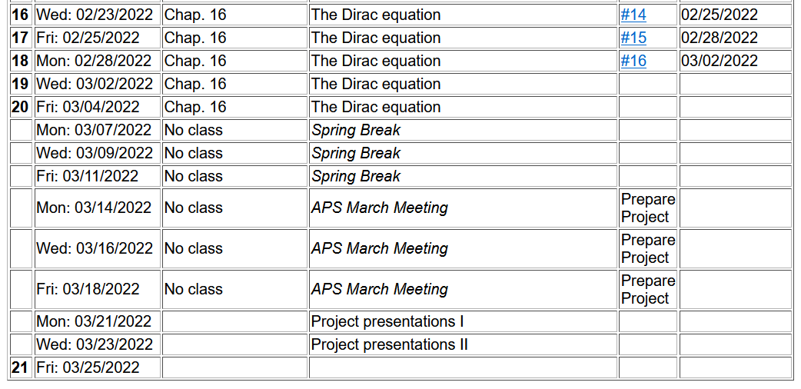
Note: Project topic needed by Friday 3/5/2022

Slide 4
Additional references –
J. J. Sakurai, Advanced Quantum Mechanics
Hans A. Bethe and Edwin E. Salpeter, Quantum Mechanics of one and two electron atoms
Dirac equation for Fermi particle in a scalar potential field

Slide 5
Dirac equation for electron in the field of a H-like ion

Slide 6
Dirac equation for electron in the field of a H-like ion -- continued

Slide 7
Dirac equation for electron in the field of a H-like ion -- continued
We can
show that:

Slide 8
Dirac equation for electron in the field of a H-like ion -- continued

Slide 9
Dirac equation for electron in the field of a H-like ion -- continued

Slide 10
More relationships between the operators

Slide 11
Summary of allowed combinations of eigenvalues
Alternatively

Slide 12
Dirac equation for electron in the field of a H-like ion -- continued

Slide 14
Some details --

Slide 16
More tricks --

Slide 18
For example, consider the example κ=-1:

Slide 19
The example showed the following results which can be proved more generally --
Also, recall -- --
Returning to our coupled equations:

Slide 22
Digression – how are these equations related to non-relativistic limit?

Slide 23
Non-relativistic connections -- continued

Slide 24
Non-relativistic connections -- continued
2/28/2022 lecture ran out of time at this slide.

Slide 25
Resuming analysis of solution of Dirac equation for H-like ion:

Slide 30
Dirac equation for electron in the field of a H-like ion
Comparison with Schrödinger equation --
Schematic diagram:
3d_{5/2}
κ=-3
3s,3p,3d
3p_{3/2},3d_{3/2}
κ=-/+2
3s_{1/2},3p_{1/2}
κ=-/+1
2s,2p
2p_{3/2}
κ=-2
2s_{1/2},2p_{1/2}
κ=-/+1
1s
1s_{1/2}
κ=-1

Slide 31
Some details

Slide 32
More details about ground state of H-like ion from Dirac equation

Slide 33
More general treatment of bound states of Fermi particle within spherical potential V(r)

Slide 34
Practical solution of radial portions of Dirac equation

