Slide 1
PHY 742 Quantum Mechanics
12:00-12:50 AM MWF Olin 103
Plan for Lecture 19:
Chap. 16 in Professor Carlson’s text:
The Dirac equation for a hydrogen-like ion
Solution of the analytic radial wave functions
Comparison with non-relativistic hydrogen-like ion

Slide 2
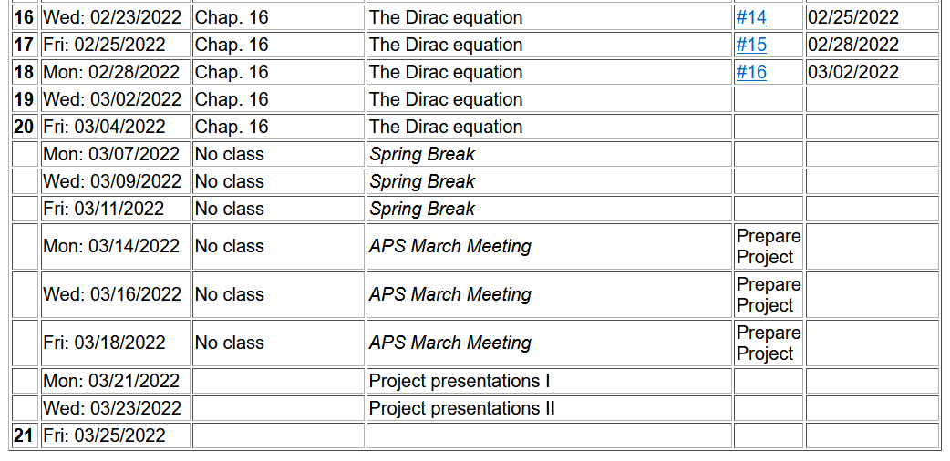
Note: Project topic needed by Friday 3/4/2022

Slide 3
Dirac equation for electron in the field of a nucleus with atomic number Z --

Slide 7
Analysis of solution of Dirac equation for H-like ion:

Slide 13
Dirac equation for electron in the field of a H-like ion
Comparison with Schrödinger equation --
Schematic diagram:
3d_{5/2}
κ=-3
3s,3p,3d
3p_{3/2},3d_{3/2}
κ=-/+2
3s_{1/2},3p_{1/2}
κ=-/+1
2s,2p
2p_{3/2}
κ=-2
2s_{1/2},2p_{1/2}
κ=-/+1
1s
1s_{1/2}
κ=-1

Slide 14
Some details

Slide 15
More details about ground state of H-like ion from Dirac equation

Slide 17
More general treatment of bound states of Fermi particle within spherical potential V(r)

Slide 18
Practical solution of radial portions of Dirac equation
Coupled radial equations, can be solved numerically

