Slide 1
PHY 742 Quantum Mechanics II
12-12:50 PhM MWF Olin 107
Plan for Lecture 1
Structure of the course
Review of main concepts from Quantum Mechanics I
Preview of topics for Quantum Mechanics II
Topic for today – Approximations for stationary quantum systems
  Reading: Chapter 12 in Carlson’s textbook

Slide 2
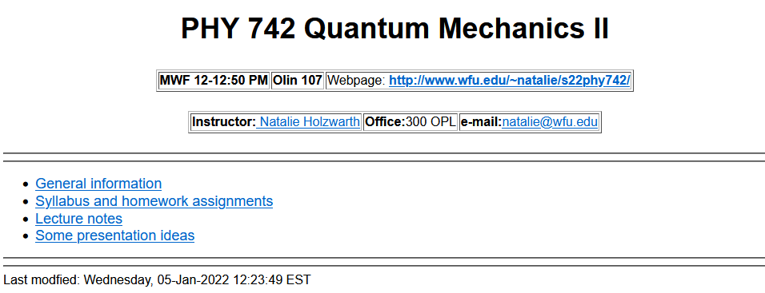
https://users.wfu.edu/natalie/s22phy742/

Slide 3
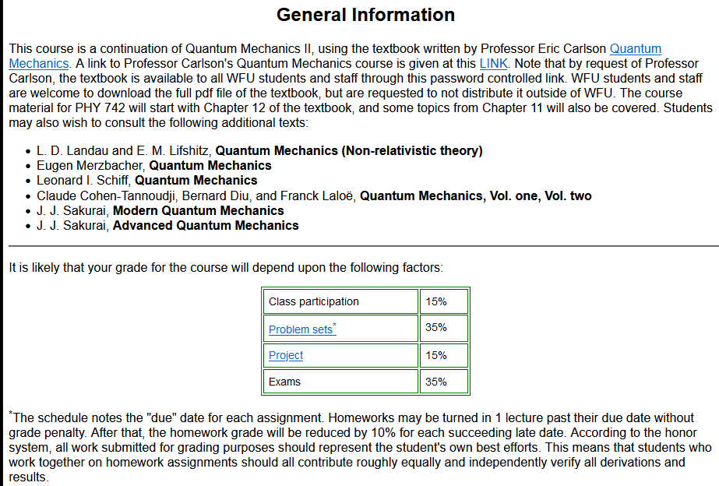

Slide 4
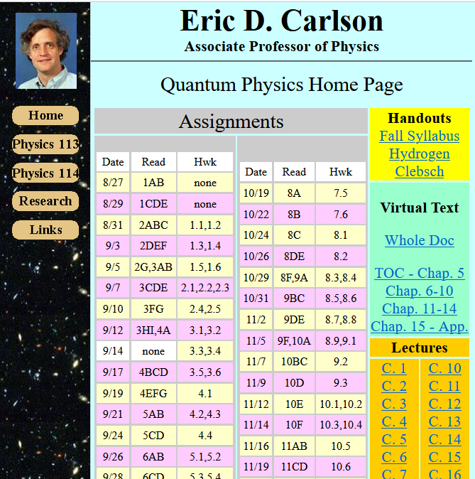
https://users.wfu.edu/ecarlson/quantum/index1.html

Slide 5

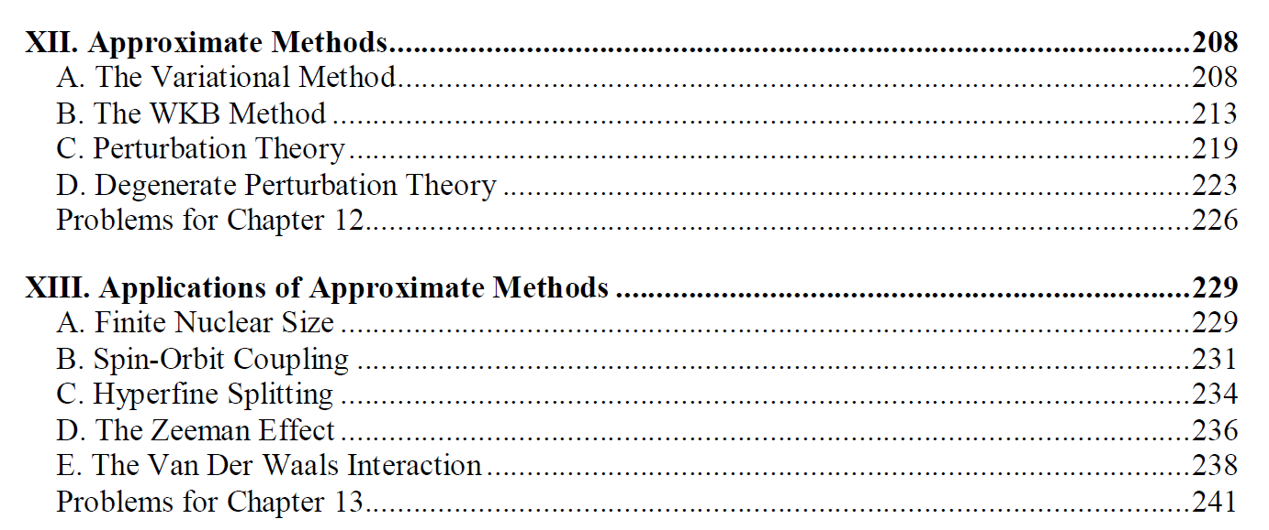
Today, we will start with XII A, followed with C and D and then B.

Slide 6
Tentative additional information –
Mon Jan 17 – MLK Holiday
Spring break March 5-13
Mid term grades due March 7
  APS March meeting March 14-18 (no class)
  Fri April 15 – Good Friday Holiday
  Thurs Apr 21 – Student wellness day (no class)
  Wed Apr 27 – Last day of class
  Apr 29-May 6 – Final exams
Particular for QM II:
  Where/how to share supplemental texts?
  Presentations -- how to interface with PHY 712?

Slide 7
Summary of topics covered in Quantum Mechanics I
Topic | Chapters in EC Text
Fundamentals and formalism of QM | 1,3,4,11
Solution of S. E. for simple 1-dim potentials | 2
Quantum mechanics of harmonic oscillator | 5
Various symmetries | 6
Angular momentum | 7
Addition and rotation of angular momentum including spin | 8
Hydrogen atom | 7
Electromagnetic forces | 9
Multiple independent particles | 10

Slide 8
Topics for Quantum Mechanics II
Single particle analysis
  Time independent perturbation methods – EC Chap. 12, 13
  Scattering of a particle from a spherical potential – EC Chap. 14
  Single electron states of a multi-well potential ➔ molecules and solids – EC Chap. 2,6
  Feynman path integral formalism – EC Chap. 11 C
  Time dependent perturbation methods – EC Chap. 15
  Relativistic effects and the Dirac Equation – EC Chap. 16
Multiple particle analysis
  Quantization of the electromagnetic fields – EC Chap. 17
  Photons and atoms – EC Chap. 18
  Multi particle systems; Bose and Fermi particles – review EC Chap. 10
  Multi electron atoms and materials
    Hartree-Fock approximation
    Density functional approximation

Slide 9
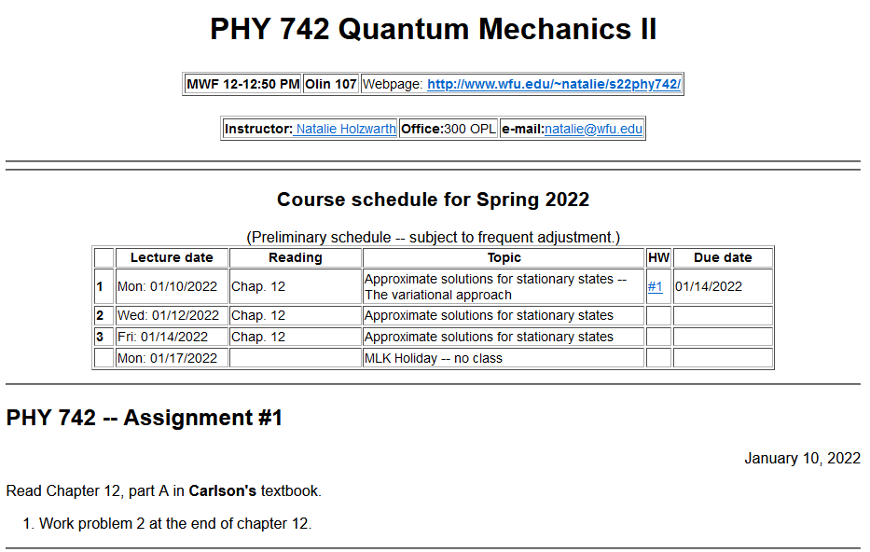

Slide 10
Your questions –
From Owen -- What are the benefits and disadvantages of the various approximation methods?
Comment – This is a very important question to ask. In general –
Variational methods – Very powerful for finding the lowest eigenstate of a system
Perturbation theory – Works well when you write the Hamiltonian as
H = H_{large} + H_{small} and you can find a full set of solutions for H_{large}
WKB – Historically important and also useful for tunneling situations for example

Slide 11
Variational methods for estimating the lowest energy eigenstate of a quantum mechanical system
Energy eigenvalue
Hermitian operator representing the Hamiltonian of the system

Slide 13
Significance of this inequality --
The inequality motivates a class of estimation methods known as variational methods to converge to the ground state energy E₀ and the corresponding ground state probability amplitude.

Slide 15
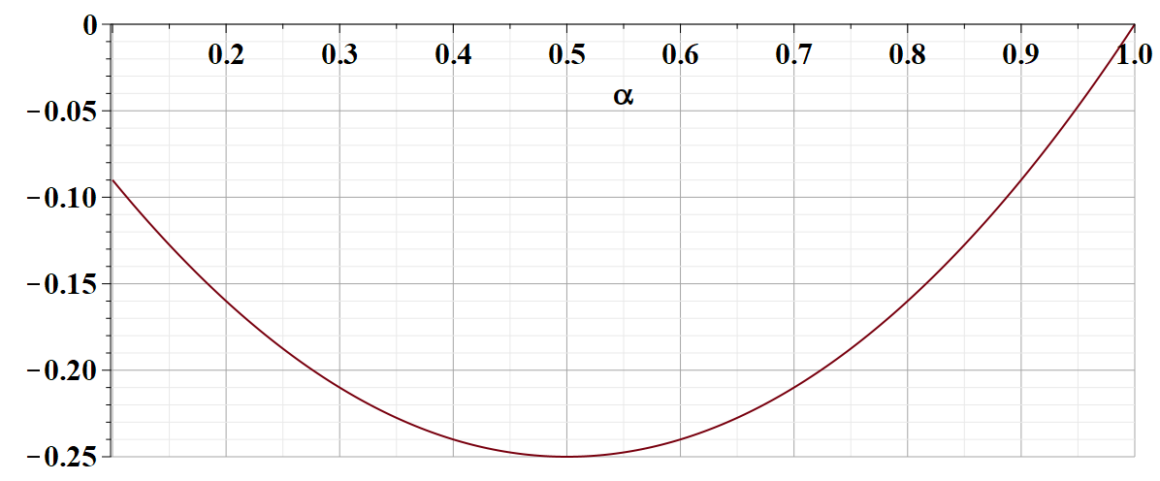
What is the significance of this result?

Slide 16
Review -- Quantum mechanics of the hydrogen atom
z
r_{e}
R_{N}
y
x

Slide 17
Quantum mechanics of the hydrogen atom
z
In center of mass coordinates
r
y
x

Slide 22
Example of normalized radial functions R_{nl}(r):

Slide 23
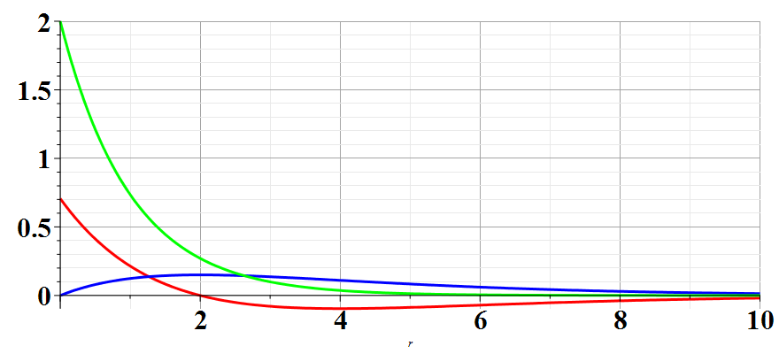
Hydrogen radial wavefunctions
R₁₀
R₂₀
R₂₁

Slide 24
Note that for the variational method, if we are so lucky as to use the correct shape function for our trial, we find the exact solution – in this case for the ground state of a hydrogen atom when we used an exponential form.
On the other hand, the variational method is still quite powerful even if we do not use the correct shape function for our trial. This is illustrated in the following example when we use a Gaussian shape function.

Slide 25
Note that this is your homework problem.

Slide 26
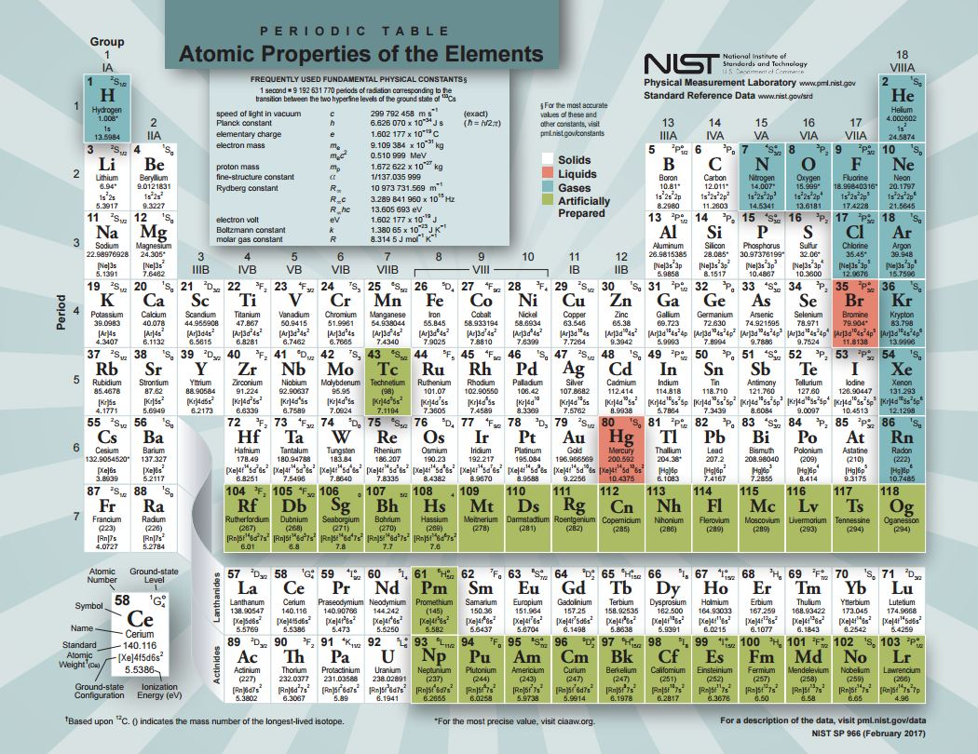

Slide 28
Example --
Unlike the case of a H atom, this Hamiltonian cannot be solved analytically.

Slide 29
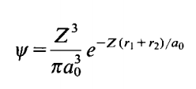
Back to estimate of wavefunction for He atom
Trial function for this case:
Here Z is a variational parameter

Slide 30
Some details

Slide 31
More details
=0

Slide 32
More details

Slide 33
More details
Useful identity:

Slide 34
More details
Consistent with earlier slides --

