Slide 1
PHY 742 Quantum Mechanics
12:00-12:50 PM MWF Olin 103
Plan for Lecture 20:
Dirac equation for hydrogen-like ions and other atoms
Chap. 16 in Carlson’s text – Supplemented with J. J. Sakurai, Advanced QM
Review of results for H-like ions
Generalization to approximate treatment of spherical atoms
Comparison with non-relativistic results

Slide 2
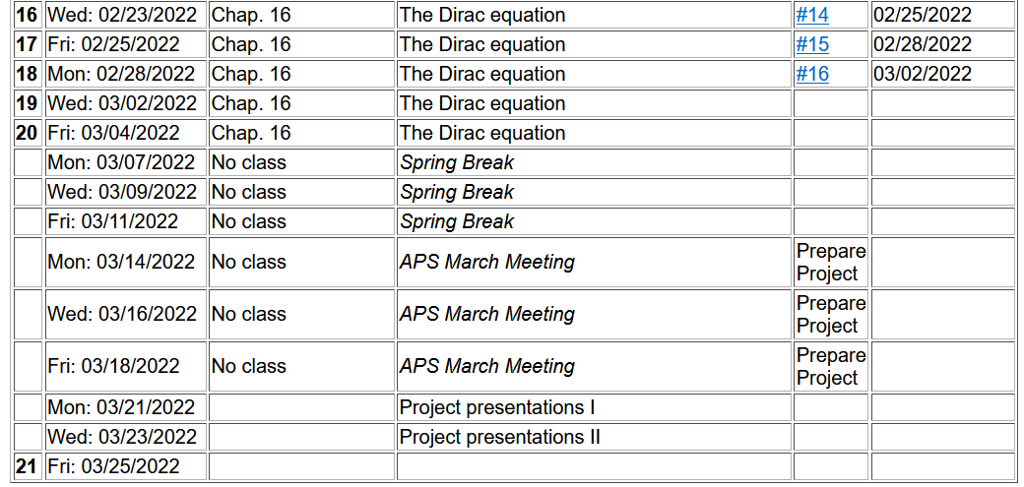

Slide 3
Dirac equation for electron in a scalar, spherically symmetric potential V(r)
We can
show that:

Slide 5
Summary of allowed combinations of eigenvalues
Alternatively

Slide 8
Dirac equation for electron in the field of a H-like ion
Comparison with Schrödinger equation --
Schematic diagram:
3d_{5/2}
κ=-3
3s,3p,3d
3p_{3/2},3d_{3/2}
κ= ± 2
3s_{1/2},3p_{1/2}
κ= ± 1
2s,2p
2p_{3/2}
κ=-2
2s_{1/2},2p_{1/2}
κ= ± 1
1s
1s_{1/2}
κ=-1

Slide 9
Physical differences due to Dirac equation on the H-like ions
α⁻¹=137.035999084
mc²=510998.950 eV

Slide 10
Physical differences due to Dirac equation on the H-like ions

Slide 11
Some details

Slide 12
More details about ground state of H-like ion from Dirac equation

Slide 13
Practical solution of radial portions of Dirac equation

Slide 14
More general treatment of bound states of Fermi particle within spherical potential V(r) -- continued

Slide 15
More general treatment of bound states of Fermi particle within spherical potential V(r) -- continued

Slide 16
More general treatment of bound states of Fermi particle within spherical potential V(r) -- continued

Slide 17
Note that eigenstates of J² have a degeneracy of 2J+1=2|κ|

Slide 18
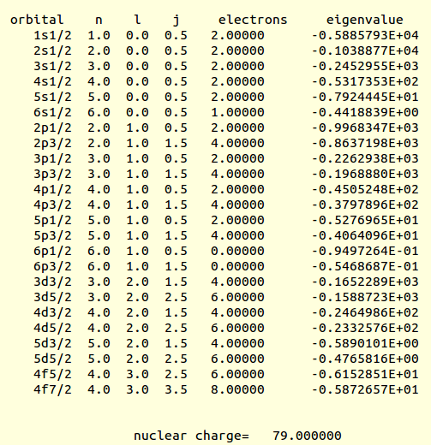
Example results for Au (from an old code)
(Ry units)

Slide 19
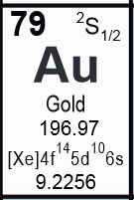
Numerical results for Au
n κ l occupancy E (Ry)
1 -1 0 2.0000000E+00 -5.9233999E+03 1s_{1/2}
2 -1 0 2.0000000E+00 -1.0443790E+03 2s_{1/2}
3 -1 0 2.0000000E+00 -2.4644922E+02 3s_{1/2}
4 -1 0 2.0000000E+00 -5.3440459E+01 4s_{1/2}
5 -1 0 2.0000000E+00 -7.9755620E+00 5s_{1/2}
6 -1 0 1.0000000E+00 -4.4827053E-01 6s_{1/2}
2 1 1 2.0000000E+00 -1.0016794E+03 2p_{1/2}
3 1 1 2.0000000E+00 -2.2723354E+02 3p_{1/2}
4 1 1 2.0000000E+00 -4.5251384E+01 4p_{1/2}
5 1 1 2.0000000E+00 -5.3102330E+00 5p_{1/2}
6 1 1 0.0000000E+00 -9.7322631E-02 6p_{1/2}
2 -2 1 4.0000000E+00 -8.6688708E+02 2p_{3/2}
3 -2 1 4.0000000E+00 -1.9749529E+02 3p_{3/2}
4 -2 1 4.0000000E+00 -3.8101322E+01 4p_{3/2}
5 -2 1 4.0000000E+00 -4.0844245E+00 5p_{3/2}
6 -2 1 0.0000000E+00 -5.5597043E-02 6p_{3/2}
3 2 2 4.0000000E+00 -1.6552601E+02 3d_{3/2}
4 2 2 4.0000000E+00 -2.4688226E+01 4d_{3/2}
5 2 2 4.0000000E+00 -5.9413837E-01 5d_{3/2}
3 -3 2 6.0000000E+00 -1.5913045E+02 3d_{5/2}
4 -3 2 6.0000000E+00 -2.3356823E+01 4d_{5/2}
5 -3 2 6.0000000E+00 -4.8110442E-01 5d_{5/2}
4 3 3 6.0000000E+00 -6.1354099E+00 4f_{5/2}
4 -4 3 8.0000000E+00 -5.8549892E+00 4f_{7/2}

Slide 20
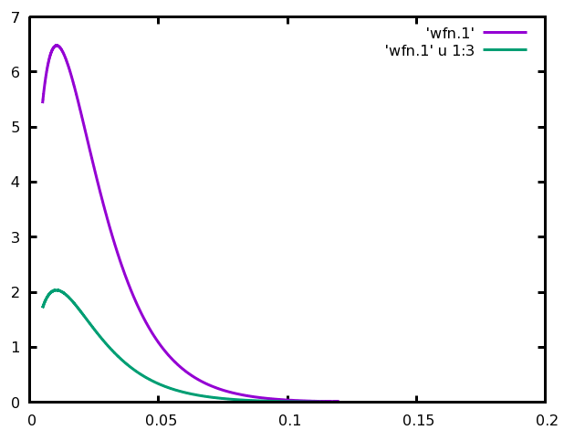
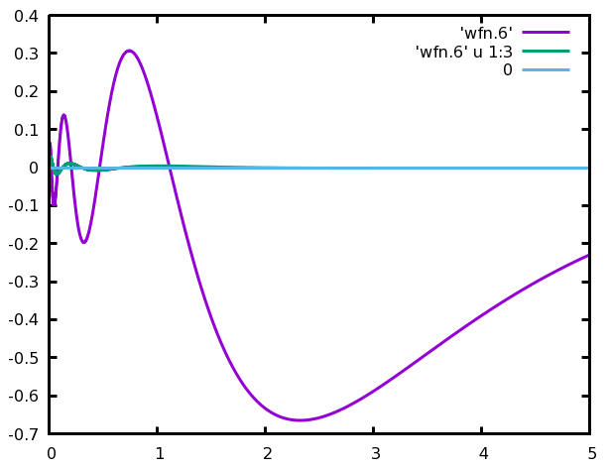
1s_{1/2}
G
For Au
F
6s_{1/2}
F
G

Slide 21
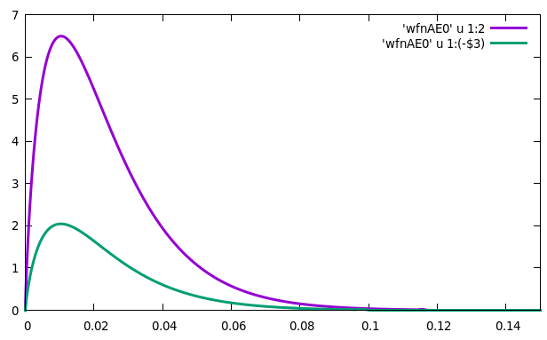
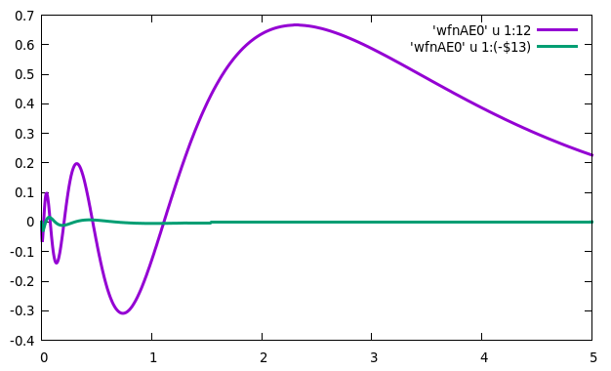
Radial wavefunctions for Au
G
G
1s_{1/2}
6s_{1/2}
F
F
r → (Bohr)
r → (Bohr)

Slide 22
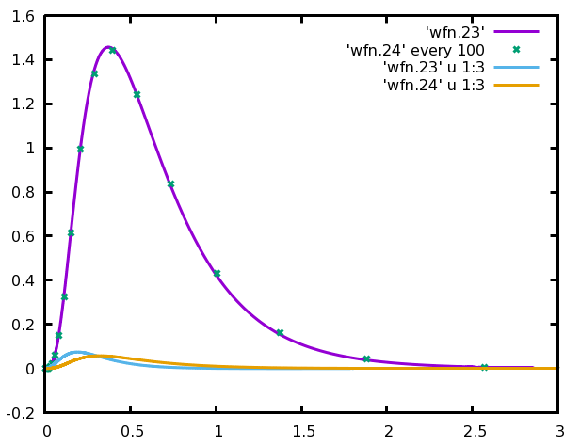
For Au
G_{4f5/2}
G_{4f7/2}
F_{4f5/2}
F_{4f7/2}

Slide 23
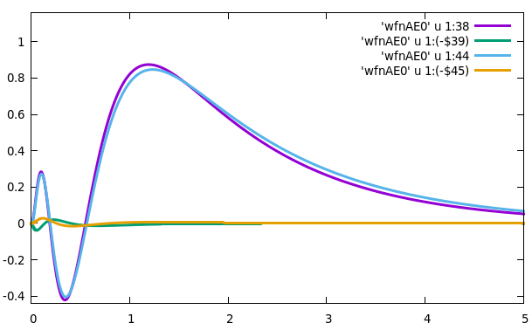
G_{5d3/2}
G_{5d5/2}
F
F

Slide 24
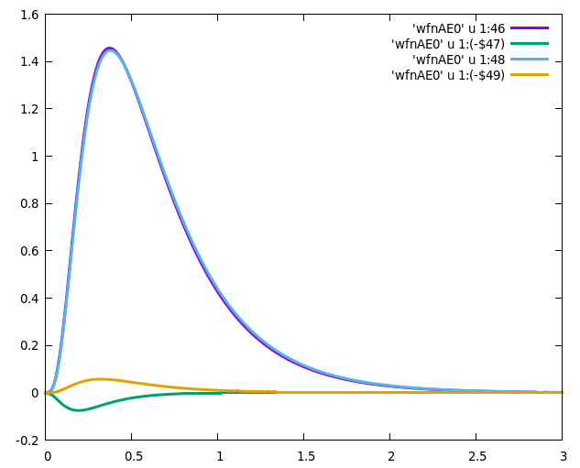
G_{4f5/2}
G_{4f7/2}
F
F

Slide 25
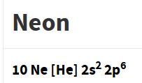
More general treatment of bound states of Fermi particle within spherical potential V(r) – continued
Some sample results within density functional theory
Ref. https://www.nist.gov/pml/data/results
Energy unit is “Hartree
1H= 27.21138602 eV
Non-relativistic
Relativistic
J=1/2
J=1/2
J=1/2
J=3/2
1s | -30.305855 |  | -30.314393
2s | -1.322809 |  | -1.326075
2p | -0.498034 |  | -0.500040 -0.496232

Slide 26
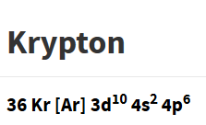
Non-relativistic
Relativistic
1s | -509.982989 |  | -517.456410
2s | -66.285953 |  | -68.209637
2p | -60.017328 |  | -61.753188 -59.789712
3s | -9.315192 |  | -9.639319
3p | -7.086634 |  | -7.347319 -7.057577
3d | -3.074109 |  | -3.032140 -2.984281
4s | -0.820574 |  | -0.851373
4p | -0.346340 |  | -0.361325 -0.33742
J=1/2
J=1/2
J=1/2
J=3/2
J=1/2
J=1/2
J=3/2
J=3/2
J=5/2
J=1/2
J=1/2
J=3/2

Slide 27
Comments on approximate relativistic effects returning to free particle equations --
Spin-orbit
Darwin term

