Slide 1
PHY 742 Quantum Mechanics II
12-12:50 PM MWF in Olin 103
Plan for Lecture 21
Quantization of the Electromagnetic fields
Review the “raising” and “lowering” operators presented in Professor Carlson’s textbook in Chapter 5: The Harmonic Oscillators and Chapter 17: Quantizing Electromagnetic Fields.
Review of the harmonic oscillator
Particle creation and annihilation operator formalism
Hamiltonian for the electromagnetic fields
Notes:
In the next few lectures, we will consider the “quantization” of the electromagnetic field, inspired by the detailed results of the analysis of the one dimensional harmonic oscillator.

Slide 2
Notes:
Note that there is one homework problem which hopefully you will be able to complete before the next lecture.

Slide 4
Review of the harmonic oscillator --
Why?
We like harmonic oscillators?
All of physics can be mapped into harmonic oscillators?
Physicists only know how to solve harmonic oscillator problems?
Harmonic oscillators inspire a new way of thinking about quantum mechanics?
Notes:
Do you like harmonic oscillators?

Slide 5
One-dimensional harmonic oscillator
Define:
Note that:
Notes:
This material is covered in Chapter V of your textbook. Presumably, you have previously derived these equations. Are they still true? At this point the operators a and a† seem to be “cute” curiosities?

Slide 6
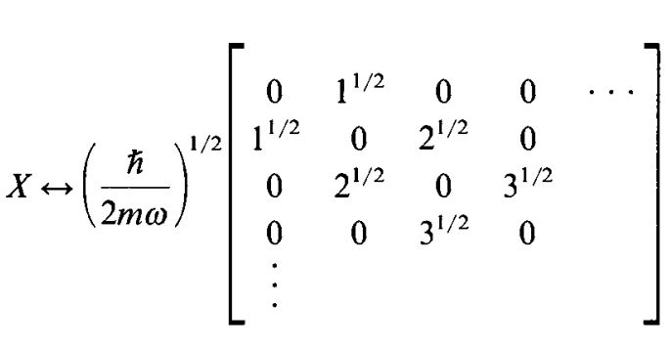
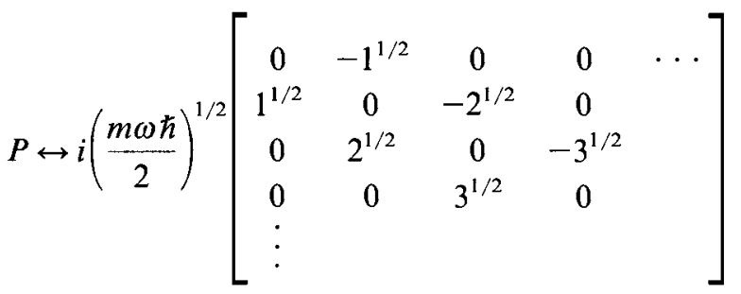
Representation of the position and momentum operators in terms of the energy eigenstates of the harmonic oscillator:
n= 0 1 2 3 …..
Notes:
It is convenient to evaluate the position and momentum operators in the basis of energy eigenstates of the harmonic oscillator denoted by the integer n.

Slide 7
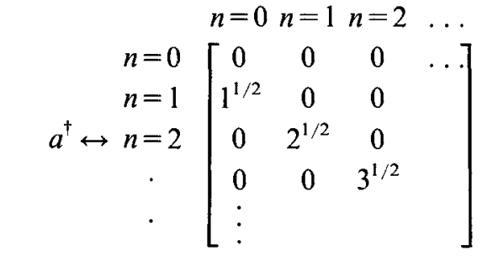
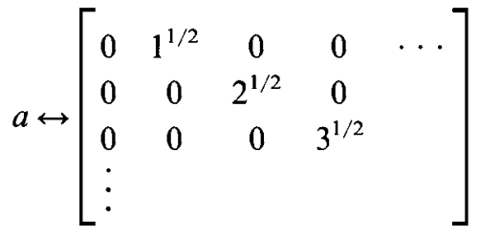
Representation of the raising and lowering operators in terms of the energy eigenstates of the harmonic oscillator:
Notes:
The a and a† operators can also be evaluated in this basis.

Slide 8
Notes:
These results are derived in detail in Chapter V. Make sure that they make sense to you.

Slide 9
Contributing to the discussion –
The creation and annihilation operators within the harmonic oscillator formalism seem to have been introduced by mathematical logic and found to have very interesting properties. In fact, as shown in Chapter 5, starting from the creation and annihilation operators, one can deduce the Harmonic Oscillator spectrum. These operators do not by themselves represent physical quantities and therefore do not “have” to be Hermitian. The matrix form of X and P in the basis of |n> is just one of many ways to represent these operators.
Further comments --
The harmonic oscillator states clearly have an associated quantum number n. It is convenient to call n a “phonon number” for the moment. We will generalize this notion in the context of electromagnetic fields.

Slide 10
How does this beautiful formalism lead to the notion of creation and annihilation operators?
➔We can “create” any phonon state from the ground state with this operator.
Notes:
The relations on this slide have no new information, but lead to a different way of thinking of the eigenstates of our system. In particular, the last equation shows that you build up a state with n phonons from state with 0 phonons. Ultimately, this leads to mapping the |0> phonon state with “vacuum” and implies that you can create an n phonon state out of vacuum.

Slide 11
Extension of these ideas to multiple independent harmonic oscillator modes
Here 1,2,..i,j… denotes an arbitrary index referencing distinct modes.
Later, we will see how this formalism has the capability of keeping track of symmetry/antisymmetry properties of multi particle systems.
Notes:
Up to now we have considered an isolated harmonic oscillator. The ideas can be extended to consideration of multiple independent and non-interacting modes at once. The formalism has some very interesting properties that we will use in this chapter and in several other chapters as well.

Slide 12
Maxwell’s equations
Notes:
Now – to the matter at hand – we need to consider electromagnetic waves and therefore need to review classical electromagnetic theory.

Slide 13
Recall the electromagnetic field energy --
It will be convenient to express Maxwell’s equations and the
electromagnetic field energy in terms of scalar and vector potentials:
Notes:
Ultimately, we will need the Hamiltonian for electromagnetic phenomena, and this will come for the electromagnetic field energy. It is convenient to express this in terms of the vector potential.

Slide 14
Further manipulations of Maxwell’s equations in terms of scalar and vector potentials --
zero in Lorenz gauge
Notes:
Here we are interested in the electromagnetic waves far from their sources.

Slide 15
Equations within the Lorenz gauge --
Note that this is one of many possible choices and it turns out to be convenient.
Notes:
The final equation here is expressed purely in terms of the vector potential.

Slide 16
Plane wave solutions to electromagnetic waves in terms of vector potentials
3 mutually perpendicular vectors
These are unit polarization vectors.
Notes:
From the equations for the vector potential, we find that there are two plane wave solutions with two different polarizations as indicated by the index σιγμα.

Slide 17
General form of vector potential as a superposition of plane waves:
Notes:
You should make sure that you are in agreement with the derivation of these equations.

Slide 18
Up to now, we have treated classical electromagnetic waves. Next time, we will consider the quantum treatment of the electromagnetic field energy ⬅➔ electromagnetic Hamiltonian
Notes:
Next time we will consider the experimental evidence that motivated consider of a quantized field and use the analogy with the Harmonic oscillator formalism to deduce the form of the quantization.

