Slide 1
PHY 742 Quantum Mechanics II
12-12:50 PM MWF in Olin 103
Plan for Lecture 22
Quantization of the Electromagnetic fields
Read Chapter 17: Quantizing Electromagnetic Fields from Professor Carlson’s.
Classical Hamiltonian for the electromagnetic fields
Quantum Hamiltonian for the electromagnetic fields
Photon eigenstates
Notes:
Historically, the notion of quantized radiation in the form of photons came very early in the development of quantum theory. Our task is to see how this quantization can be derived from the classical equations of Electrodynamics.

Slide 2
Notes:
This is the altered schedule. Note that there is one homework problem which hopefully you will be able to complete before the next lecture.

Slide 4
Notes:
The final equation here is expressed purely in terms of the vector potential.

Slide 5
Plane wave solutions to electromagnetic waves in terms of vector potentials
3 mutually perpendicular vectors
polarization unit vectors.
Notes:
From the equations for the vector potential, we find that there are two plane wave solutions with two different polarizations as indicated by the index σιγμα.

Slide 6
General form of vector potential as a superposition of plane waves:
Notes:
From the plane wave terms, we can simplify the form of the energy of the electromagnetic field.

Slide 7
Some details, with more care to use real functions --
Notes:
Here are some details of the derivation.

Slide 8
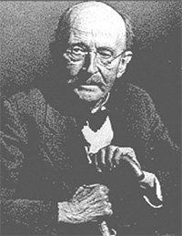
In the next slide, we will “jump” to quantizing the electromagnetic field using the analogy of the harmonic oscillator Hamiltonian. In fact, the analogy has nothing to do with the physics of the harmonic oscillator other than their particle symmetry as Bose particles.
Historical importance of the formula for Blackbody radiation
A blackbody means an idealized opaque (non-reflective) material which can absorb and emit electromagnetic radiation. If the body has an equilibrium temperature T, the energy associated with the blackbody is <U>. Using statistical mechanics and the assumption of quantized electromagnetic radiation, Planck showed that the black body internal energy and its distribution is given by in terms of frequency f:
Max Planck 1858-1947

Slide 9
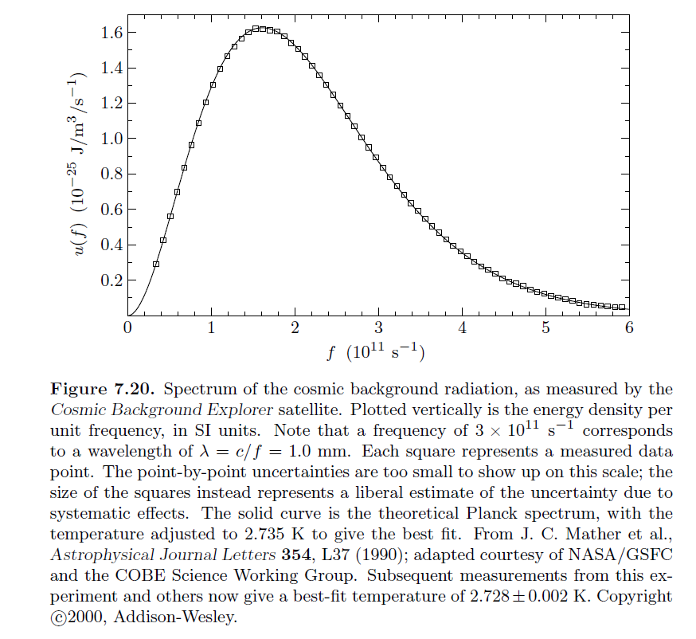
Figure from:
An Introduction to Thermal Physics, by Daniel V. Schroeder (Addison Wesley, 2000 and now Oxford University Press)
Showing frequency distribution of blackbody radiation from the big bang.

Slide 10
Big leap --
Notes:
Now consider how the EM field energy can be quantized, thinking in terms of the analogy of these equations to those of the Harmonic oscillator. We introduce a normalization factor and the creation and annihilation operators.

Slide 11
Uncontrolled energy shift
Notes:
Reviewing the commutation relations for the creation and annihilation operators. At the end, we do arrive at an expression that is very much like that of the Harmonic oscillator. However, in this case, the constant term causes trouble because it represents an uncontrolled energy. No problem. If it is unphysical it is strategically removed. Unfortunately, it will come back to bother us on occasion…

Slide 12
Some additional comments on the “fixed” solution --
Troublesome term
Comment: For the phonon case which served as our model, the notion of zero point motion makes physical sense. For the electromagnetic Hamiltonian the role of the equivalent concept is not quite clear (at least to me). We need to be careful when we see divergent energies to distinguish physical processes from mathematical issues.

Slide 13
Creation and annihilation operators:
Note: We are assuming that the polarization vector is real.
Notes:
With these definitions of the vector potential amplitudes, we can now write an expression for the quantum mechanical form of the vector potential.

Slide 14
Notes:
From the vector potential, we can also write expressions for the electric and magnetic fields.

Slide 15
What is the expectation value of the E field for a pure eigenstate |n> of the electromagnetic Hamiltonian?
A complex (non zero) number
Zero
Infinity
What is the expectation value of the B field for a pure eigenstate |n> of the electromagnetic Hamiltonian?
A complex (non zero) number
Zero
Infinity
➔In fact, these are non-trivial questions
Notes:
What do you think is going to happen?

Slide 16
At this point, we might wonder how the classical and quantum pictures of the EM field can be reconciled --
An interesting picture comes from a particular linear combination of quantum states of a single mode (kσ) arising for example in a laser

Slide 17
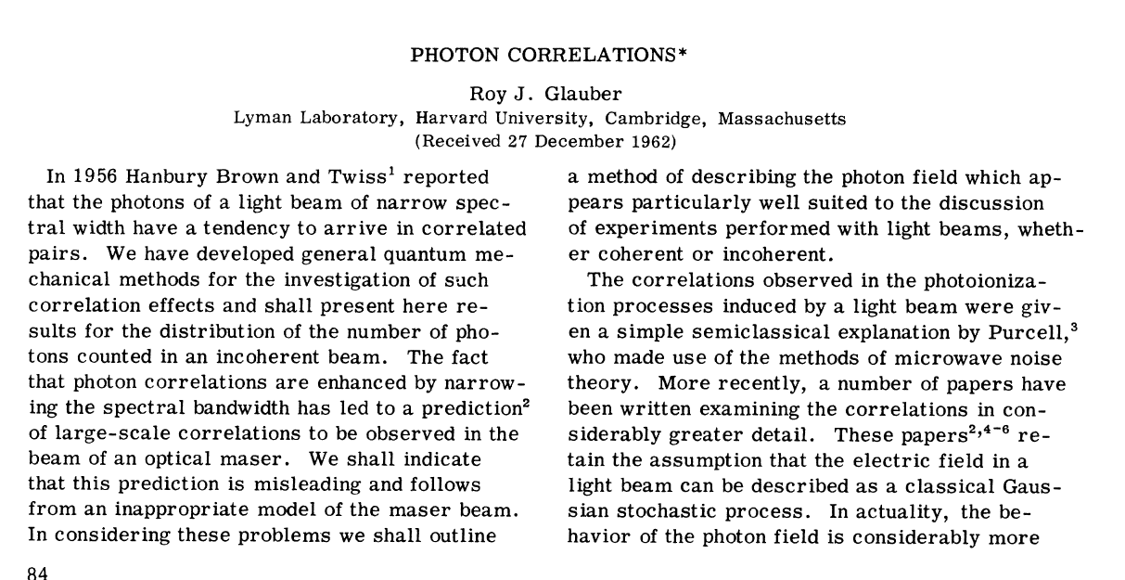
How does a quantum mechanical E or B field exist? Consider a linear combination of pure photon states --
Notes:
In this paper, the notion of a “coherent” state was introduced. As we will see, the expectation values of the electric and magnetic fields are non-zero for a system in a coherent state.

Slide 18
Notes:
It is possible to prove these identities (for HW #18).

