Slide 1
PHY 742 Quantum Mechanics II
12-12:50 PM MWF in Olin 103
Notes for Lecture 24
Interaction of quantum electromagnetic fields with matter
Read Professor Carlson’s textbook: Chapter 18. Photons and Atoms
Review of quantum theory of electromagnetism
Quantum treatment of the interaction of atoms and electromagnetic fields
Examples of atomic transitions
Some comments on lasers and masers
Notes:
This lecture re-examines the interaction of electromagnetic radiation with charged particles, now including the quantum effects of the fields. This material is treated in Professor Carlson’s text in Chapter 18 (A&B).

Slide 2
Notes:
There is not a new homework for this lecture.

Slide 3
Summary of quantum electromagnetism
Notes:
The is a review of equations discussed in Lecture 22 & 23

Slide 4
Properties of the creation and annihilation operators:
Note: We are assuming that the polarization vector is real. More generally there is a phase factor for each mode which we are ignoring at this moment.
Notes:
Continuing review of previous results.

Slide 5
Notes:
Review continued.

Slide 6
Previously (Lecture 14), we considered a charged particle in the presence of a classical electromagnetic field characterized by vector potential A and scalar potential U:
We used time dependent perturbation theory to analyze the effects of H¹
Notes:
Now consider the treatment of the interaction of a particle with a classical electromagnetic field as covered in Lecture 12.

Slide 7
Fermi Golden rule for the rate of transition between states I and f:
Notes:
Resonant time-dependent perturbation theory lead to Fermi’s Golden rule.

Slide 8
What is different about the quantum case?
Minor differences only for cases of very small or large EM fields?
New physics introduced?
Notes:
Please weigh in on this question.

Slide 9
What is different about the quantum case?
Notes:
Jumping into the quantum case, we need to modify the previous treatment by adding the Hamiltonian for the quantum electromagnetic field. We also need to use the electromagnetic potentials.

Slide 10
We can still use the Fermi Golden rule for transitions between two states of the zero order
system A⁰ ←→B⁰
(Here we are suppressing the time dependence which should also be taken into account.)
Notes:
Now the zero order Hamiltonian includes both the particle states and the photon states. In writing the matrix element, we leave the portions involving the particle states as in the classical treatment, but the photon states need also be evaluated.

Slide 11
Some details --
absorption
Notes:
First consider the case of the absorption. We see that the transition rate depends is proportional to the number of photons in the initial state.

Slide 12
More details --
emission
Notes:
Now consider the case of emission. The transition rate in this case is proportional to the number of photons in the initial state plus 1. What do you suppose is the significance of that.

Slide 13
What is different about the quantum case?
Classical EM field
Matrix element depends on atomic selection rules
Matrix element depends on EM field intensity
Quantum EM field
Matrix element depends on atomic selection rules
Matrix element depends on photon eigenstates; absorption different from emission
Possibility of spontaneous emission
Notes:
Here are some comments about the differences between the classical and quantum cases.

Slide 14
Summary of results --

Slide 15
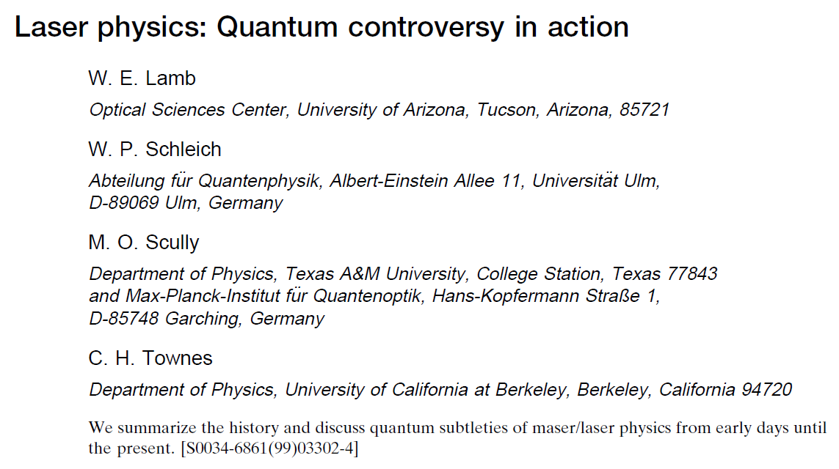
Lasers and Masers were developed to make use of the relationship between absorption and emission of EM radiation
Rev. Mod. Phys. 99, S263 (1999)
Notes:
The physics discussed here forms the basis of the laser technology. This is a historical retrospective of some of the ideas used to develop various laser types by some of the key players.

Slide 16
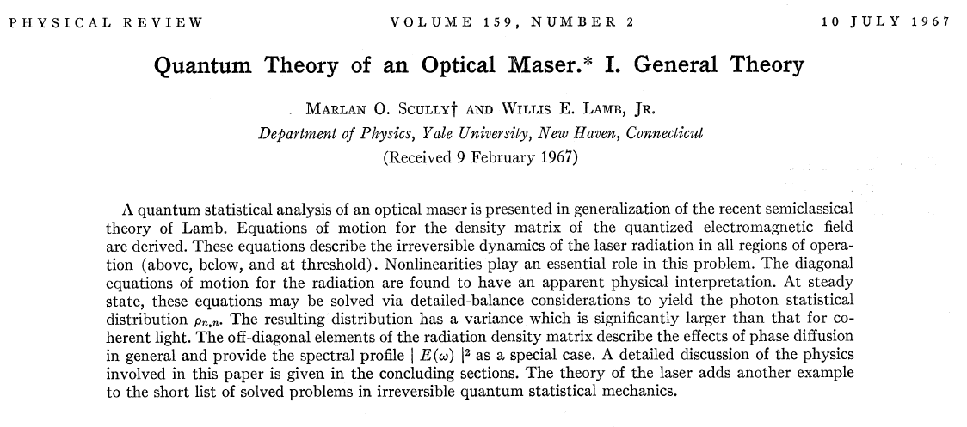
Phys. Rev. 159, 208 (1967)
Notes:
This is one of the early theory developments of laser physics. It is based on coupling the transition rate equations with rate equations for the photon populations in such a way as to achieve large field strengths.

Slide 17
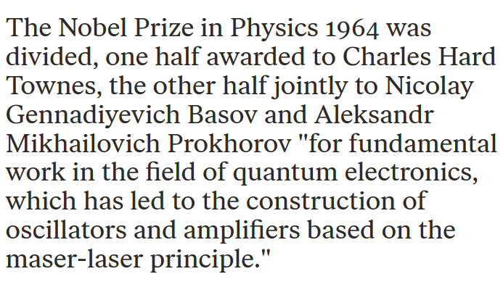

Slide 18
Summarizing thoughts --
These diverging terms reappear when we evaluate the variance of the E or B fields for a pure eigenstate of the EM Hamiltonian and is thought to be related to the notion of vacuum fluctuations.

Slide 19
More summarizing thoughts --
These coherent states are an example of linear combinations of pure EM eigenstates that represent features of observed electromagnetic properties.

