Slide 1
PHY 742 Quantum Mechanics II
12-12:50 AM MWF Olin 103
Notes for Lecture 26
Quantum mechanics of multiple particle systems
Continue reviewing Professor Carlson’s textbook: Chapter 10. Multiple particles (Sec. A&B)
Non-interacting particles
Second quantized formalism for Bose particles
Second quantized formalism for Fermi particles
Interaction terms
Notes:
In this lecture, we will continue our consideration of multiple particle systems which is discussed in Chapter 10 of your textbook. We continue to consider the ideal situation in which the multiple particles do not interact with each other.

Slide 2
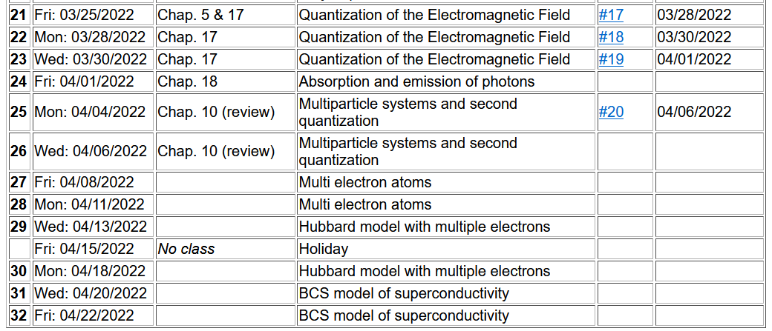
Tenative plan --

Slide 3
Quantum mechanical treatment of multiparticle systems
z
1
2
5
4
3
y
x
Notes:
This diagram illustrates a general system to be considered where N particles are described by N different coordinates. The lower case “h” is used to emphasize a single particle Hamiltonian.

Slide 4
Quantum mechanical treatment of multiparticle systems
Here we are using h(r) to denote single particle contributions.
Does not take into account particle symmetry.
Notes:
Here we summarize the equations from Lecture 25. The non-interacting total Hamiltonian can be written as a sum of single particle Hamiltonian terms.

Slide 5
Refinement of the results for treatment of distinguishable or indistinguishable particles
P=permutation operator
Notes:
Here we summarize the particle permutation properties of Fermi and Bose particles. Using the permutation operator.

Slide 6
Treating multiparticle systems using “second” quantization formalism
Notes:
Defining the basis eigenstates from the single particle Hamiltonian.

Slide 7
Treating multiparticle systems using “second” quantization formalism -- continued
Notes:
Introducing the notion of “second” quantization.

Slide 8
In general, the number operator can be expressed in terms of a product of two operators. For the case of Bose particles, these operators are very similar to the raising and lowering operators of the harmonic oscillator.
Notes:
Considering first the case of Bose particles.

Slide 9
Second quantization for Bose particles, continued
Notes:
For Bose particles, we can use the same relationships found for harmonic oscillators and for the quantized electromagnetic fields.

Slide 10
Second quantization for Fermi particles
Notes:
Now consider the case for Fermi particles.

Slide 11
These results follow from the anti commutator relations of the operators.
Notes:
These results follow from the anti-commutation relations. Your homework for this lecture is to verify these relationships.

Slide 12
Some details --

Slide 14
Note that the symmetry of the wavefunction is built into the formalism for Bose particles
Note that the antisymmetry of the wavefunction is built into the formalism for Fermi particles
Notes:
What do you think are the advantages/disadvantages of this second quantized formalism?

Slide 15
More general treatment of multiparticle system
interparticle interaction
Notes:
Next time, we will start to think about what happens when the particles interact.

Slide 16
Pros and Cons for using second quantization –
Pros –
Beautiful, compact, ….
Worthy of physicists …
Cons –
Does not really introduce new physics
Slater determinants and symmetrization/antisymmetrization operators are good enough

Slide 17
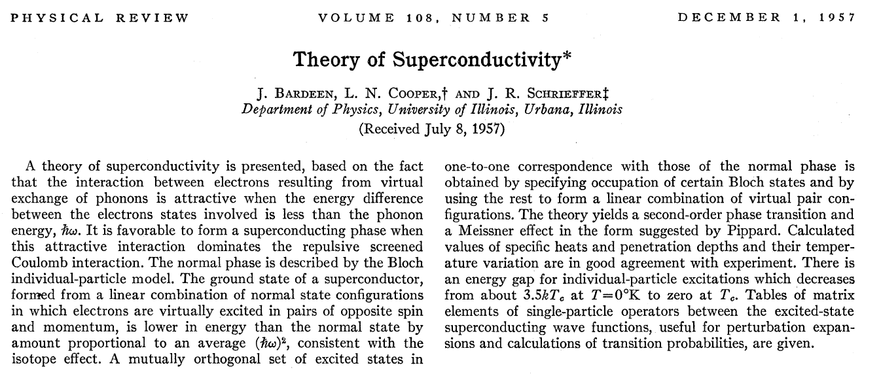
Historical paper and its use of second quantization --

Slide 18
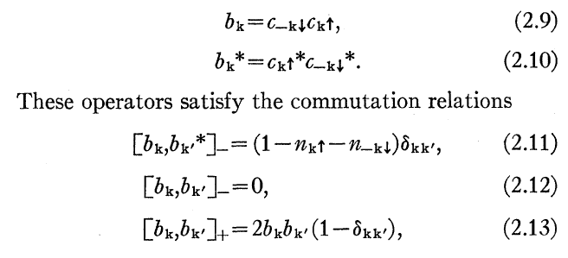
Model Hamiltonian for Cooper pairs (weakly paired electrons described by b_{k} which interact via the potential term --

Slide 19
Example of a multi-electron atom – He atom with 2 electrons and Z=2

Slide 20
What is missing?
Electron spin.
Electron spin does not appear in this Hamiltonian and therefore cannot effect the analysis?
Electron spin does not appear in this Hamiltonian but can have a profound effect on the analysis?

Slide 22
Spectrum of single particle states for He atom (schematic)
.
.
.

Slide 23
Ground state configuration for He atom
.
.
.

Slide 24
Expectation value of Hamiltonian for ground state of He atom

Slide 25
Expectation value of Hamiltonian for ground state of He atom

Slide 26
Now consider the interaction term

Slide 27
Expectation value of Hamiltonian for ground state of He atom

Slide 28
Evaluation of two particle term, continued
Why?
Next time, we will analyze this result and consider extension of the analysis to excited electronic states of He.
Notes:
To be continued….

