Slide 1
PHY 742 Quantum Mechanics II
12-12:50 AM MWF Olin 103
Notes for Lecture 27
Quantum mechanics of multiple particle systems
Atom example systems -- using second quantization formalism and focusing on Fermi particles
He atom in its ground state
He atom in an excited state
Other atomic systems -- multiplet splittings
Notes:
In this lecture, we will continue our discussion of multiparticle systems – particularly, multi electron atoms as examples

Slide 2
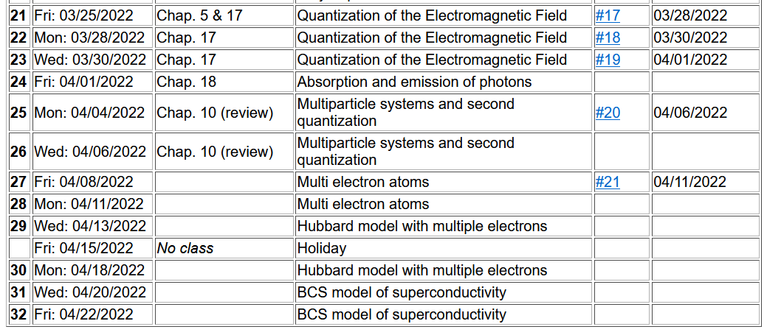

Slide 4
Review -- Multiparticle systems using “second” quantization formalism
Start with a basis of functions that can span the space of our multiparticle system. Typically, the basis functions are formed from single particle states.
Notes:
Defining the basis eigenstates from the single particle Hamiltonian.

Slide 5
Representing the single particle system within the basis:
Second quantization for Fermi particles described in this basis
Notes:
Introducing the notion of “second” quantization.

Slide 6
These results follow from the anti commutator relations of the operators.
Notes:
These results follow from the anti-commutation relations. Your homework for this lecture is to verify these relationships.

Slide 7
Some details --

Slide 8
From “first” quantization --
To “second” quantization --

Slide 9
More general treatment of multiparticle system (focusing on Fermions)
interparticle interaction
Notes:
Next time, we will start to think about what happens when the particles interact.

Slide 10
Example of a multi-electron atom – He atom with 2 electrons and Z=2

Slide 11
More complete considerations --

Slide 13
Spectrum of single particle states for He atom (schematic)
.
.
.

Slide 14
Ground state configuration for He atom
.
.
.

Slide 15
Expectation value of Hamiltonian for ground state of He atom

Slide 16
Expectation value of Hamiltonian for ground state of He atom

Slide 17
Now consider the interaction term

Slide 18
Expectation value of Hamiltonian for ground state of He atom

Slide 19
Evaluation of two particle term, continued
Why?
Notes:
To be continued….

Slide 20
Summary of results of ground state of He atom --
Note: HW21 asks you to evaluate these expressions and compare the results with a variational approach discussed in Lecture #1.

Slide 21
Discussion – how accurate is our treatment of the ground state of the He atom?
We get a numerical result – it must be correct.
The variational approach used in Lecture 1 was more accurate.
If (b) is the conclusion – what is the problem with the second quantization approach?
It should only be used for qualitative analysis
Second quantization approach is in principle exact, but we can improve our solution.

Slide 22
Continuing our example of He as an illustration of the second quantization formalism, but using simple expectation values --
He atom (Z=2) in terms of single particle states representing excited configurations
2s
2s
1s
1s

Slide 23
Digression of atomic term notation
2s
1s

Slide 24
What should we do?
Use one or the other?
Use linear combination of both solutions?
2s
Actually, in this case, we can use our knowledge of addition of angular momentum to know that
For S=0, the spatial part of the 2 particle wavefunction is symmetric in particle exchange.
1s

Slide 25
In this case, our knowledge of addition of angular momentum to know that
For S=1, the spatial part of the 2 particle wavefunction is antisymmetric in particle exchange.
2s
1s

Slide 26
Summary of results for excited state He atom in this approximation

Slide 27
