Slide 1
PHY 742 Quantum Mechanics II
12-12:50 PM MWF Olin 103
Plan for Lecture 28
Quantum mechanics of a multi electron atom
Using second quantization formalism together with material from Professor Carlson’s textbook: Chapter 10. Multiple particles (Sec. F) and also Chapter 8. Spin and Adding Angular Momentum (Sec. C)
    Review of what we have learned so far
    General discussion of atomic term analysis
    Examples and comparison with NIST atomic database

Slide 2
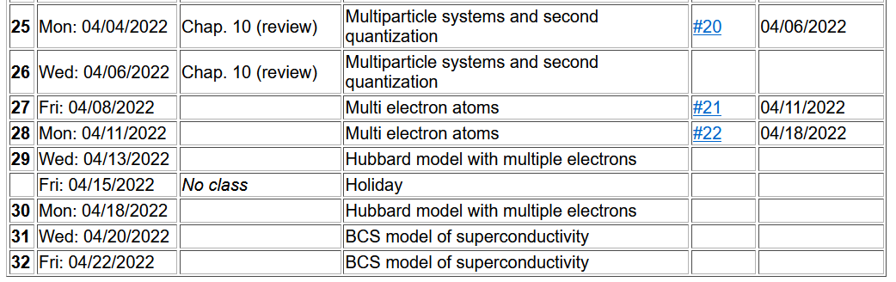
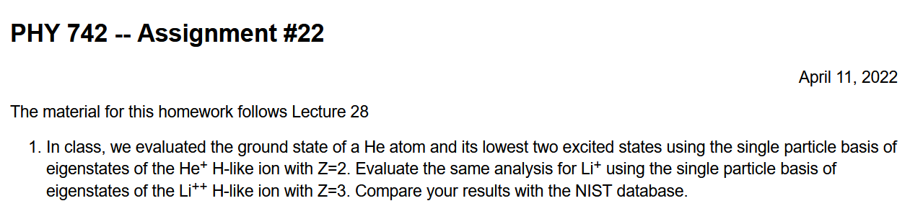

Slide 3
Focusing on multielectron systems --

Slide 4
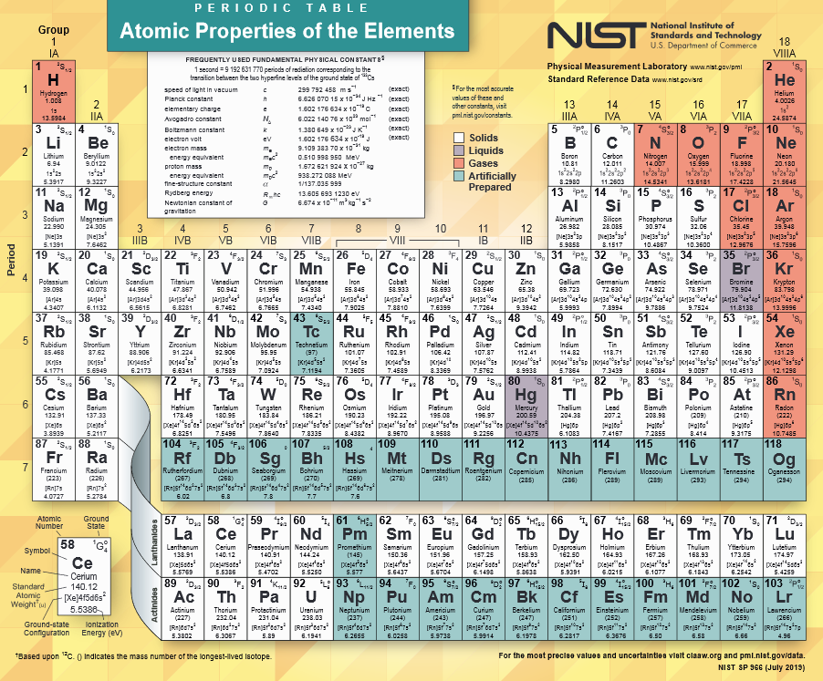
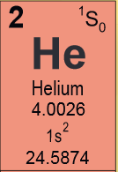
https://www.nist.gov/system/files/documents/2019/12/10/nist_periodictable_july2019_crop.pdf
Notes:
In principle, we can calculate the electronic structure for any atom in the periodic table. Last time we considered the ground state of the He atom.

Slide 5
Notes:
Setting up the basis for the problem. In fact the analysis is equivalent to a first order perturbation theory for the interaction term v.

Slide 6
Notes:
Defining single particle and two particle interaction terms within the second quantization formalism.

Slide 7
Ground state configuration for He atom
.
.
.
Notes:
Consider first the lowest energy state of this system.

Slide 8
Summary of results
Notes:
What is the total electron spin of this He atom?

Slide 9
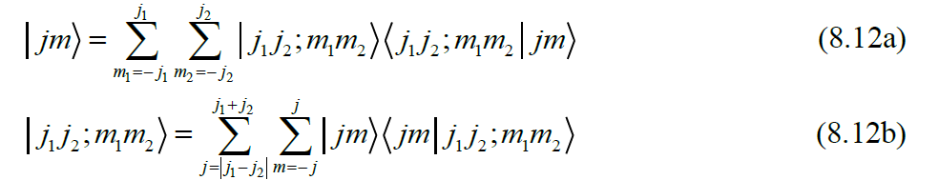
While the ground state of the He atom is a very simple case, it illustrates the general properties of many electron atoms in a spherical environments. Because of the spherical symmetry, total angular moment of the system is conserved. If we assume that spin-orbit interactions are negligible, then total spin angular momentum and total orbital angular momentum are each separately conserved. Please review Chapter 8 of your textbook to know how to “add” angular momentum using Clebsch-Gordan coefficients.
Notes:
This material is covered in Chapter 8 of your textbook.

Slide 10
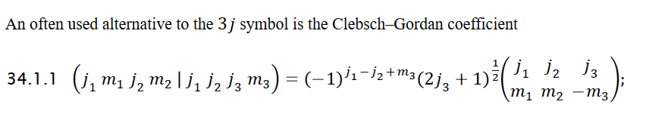
Note, for practical calculations of Clebsch-Gordan coefficients, a good source is NIST’s DLMF -- https://dlmf.nist.gov/34.1
Professor Carlson also has a working maple script on his website.
For the spherical atom without spin-orbit coupling, the total spin angular momentum S and the total orbital angular momentum L are both conserved. The atomic term notation is

Slide 11
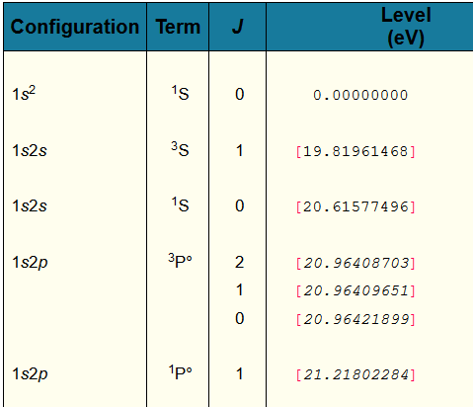
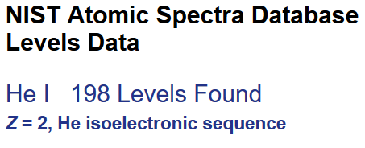
Example from NIST
Notes:
The atomic spectra of all of the elements have been well studied over the years and NIST has collected the data in the form of a table of atomic energy levels such as shown here for He. The ground state of each atom is chosen as the zero of energy. In this case, the lowest energy excitations are at higher energy by at approximately 20 eV or more.

Slide 12
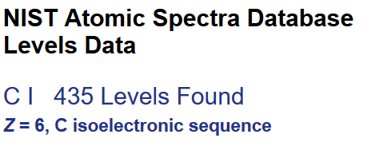
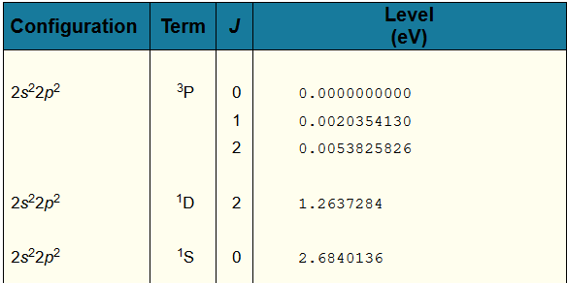
Example from NIST
Notes:
The atomic levels of C are very interesting. For the ground state configuration of 1s^2 2s^2 2p^2, we see that there are different arrangements leading to 3 different atomic terms. The lowest term has the designation ^3P while the highest term has the designation ^1S, having an energy 2.84 eV higher.

Slide 13
Back to the discussion of He
Ground state:
.
.
.
Notes:
This slide summarizes the analysis of the ground state wavefunction.

Slide 14
Digression -- How do we know that the total spin of this state is S=0?
Clearly M_{S}=0 -- but do we really know that S=0?
  We don’t know
  We know because ??
Notes:
What do you think?

Slide 15
Back to the discussion of He
A possible excited state:
.
.
.
Notes:
Now consider a possible excited state. Notice that the spin degeneracy is specified as 3, while only one spin configuration is mentioned. What can explain this?

Slide 16
Energy estimate of the ³S excited state of He
Notes:
This follows the analysis we discussed in Lecture 27.

Slide 17
Notes:
Writing the spatial parts of the matrix elements in a way that we can evaluate them.

Slide 18
Notes:
Explicit formulas for He evaluated using Maple.

Slide 19
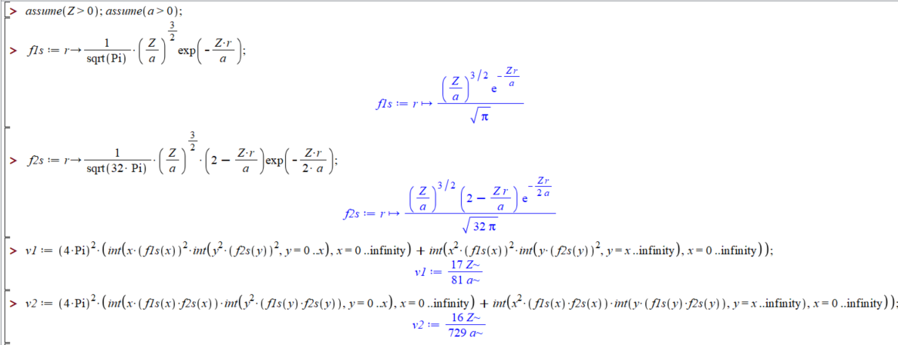
Maple script for evaluating integrals --
Notes:
Maple script for this case.

Slide 20
Summary of results for excited state:
.
.
.
Notes:
Summary of the results just analyzed.

Slide 21
Consider another excited state of He
  While these two states are orthogonal to each other, they are mixed by the Hamiltonian, so we must consider them together
.
.
.
.
.
.
Notes:
Now consider a different excited state configuration, this time with total spin projection M_{S}=0. In this case, there are two configurations that we need to consider together.

Slide 22
Consider another excited state of He -- continued
Notes:
Evaluating the Hamiltonian in the A and B basis.

Slide 23
Consider another excited state of He – continued
Since the two states are mixed by the Hamiltonian, we need to consider their linear combination:
Notes:
Summary of results.

Slide 24
Consider another excited state of He – continued
One solution:
Another solution:
Notes:
How do we really understand how to separate out the singlet and triplet state for this case?

Slide 25
Summary of analysis of ground state and lowest excited states of He atom
Single particle states
Two particle states
(first order perturbation)
Energies
Calc. (eV) NIST (eV)
19.4 20.6
17.0 19.8
0.00 0.00
Notes:
Summary of the numerical results. Do you call this success? How could the calculation be improved?

Slide 26
What do you think about these results
  Very discouraging
  Very encouraging
  Needs more work
Other formulations
  Form basis functions that are eigenfunctions of total spin
    Eigenfunctions of total spin may be symmetric or antisymmetric wrt particle exchange.
Sym Anti
Anti Sym
or

Slide 27
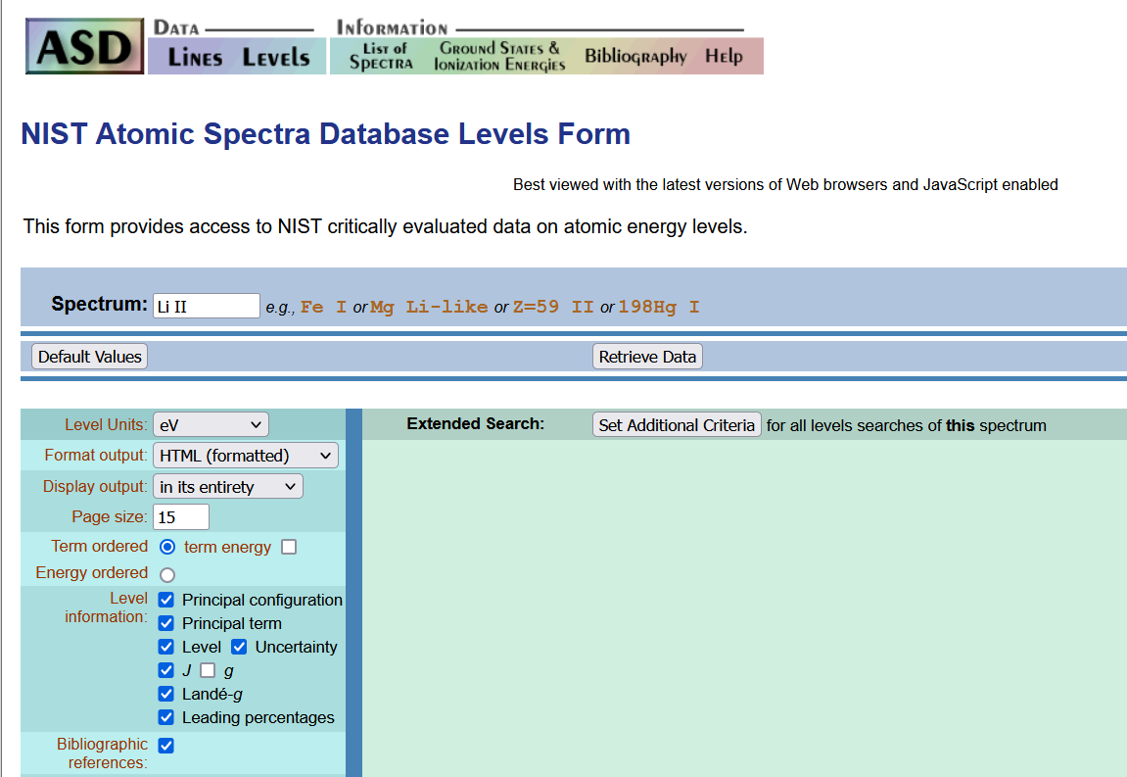
https://physics.nist.gov/PhysRefData/ASD/levels_form.html

Slide 28
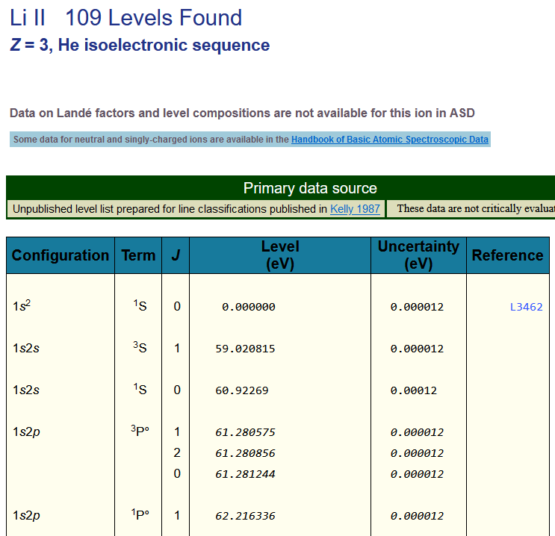
What do you expect to be the atomic term for the lowest energy of Li I?

Slide 29
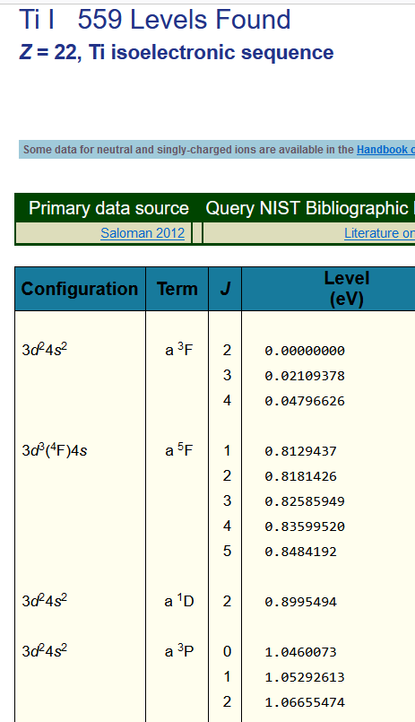
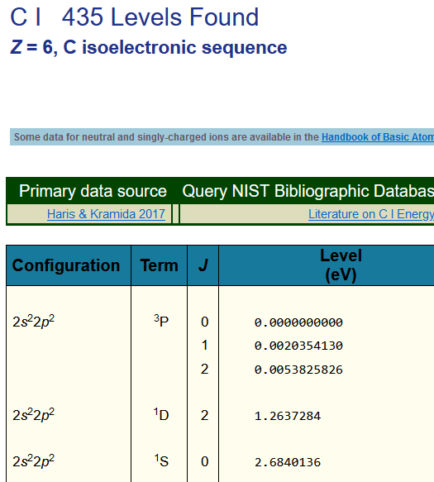
Examples of atoms in their ground state with complicated multiplet term splittings

