Slide 1
PHY 742 Quantum Mechanics II
12-12:50 PM MWF Olin 103
Plan for Lecture 29
Quantum mechanics of a multi electron atom
Analysis of atomic term splittings
Energy of closed shells
1 electron outside a closed shell
2 electrons outside a closed shell

Slide 3
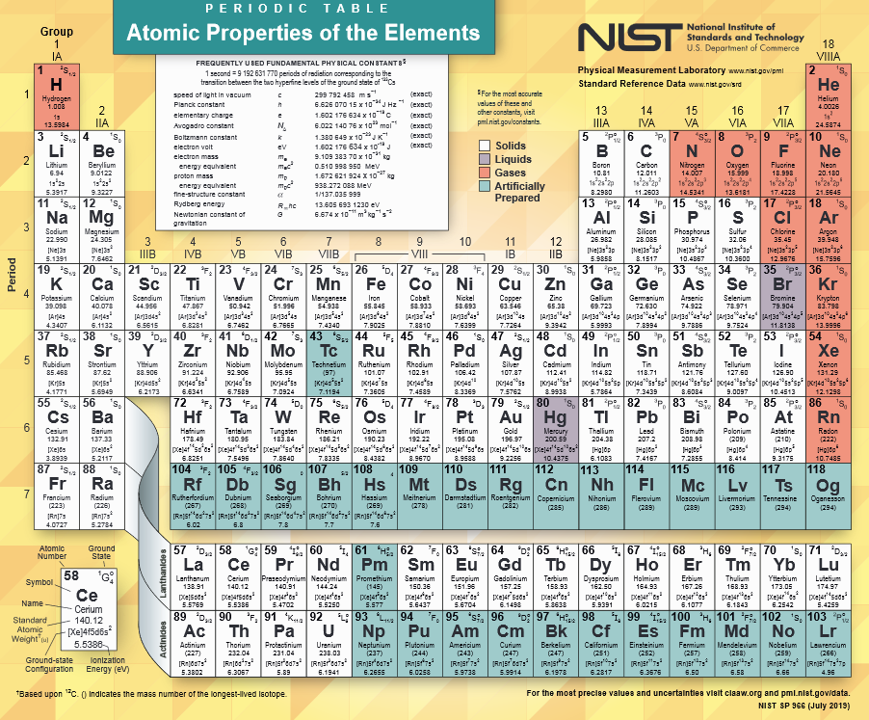
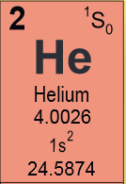
https://www.nist.gov/pml/periodic-table-elements
Closed shell
Notes:
In principle, we can calculate the electronic structure for any atom in the periodic table. Last time we considered the ground state of the He atom which is a “closed shell”.

Slide 4
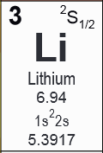
One electron outside a closed shell

Slide 5
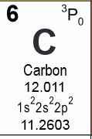
2 electrons outside a closed shell

Slide 6
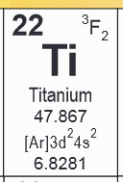
2 electrons outside a closed shell

Slide 7
In this discussion, we focus our attention on the multiplet structures of atoms in their ground states, where the zero order structure is described in terms of the single particle Hamiltonian. For this discussion, the single particle Hamiltonian is a H-like ion with nuclear charge Z. As you can imagine, the numerical errors increase as Z increases. However, the qualitative features remain correct. The numerics can be improved by defining other single particle Hamiltonians. For example, density functional Hamiltonians work quite well in this context.
DEFINITION: Closed shell configuration means that for any given “shell” with orbital angular momentum quantum number l, there are 2(2l+1) electrons occupying that shell.
For example: ns² np⁶ nd¹⁰ nf¹⁴

Slide 8
General form Hamiltonian for N-electron atom
1
2

Slide 9
Review of ground state of He atom (example of closed shell system)
Notes:
Setting up the basis for the problem. In fact the analysis is equivalent to a first order perturbation theory for the interaction term v.

Slide 10
Ground state configuration for He atom
.
.
.
Notes:
Consider first the lowest energy state of this system.

Slide 11
Summary of results
Notes:
What is the total electron spin of this He atom?

Slide 12
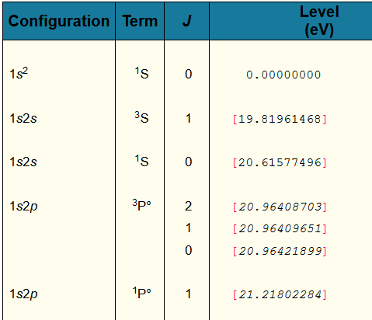
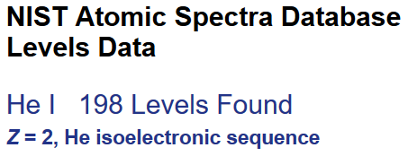
Example from NIST
https://physics.nist.gov/PhysRefData/ASD/levels_form.html
Notes:
The atomic spectra of all of the elements have been well studied over the years and NIST has collected the data in the form of a table of atomic energy levels such as shown here for He. The ground state of each atom is chosen as the zero of energy. In this case, the lowest energy excitations are at higher energy by at approximately 20 eV or more.

Slide 13
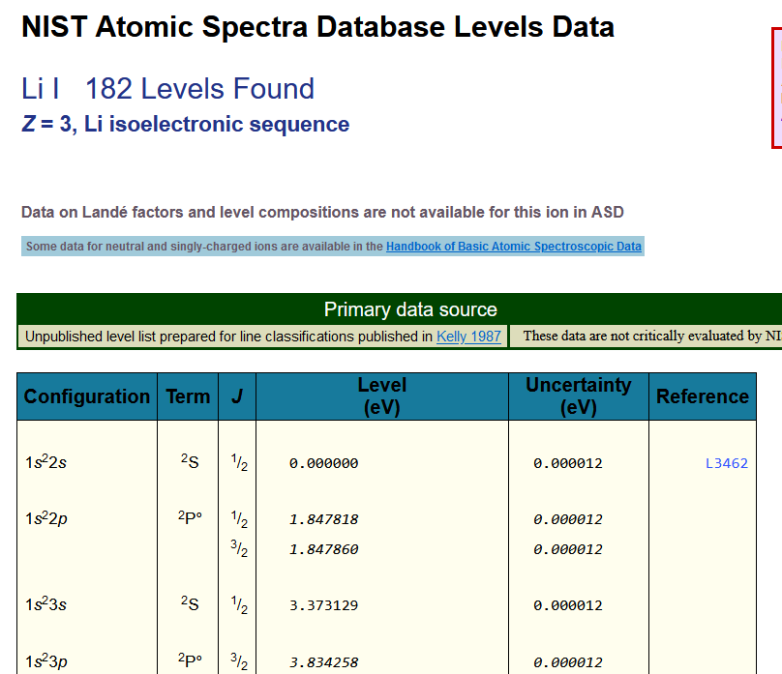
Example of atom with one electron outside complete shell

Slide 14
In order to analyze these atoms – we need to be able to evaluate the electron interactions
These angular terms have been tabulated by Condon and Shortley and others

Slide 15
Here, the angular integrals are given in terms of Gaunt Coefficients and 3j symbols:

Slide 16
Digression on angular relationships --
“Addition” of angular momentum
3-j
Clebsch-Gordan
link to more information:
http://dlmf.nist.gov/34.1

Slide 17
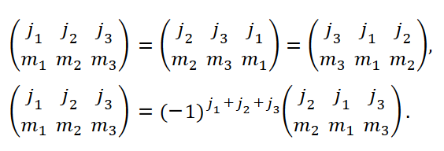
Some symmetry properties of 3-j symbols:

Slide 18
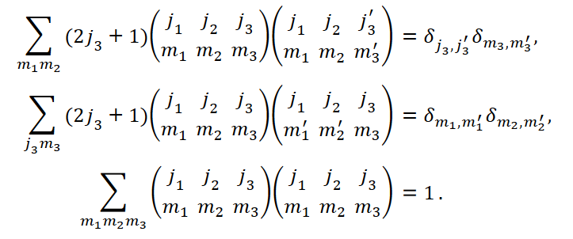
Some orthogonality properties of 3-j symbols:

Slide 19
Relationship of 3-j symbols to integrals over spherical harmonics and related functions
Gaunt Coefficient

Slide 20
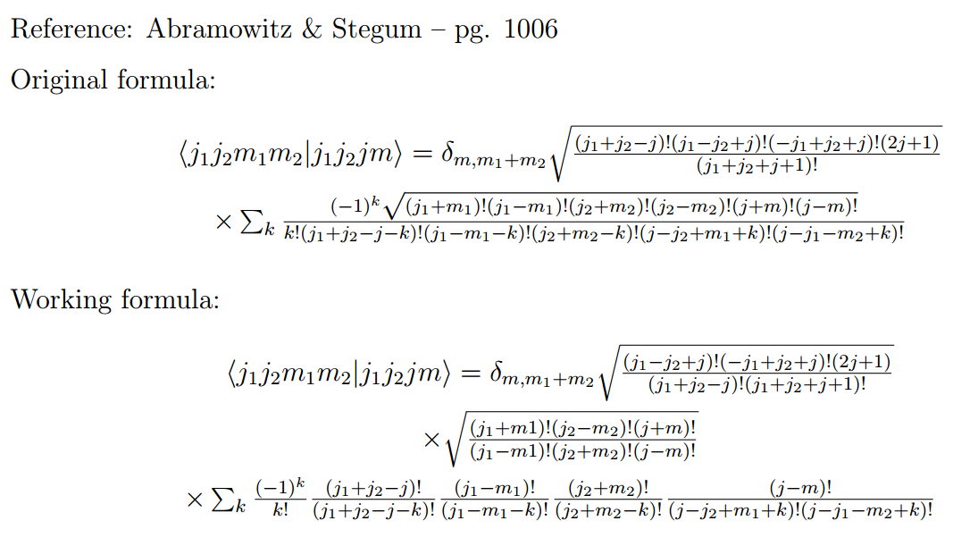
Explicit formula for Clebsch-Gordon coefficients:

Slide 22
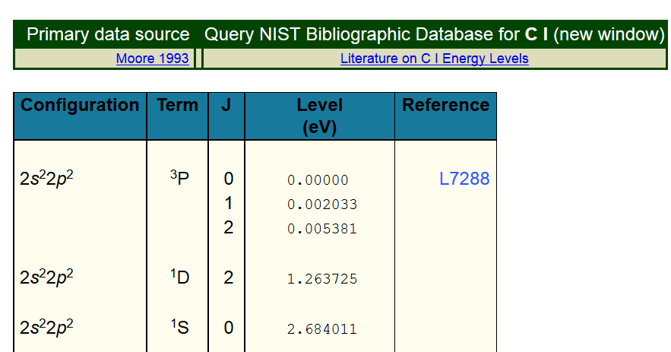
Consequences of orbital coupling on energies of multi-electron atoms
Example C 1s² 2s² 2p²
https://physics.nist.gov/PhysRefData/ASD/levels_form.html

Slide 23
Atomic term notation:
For the example of the single particle configuration
np²
L symbol spin for 2 electrons
--------------------------------------------
0 S S=0
1 P S=1
2 D S=0
In this case, it happens that L+S=even
why?

Slide 24
Example for C 1s² 2s² 2p²

Slide 25
Example for ¹D state

Slide 28
Taking into account anti-symmetry of two-particle wavefunction

Slide 29
Must be anti-symmetric
S=1, symmetric
degeneracy:
2S+1=3
S=0,
anti-symmetric
degeneracy:
2S+1=1

Slide 30
Extending these arguments, Condon and Shortley concluded that in general L+S=even
➔Valid atomic terms for Carbon:

Slide 31
Summary of results for analysis of atomic term energies
single electron terms
electron-electron interaction

Slide 32
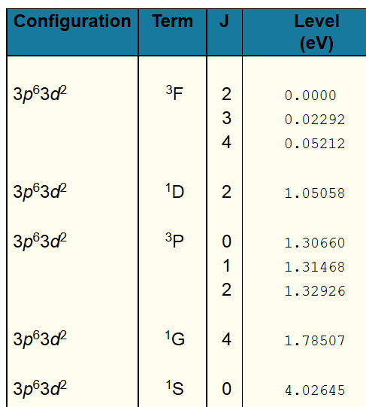
Another example – Ti⁺² (1s² 2s² 3s² 2p⁶ 3p⁶ 3d²)
Note that for simplicity, the outer 4s² electrons have been removed.
From NIST:
45 pairs of single particle states → 5 atomic terms

