Slide 1
PHY 742 Quantum Mechanics II
12-12:50 PM MWF Olin 103
Plan for Lecture 30
Quantum Mechanics of the Hubbard Model
Motivation and history of model
Two-site example
N-site example in one-dimension

Slide 3
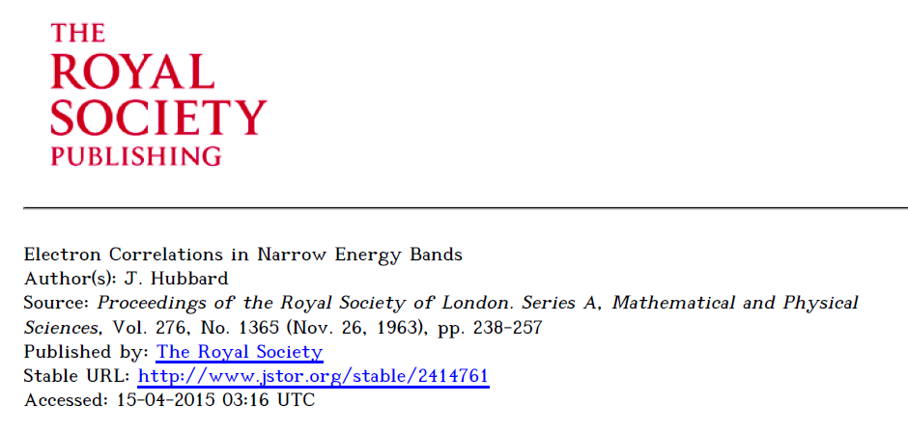
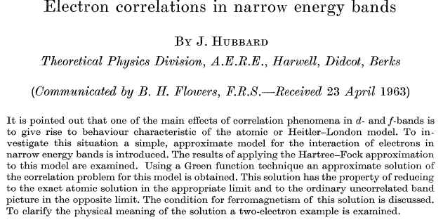

Slide 4
The Hubbard Hamiltonian:
single particle contribution
two particle contribution

Slide 5
l = 1 2 3 4
Possible configurations of a single site

Slide 6
Hubbard model -- continued
t represents electron “hopping” between sites, preserving spin
U represents electron repulsion on a single site

Slide 7
Two-site Hubbard model

Slide 8
➔
1 2
1 2

Slide 9
Two-site Hubbard model

Slide 10
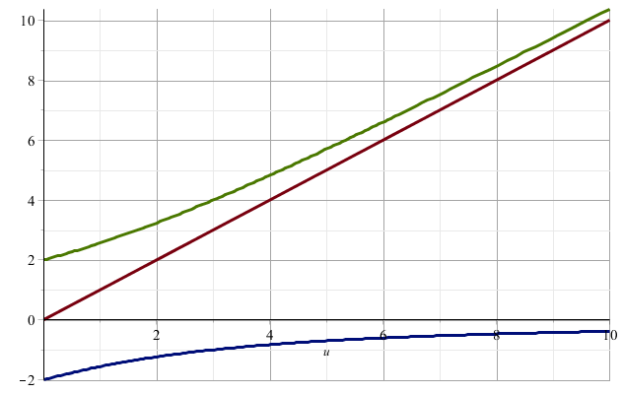
Eigenvalues of the 2-site Hubbard model
E/t
U/t

Slide 11
Two-site Hubbard model
Ground state of the two-site Hubbard model
Single particle limit (U →0)

Slide 12
Two-site Hubbard model
Single particle limit (U →0)
Full spectrum for spin 0 eigenstates
Single particle picture:
+t
E₁
E₂
E₃
-t

Slide 13
N-site system in one dimension
Solved analytically in 1968 Extension to 2 and 3 dimensions has remained elusive…..
https://doi.org/10.1103/PhysRevLett.20.1445 https://doi.org/10.1103/PhysRevLett.21.192.2
https://doi.org/10.1016/S0378-4371(02)01785-5 reminiscence and proofs

Slide 14
Consider the single particle term --
Here we imagine that the basis functions for a site n are localized on that site – Wannier functions --
Now we assume that we have N electrons (N →ꝏ) and that all of the states have equal probability of being on any of the sites.

Slide 15
…
…
These are only two examples of possible wavefunctions, all of which have have different energies
Systematic approach using Bloch symmetry --

Slide 18
Single particle eigenstates --

Slide 19
Single particle contributions --
ε_{k}/t=2
ε_{k}/t=0= ε_{F}/t
k
ε_{k}/t=-2
k=−π/a
k=π/a

Slide 20
Treatment of the full one-dimensional Hubbard model -- using the Bloch basis --

Slide 21
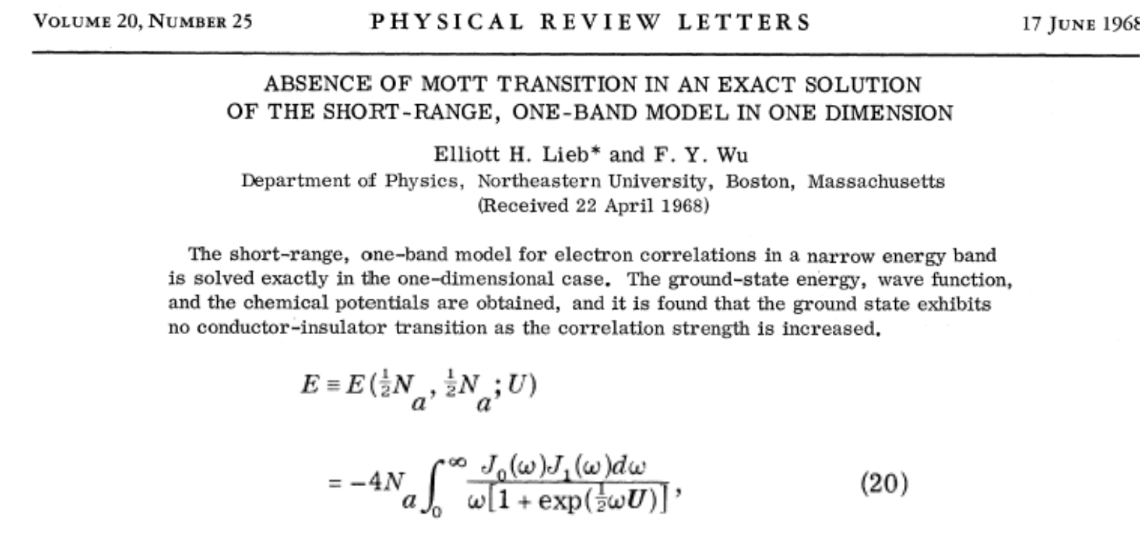
Exact solution --

Slide 22
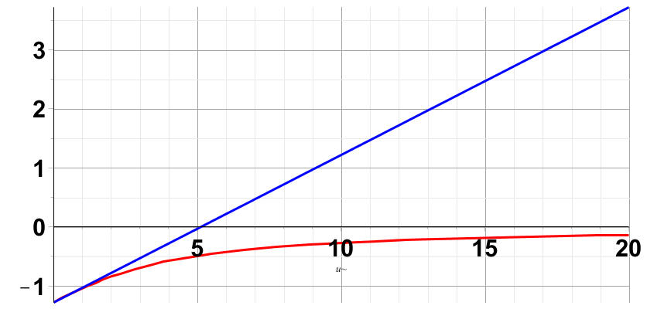
Evaluation of exact model in comparison with Hartree-Fock approximation
Hartree-Fock
Exact

Slide 23
Some details of Hartree-Fock approximation, first using 2-site, 2 electron example --

Slide 24
Two-site Hubbard model -- Hartree-Fock approximation
Variational search for lower energy solutions

Slide 25
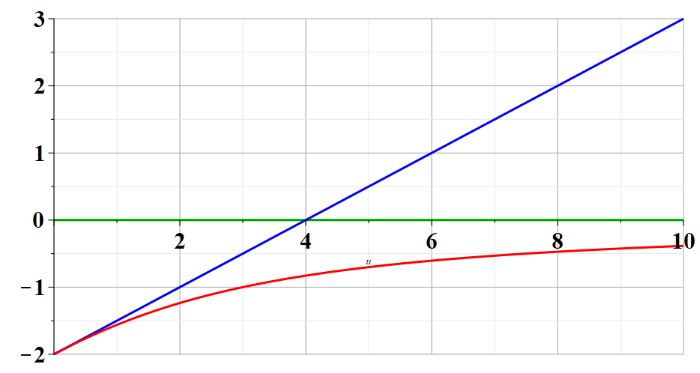
Comparison of 2-site Hubbard model – solutions for ground state --
Hartree-Fock – spin 0
E/t
Hartree-Fock – spin 1
Exact
U/t

Slide 26
Some details of the Hartree-Fock treatment of the full one-dimensional Hubbard model --
In the k-basis, the Hubbard model takes the form:

Slide 27
note that k_{F}=π/(2a)

Slide 28
Evaluation of exact model in comparison with Hartree-Fock approximation
Hartree-Fock
Exact
U/t
To be continued…

