Slide 1
PHY 742 Quantum Mechanics II
12-12:50 PM MWF Olin 103
Plan for Lecture 31
Quantum Mechanics of the Hubbard Model
Summary of results for one-dimensional periodic system
Simple Hartree-Fock solution
More complicated Hartree-Fock solutions
Comment about solutions in higher dimensions
LDA+U formalism

Slide 3
The Hubbard Hamiltonian:
single particle contribution
two particle contribution

Slide 4
N-site system in one dimension
Solved analytically in 1968 Extension to 2 and 3 dimensions has remained elusive…..
https://doi.org/10.1103/PhysRevLett.20.1445 https://doi.org/10.1103/PhysRevLett.21.192.2
https://doi.org/10.1016/S0378-4371(02)01785-5 reminiscence and proofs

Slide 5
Consider the single particle term --
Here we imagine that the basis functions for a site n are localized on that site – Wannier functions --
Now we assume that we have N electrons (N →ꝏ) and that all of the states have equal probability of being on any of the sites.

Slide 6
…
…
These are only two examples of possible wavefunctions, all of which have have different energies
Systematic approach using Bloch symmetry --

Slide 9
Single particle eigenstates --

Slide 10
Single particle contributions --
ε_{k}/t=2
ε_{k}/t=0= ε_{F}/t
k
ε_{k}/t=-2
k=−π/a
k=π/a

Slide 11
Treatment of the full one-dimensional Hubbard model -- using the Bloch basis --

Slide 13
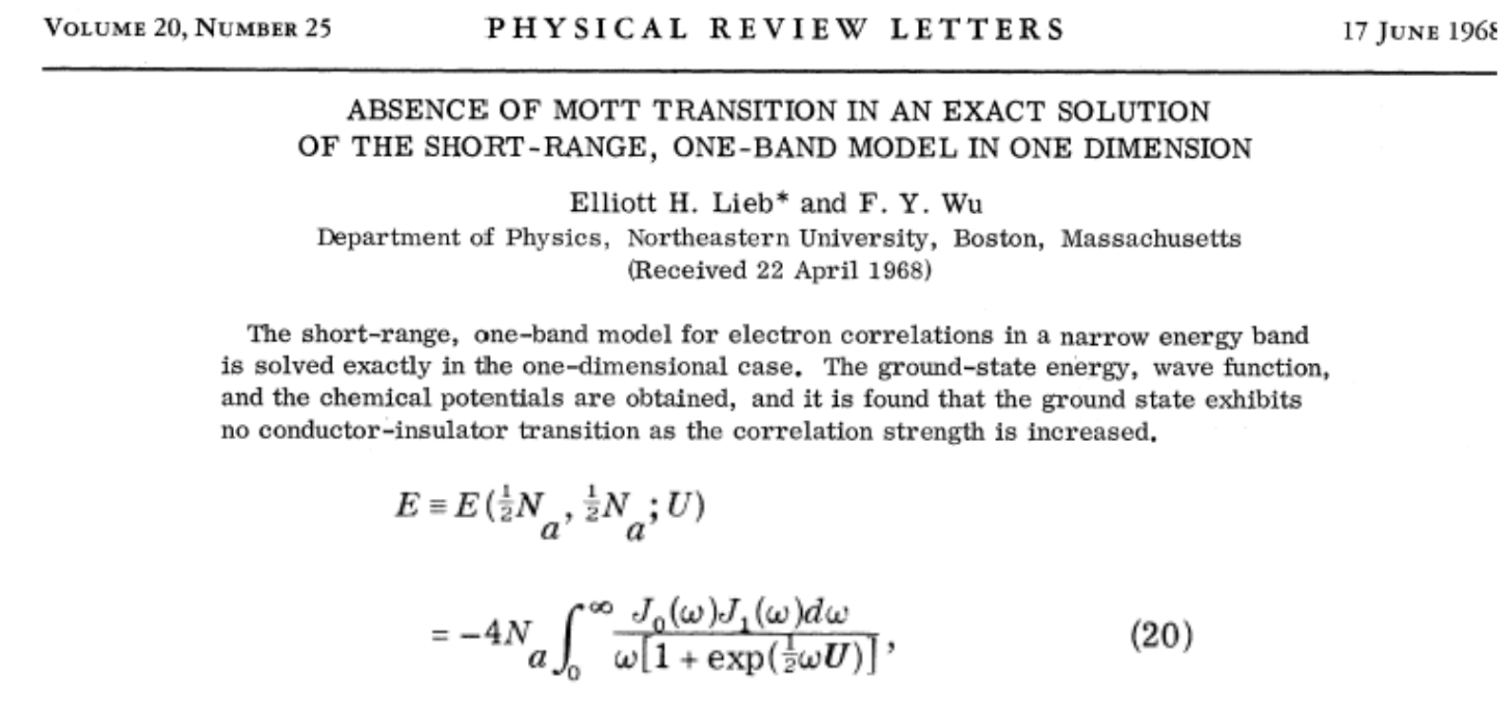
Exact solution --

Slide 14
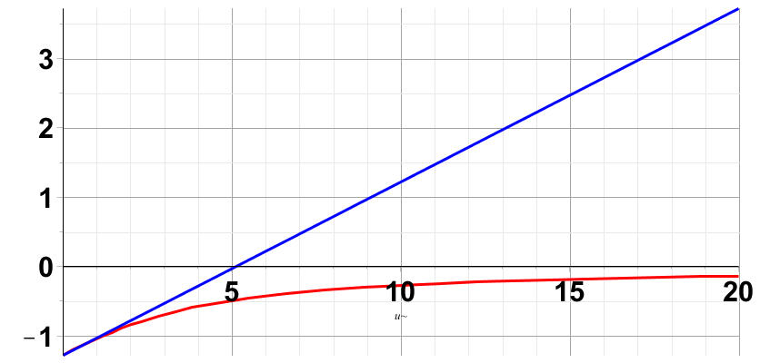
Evaluation of exact model in comparison with Hartree-Fock approximation
Hartree-Fock
Exact
U/t

Slide 15
Can we improve the Hartree-Fock analysis?
What if we populate all N sites with with spin up electrons – “ferromagnetic” solution
Note that in the Bloch basis, this corresponds to filling all of the single particle states with spin up electrons

Slide 16
Digression – we can define a magnetization --
m=1 for the Ferromagnetic case
m=0 for the simple case

Slide 17
Evaluation of exact model in comparison with Hartree-Fock approximation
Hartree-Fock m=0
Hartree-Fock m=1
Exact
U/t

Slide 18
Approximate solutions in terms of single particle states; “broken symmetry” Hartree-Fock type solutions

Slide 20
Spin density wave solution -- continued
Using slightly different notation ---

Slide 21
Spin density wave solution -- continued

Slide 22
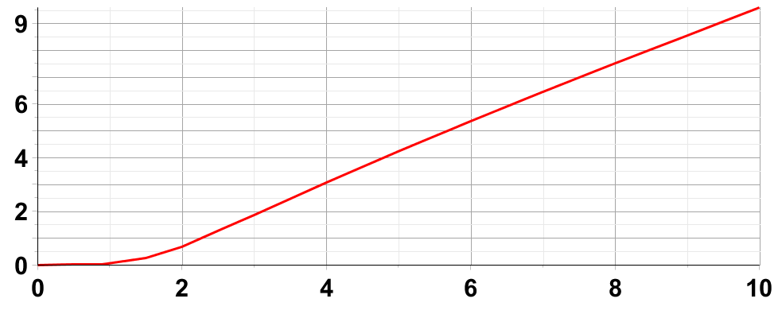
Spin density wave solution -- continued
Δ
u

Slide 23
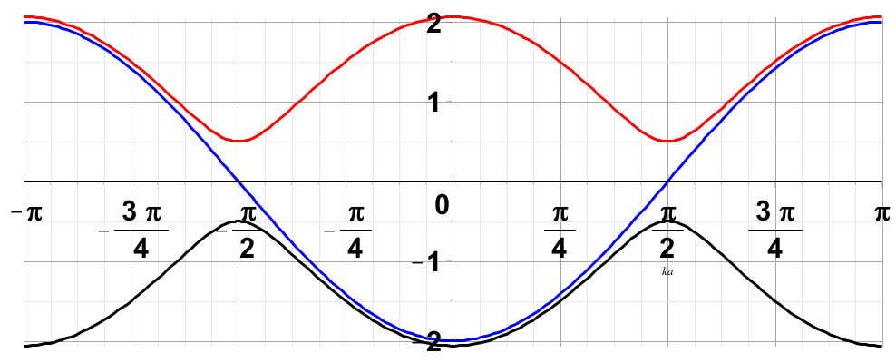
Spin density wave solution -- continued
Effects on single particle states

Slide 24
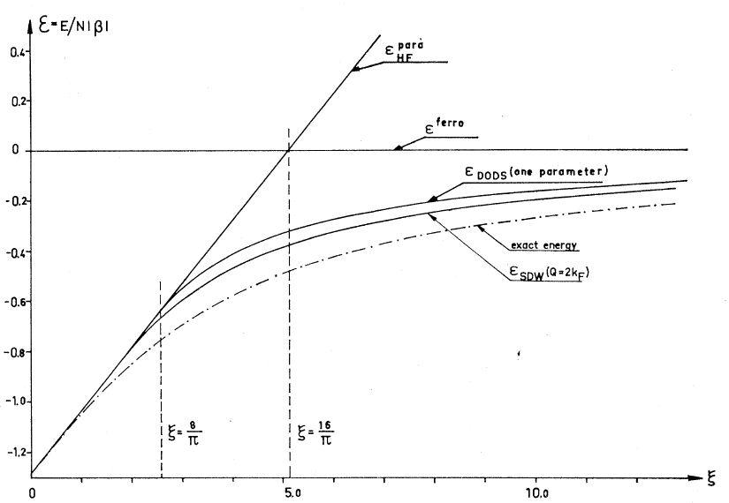
Spin density wave solution -- continued

Slide 25
SDW form:
a
For spin ↑
(x cos θ_{k})
For spin ↓
(x sin θ_{k})

Slide 27
Comment on Hubbard model in higher dimensions –
Used to study model systems of finite size with exact diagonalization

Slide 28
Motivation for the LDA+U approach

Slide 30
Details of the self-interaction problem
Hartree-Fock formalism removes self-interaction error
LDA+U approximately removes self-interaction error and can possibly add some additional physics

Slide 31
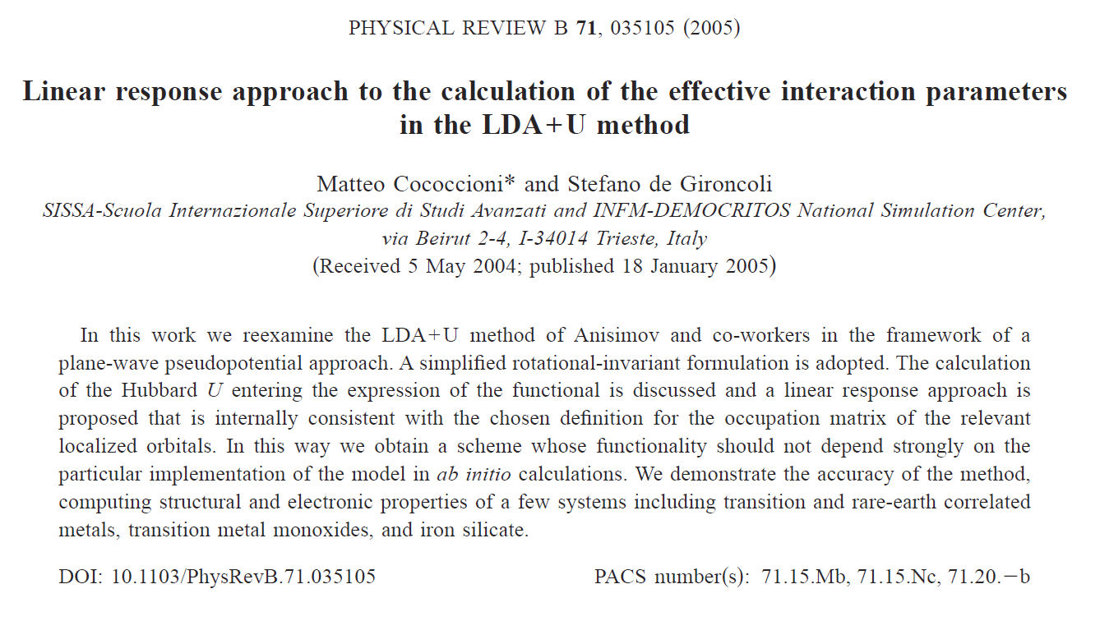

Slide 32
Total energy expression for LDA+U used by Cococcioni and de Gironcoli for all atomic sites I:
Coulomb and exchange interactions on atomic sites corrected for “double counting”
In principle the atomic site contributions could be calculated using atomic basis functions. Alternatively they can be introduced as model parameters or determined consistently from the modified equations.

Slide 33
LDA+U – continued
Approach is particularly important for describing d and f electrons where spin and orbital degeneracies also appear. Cococcioni and de Gironcoli use dominating spherically symmetric contribution and allow site occupancies n_{I} to vary consistently.

Slide 34
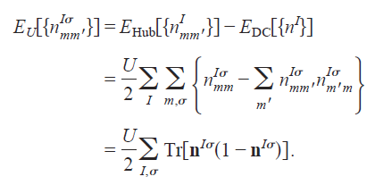
Simplified LDA+U Hamiltonian
Atomic site occupations n^{Iσ} depend on choice of basis functions, but net result should be robust.
Behavior of energy with expectation value.

Slide 35
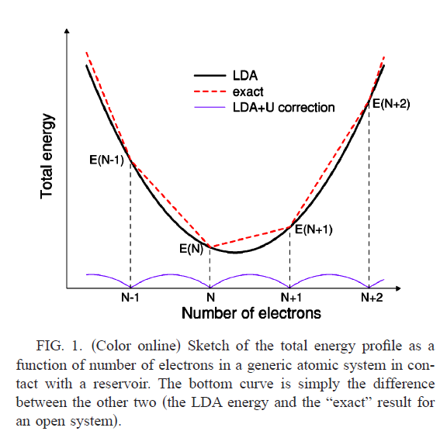
Needed correction to be provided by U term.

Slide 36
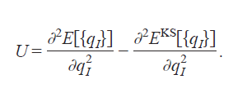
Cococcioni and de Girancoli proposal for calculating U:

Slide 37
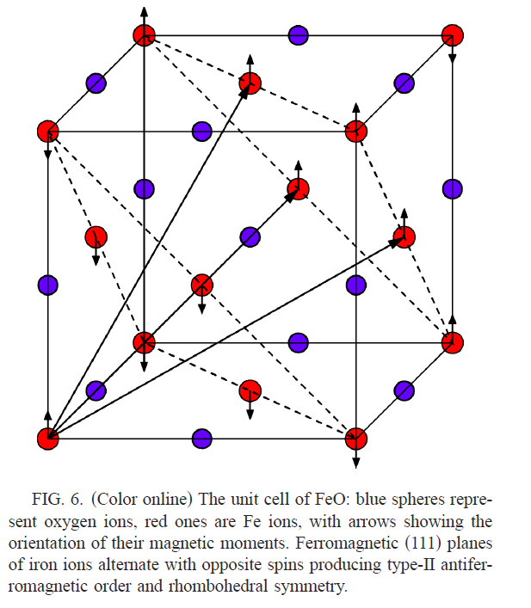
Cococioni & de Gironcoli
Example for FeO

Slide 38
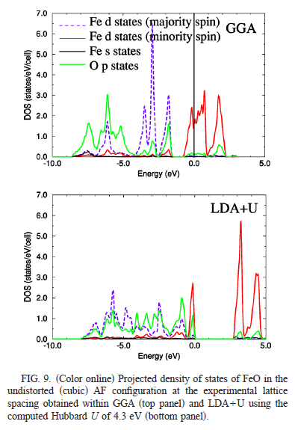
Cococioni & de Gironcoli

Slide 39
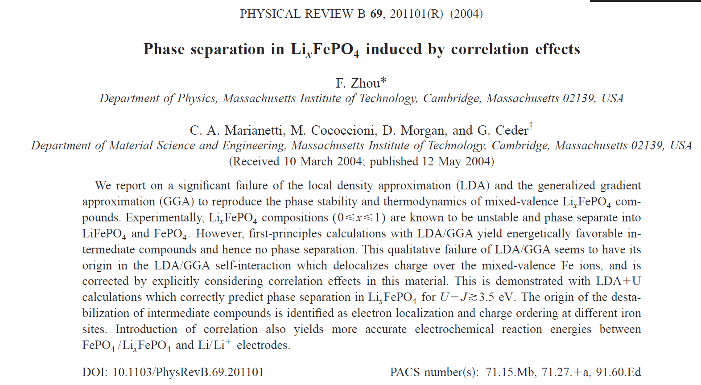
Application of LDA+U to phase stability of Li_{x}FeO₄

Slide 40
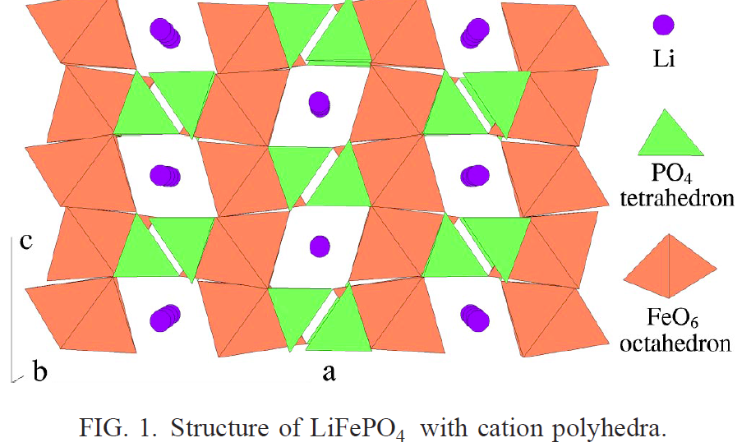
Experimentally, Li_{0.5}FePO₄ is unstable wrt to FePO₄ and LiFePO₄.

Slide 41
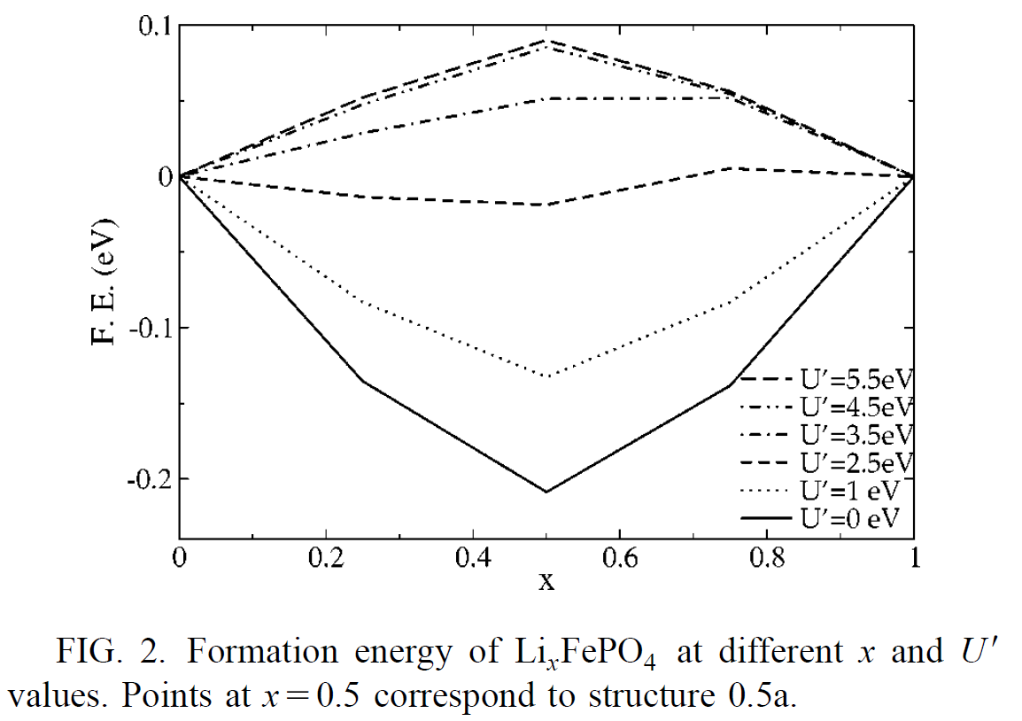
Simplified LDA+U

