Slide 1
PHY 742 Quantum Mechanics II
12-12:50 PM MWF Olin 103
Notes for Lecture 32
A short introduction to the quantum theory of superconductivity
Bardeen, Cooper, Scrieffer, Phys. Rev. 108, 1175 (1957)
Cooper pairs
Gap equation
Estimate of T_{c}
Some of the slides contain materials from the textbook, Solid State Physics; Second Edition by Giuseppe Grosso and Giuseppe Pastori Parravicini (Academic Press, 2014)
Notes:
We will go over some of the concepts of this famous paper.

Slide 3
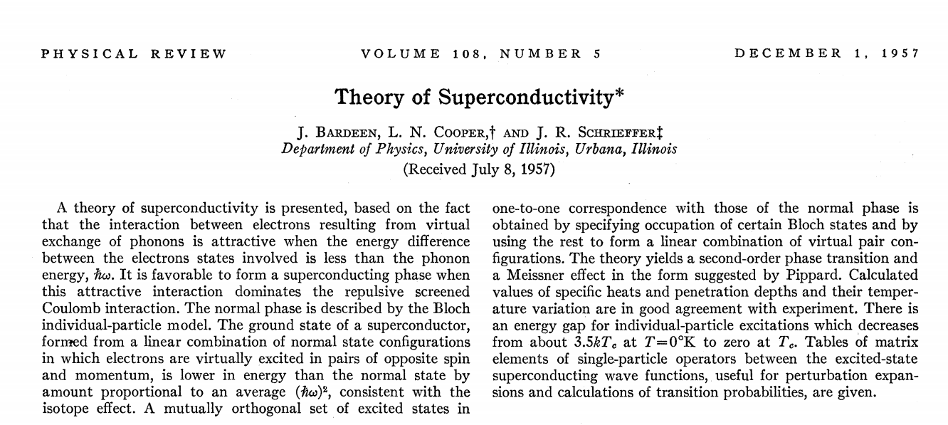
Some of you may wish to read the paper which is available from zsr.wfu.edu https://doi.org/10.1103/PhysRev.108.1175

Slide 5
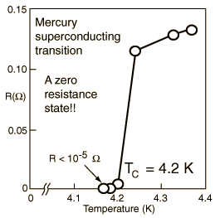
Overview of superconductivity --
Ref:D. Teplitz, editor, Electromagnetism – paths to research,
Plenum Press (1982); Chapter 1 written by Brian Schwartz and Sonia Frota-Pessoa
History:
1908 H. Kamerlingh Onnes successfully liquified He
1911 H. Kamerlingh Onnes discovered that Hg at 4.2 K has vanishing resistance
1957 Theory of superconductivity by Bardeen, Cooper, and Schrieffer
The surprising observation was that electrical resistivity abruptly dropped when the temperature of the material was lowered below a critical temperature T_{c}.

Slide 6
Some thoughts related to the statistical mechanics of Bose particles
For Bose particles, many particles can occupy the same state. This means that for non-interacting Bose particles, according to statistical mechanics, at very low temperature, it is possible for a macroscopic number of particles to occupy the lowest single particle state and produce a “Bose condensate”. ⁴He is not a good
example of this, since the particles have significant interactions, but the superfluid behavior is logically related. A better example was demonstrated in 1995 with 2.5 x 10¹² ⁸⁷Rb atoms cooled to 1.7 x 10⁻⁷K.
For superconductivity, electrons are the particles. How is possible for Fermi particles to behave with Bose-like statistics?

Slide 7
Notion of a Cooper pair
Starting with a material with all the states filled up to the Fermi level, we focus attention on a pair of states which have a net attractive interaction U(r₁,r₂):
The thinking is that the interaction is related to lattice vibrations and had an energy

Slide 8
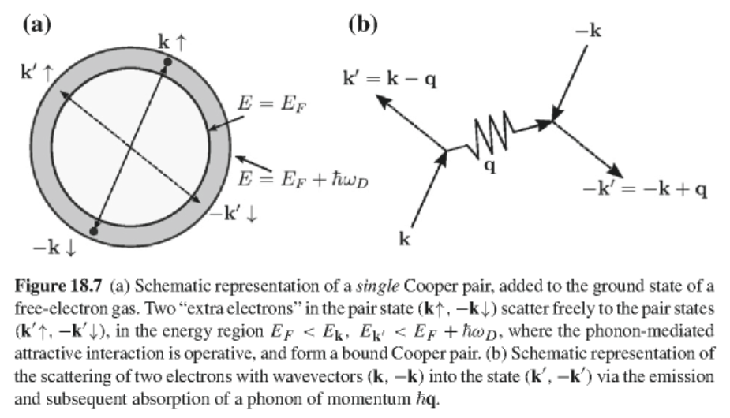
Notes:
Not sure that this helps… The thinking is that the pair of states are very close to the Fermi level.

Slide 9
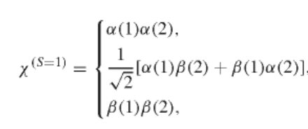
Properties of pair wavefunction
Spin part:
or
Notes:
The pair of electrons can have total spin 0 or 1 which determines the spatial symmetry to be symmetric or antisymmetric, respectively.

Slide 10
Here are some possible functional forms for the spatial part of the Cooper pair. Which of these are associated with S=0 and which are associated with S=1?

Slide 11
Properties of pair wavefunction – continued
Assume that the electron pair can be represented by a linear combination of plane wave states of wavevectors k and -k:
What is g(k)?
Notes:
It will be convenient to express the spatial part in terms of the Fourier representation.

Slide 12
Define Fourier transform of interaction potential:
Equation satisfied by pair amplitude functions:
Notes:
Here is the equation that the unknow amplitude g(k) must satisfy. The initial states are below the Fermi level and scattered states are above the Fermi level.

Slide 13
Cooper pair equations -- continued
Simplified model for interaction:
Notes:
Simplifying the interaction term to a constant. Why must Cooper pair states have singlet spin?

Slide 14
Cooper pair equations -- continued
Non-trivial solution for singlet state:
E_{pair}
Equation to determine eigenstate energy:
How did the DOS come into the result?
n
Density of states (one electron basis)
Notes:
How does the derivation of the eigenstate energy equation work?

Slide 15
Using the Debye approximation:
Cooper pair equations -- continued
Binding energy:
Shows that a singlet Cooper pair is more stable than the independent particle system even for small U_{0.}
What justifies this conclusion?
Notes:
Why do we conclude that the Cooper pair is more stable?

Slide 16
Variational determination of the ground-state wavefunction in the BCS model
Second quantization
Note that the Cooper pair singlet state can be written
Notes:
It is convenient to use second quantization

Slide 17
Variational determination of the ground-state wavefunction in the BCS model -- continued
independent particle states
Cooper-pair interaction
Consider a ground state wavefunction of the form
probability amplitude for forming Cooper pair
Notes:
Hamiltonian of the BCS model. The parameters u and v will be determined variationally.

Slide 18
Variational determination of the ground-state wavefunction in the BCS model -- continued
Need to minimize the expectation value:
Here μ is essentially E_{F}.
After some algebra:
Notes:
Writing out the energy to be determined variationally.

Slide 19
Variational determination of the ground-state wavefunction in the BCS model -- continued
Convenient transformation:
Define:
Notes:
Clever tricks and notations.

Slide 20
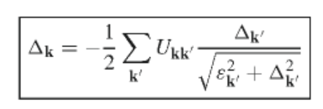
Variational determination of the ground-state wavefunction in the BCS model -- continued
In terms of the “gap parameter” the variational equations become:
Notes:
In the end, we have an integral equation for the gap parameter.

Slide 21
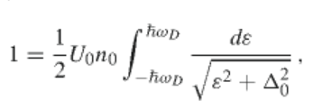
Variational determination of the ground-state wavefunction in the BCS model -- continued
Simplified model
Using DOS:
Notes:
Make a simplified model for the interaction term in order to solve the equation.

Slide 22
Variational determination of the ground-state wavefunction in the BCS model -- continued
Solving for the gap parameter:
Estimating the ground state energy of the superconducting state:

Slide 23
Estimating the ground state energy of the superconducting state – continued
Using the variational solution and integrating the DOS:
Notes:
Here we assume that the gap parameter is smaller that the phonon energy.

Slide 24
Effects of temperature:
Thermal average of Cooper pair operator:
Define
average
fluctuations
Notes:
Now we need to consider how temperature affects the analysis.

Slide 25
Modified Gap relationship
Fermi-Dirac distribution
Modified Gap equation
Notes:
Introducing the Fermi-Dirac distribution

Slide 26
Simplified model
Notes:
Evaluating expressions for simplified model

Slide 27
Evaluation of the integral
Notes:
Some arithmetic…

Slide 28
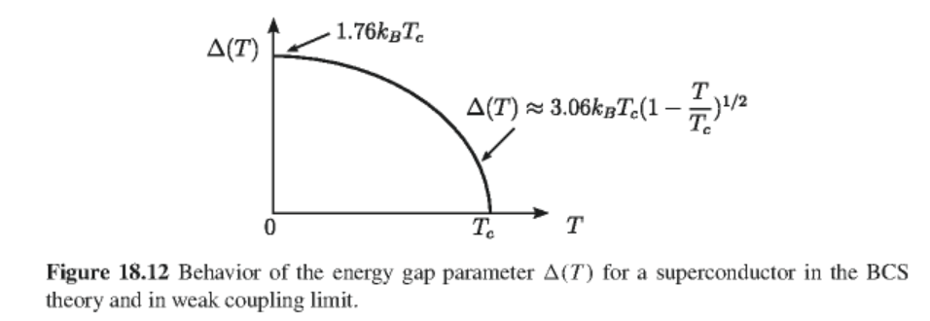
Numerical evaluation of integral:
Notes:
At the critical temperature, the gap is 0. Graph shows qualitative temperature dependence.

Slide 29
Estimation of critical magnetic field (BCS paper)
Free energy of normal state
Free energy of superconducting state
After some approximations, etc.:
Notes:
Relationship to critical field.

Slide 30
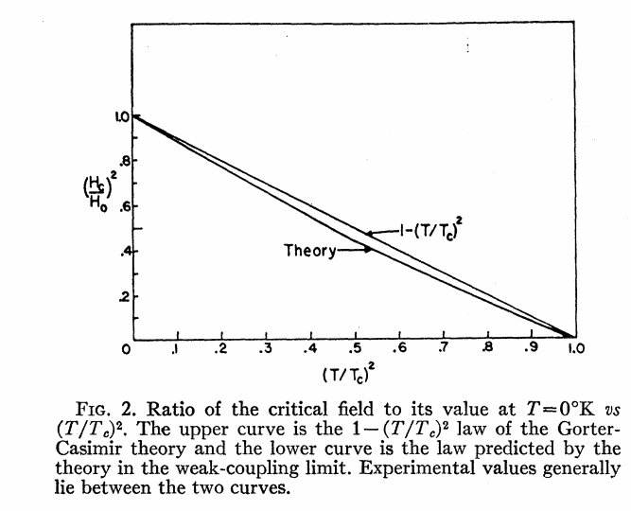
Notes:
Figure from BCS theory showing agreement with experiment.

Slide 31
What do you think?
Full of admiration
Full of disgust
Not full
Want to read more
Never want to see this again

