Slide 1
PHY 742 Quantum Mechanics II
12-12:50 PM MWF Olin 103
Notes for Lecture 33
Continuation of introduction to the quantum theory of superconductivity
Bardeen, Cooper, Scrieffer, Phys. Rev. 108, 1175 (1957)
Summary of Fritz London’s theory and of Cooper pair concept
Gap equation
Estimate of T_{c}
Comparison with London analysis

Slide 3
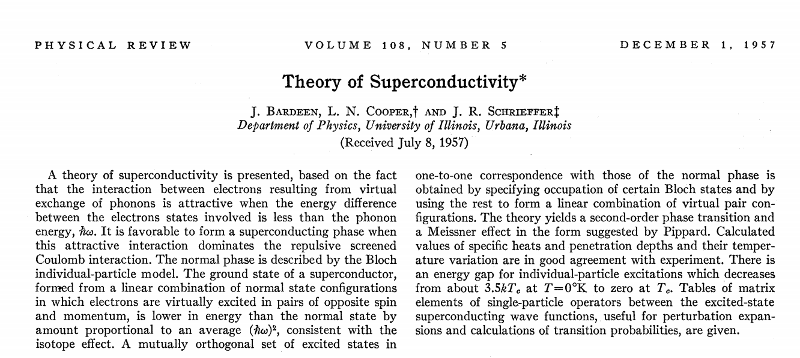
Some of you may wish to read the paper which is available from zsr.wfu.edu https://doi.org/10.1103/PhysRev.108.1175

Slide 4
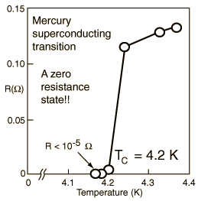
Overview of superconductivity --
Ref:D. Teplitz, editor, Electromagnetism – paths to research,
Plenum Press (1982); Chapter 1 written by Brian Schwartz and Sonia Frota-Pessoa
History:
1908 H. Kamerlingh Onnes successfully liquified He
1911 H. Kamerlingh Onnes discovered that Hg at 4.2 K has vanishing resistance
1957 Theory of superconductivity by Bardeen, Cooper, and Schrieffer
The surprising observation was that electrical resistivity abruptly dropped when the temperature of the material was lowered below a critical temperature T_{c}.

Slide 5
Some thoughts related to the statistical mechanics of Bose particles
For Bose particles, many particles can occupy the same state. This means that for non-interacting Bose particles, according to statistical mechanics, at very low temperature, it is possible for a macroscopic number of particles to occupy the lowest single particle state and produce a “Bose condensate”. ⁴He is not a good
example of this, since the particles have significant interactions, but the superfluid behavior is logically related. A better example was demonstrated in 1995 with 2.5 x 10¹² ⁸⁷Rb atoms cooled to 1.7 x 10⁻⁷K.
For superconductivity, electrons are the particles. How is possible for Fermi particles to behave with Bose-like statistics?
Introduced the notion of a Cooper pair of electrons that behave somewhat like electrons and that are stabilized by an attractive interaction.

Slide 6
Some phenomenological theories < 1957 thanks to F. London
Note: Equations are in cgs Gaussian units.

Slide 8
Some phenomenological theories < 1957

Slide 9
London model – continued
Here we assume we know the boundary value at x=0.

Slide 10
London model – continued
λ_{L}
x

Slide 11
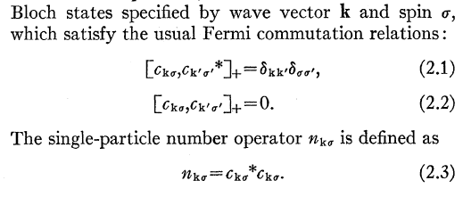
Challenge for BSC –
What is the microscopic origin of this two-electron current and why is it stable at low temperature?
Using creation/annihilation operators for Bloch eigenstates:

Slide 12
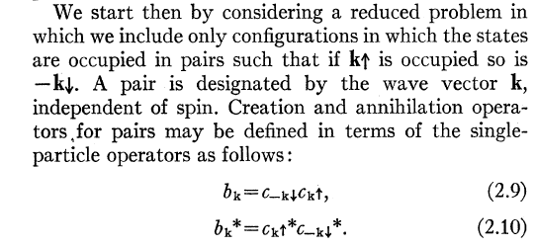
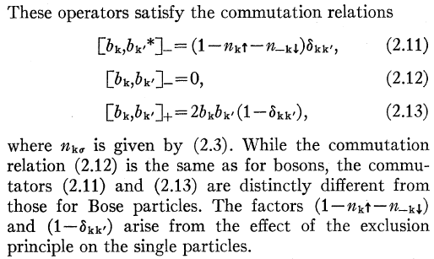
From these single particle states, form Cooper pair states
The BCS Hamiltonian takes the form:

Slide 13
The BCS Hamiltonian takes the form:
Single particle energy
Relative to ε_{F}
Attractive interaction potential
due to electron-phonon interaction
Form of variational wavefunction:
Here the variational parameters h_{k} represent the probability that pair state k is occupied.

Slide 14
Evaluating the matrix elements --
Optimizing the energy with respect to the variational parameters:

Slide 15
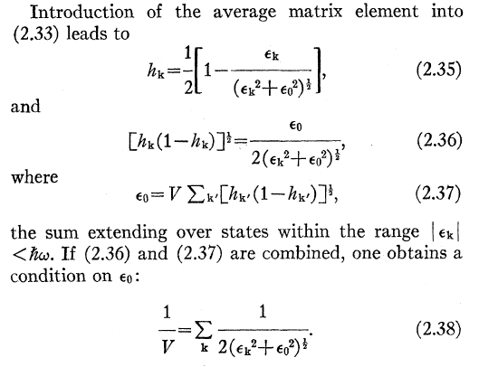
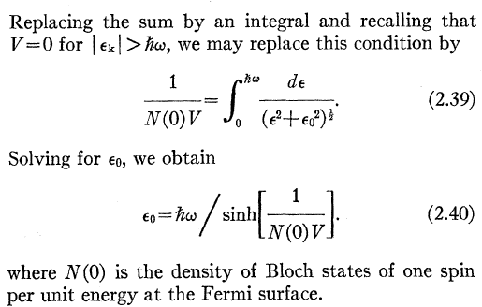

Slide 16
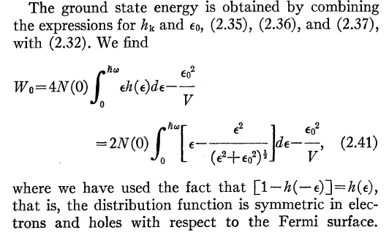
At 0K, the energy difference of the superconducting state relative to the “normal” state is:

Slide 17
Ground state of BCS Hamiltonian at 0 K --
Considering excitations to this ground state – BCS Hamiltonian has a energy gap of 2ε₀
The transition temperature T_{c} can be estimated as the solution when ε₀ = 0.

Slide 18
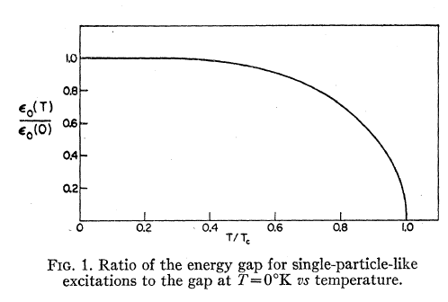
Plot of gap parameter as a function of temperature --

Slide 19
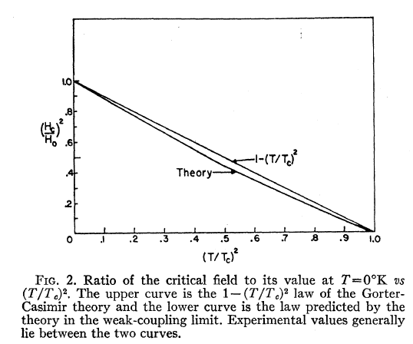
This treatment has assumed that there are no magnetic fields present in the system. An applied magnetic field can also affect superconductivity.

Slide 20
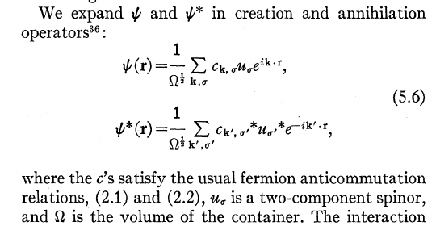
Superconducting current –
Single particle Bloch wavefunctions --
The paramagnetic contribution is complicated, but is generally small at low temperature.
However, the diamagnetic term:
is significant and is consistent with the London expression.

Slide 21
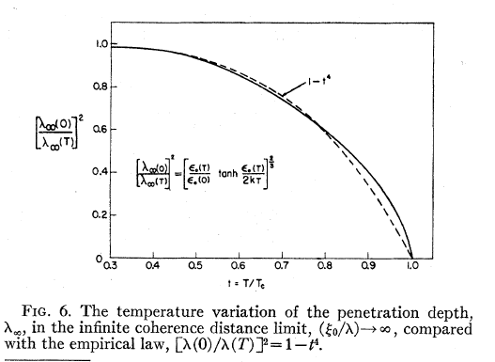
BCS estimate of penetration depth --

