Slide 1
PHY 742 Quantum Mechanics II
12-12:50 PM MWF Olin 103
Notes for Lecture 34
Review
Overview
Examples

Slide 3
Main topics, covering Chapters 12-18 + of Professor E. Carlson’s textbook
Approximation methods for Quantum Mechanical problems; time-dependent and time independent
Quantum mechanical scattering theory
Dirac equation
Quantization of the electromagnetic field
Treatment of multiparticle systems
Special cases

Slide 4
Example solution --

Slide 5
From Lecture 8 --

Slide 7
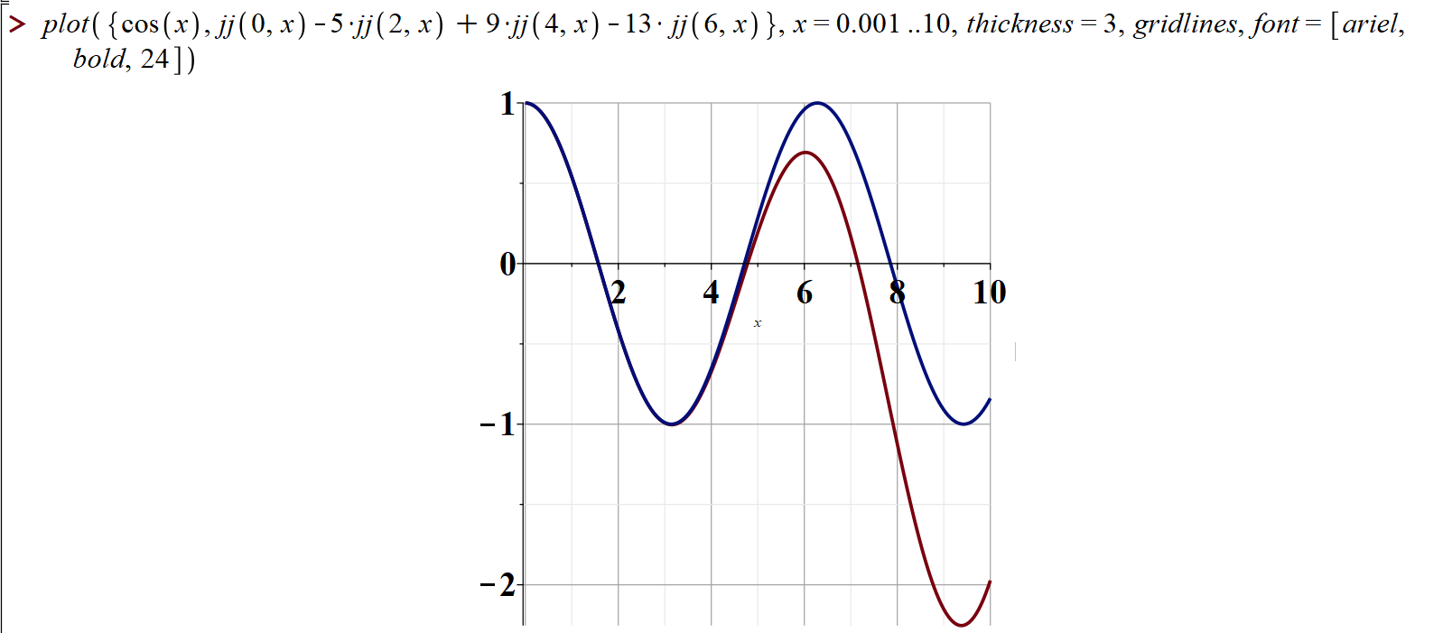

Slide 8
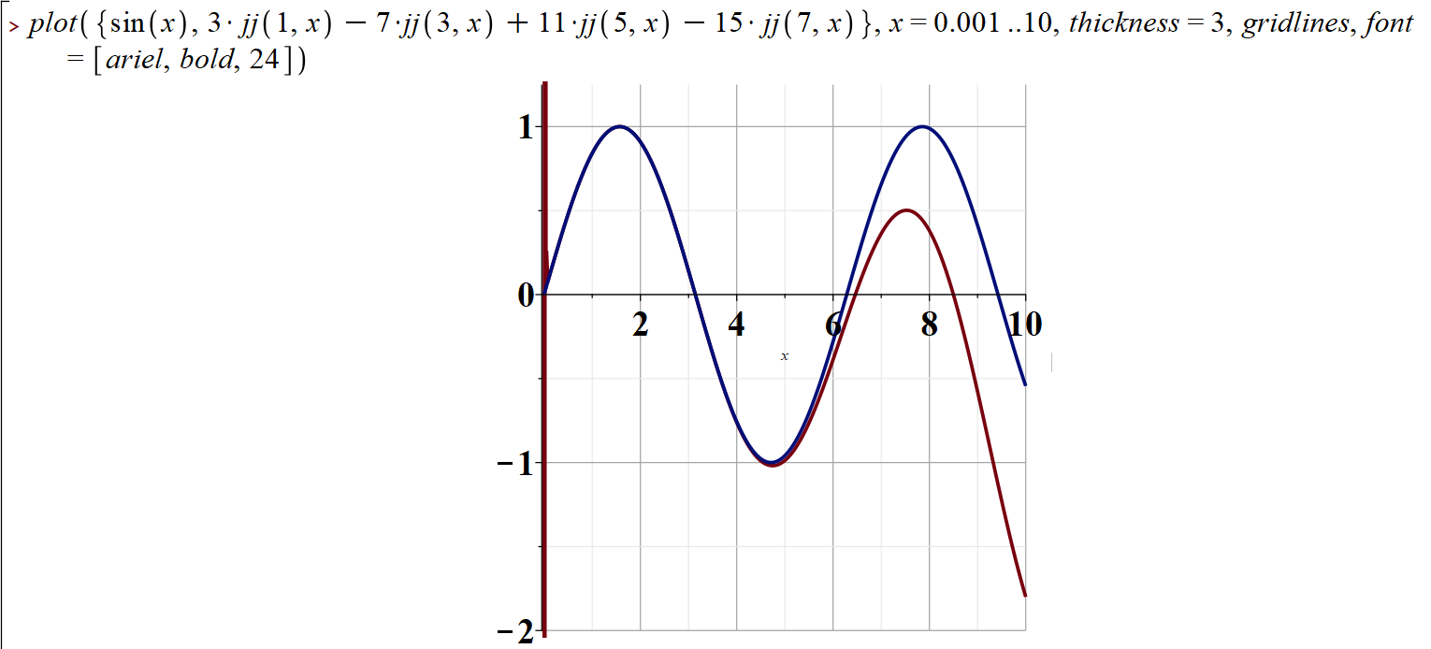

Slide 9
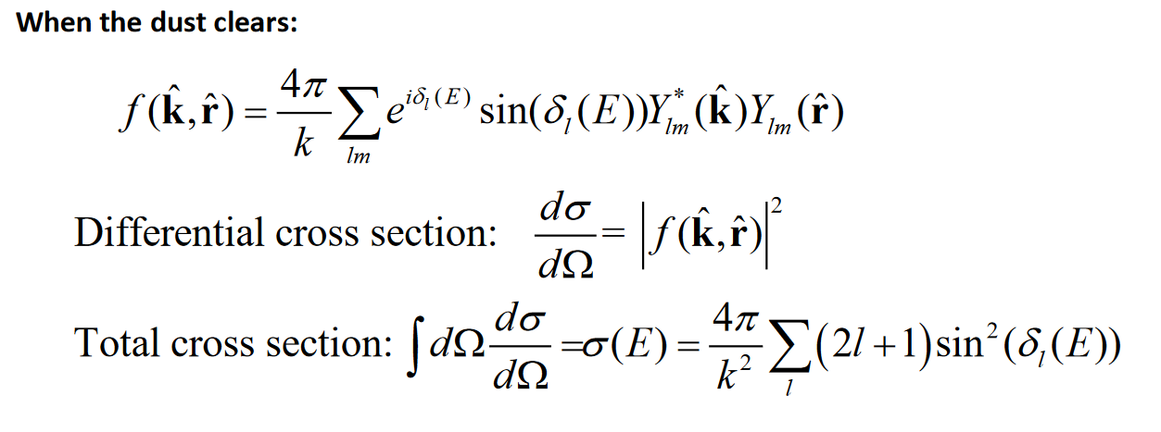
Do you think this expansion is useful?
Is it helpful to encourage you to plot these functions to see how the expansion works/fails?

Slide 10
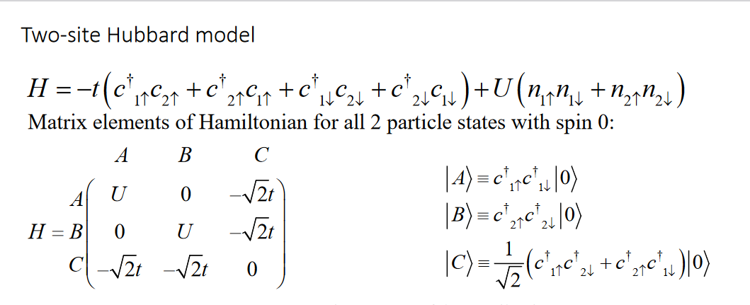
Another example – from Lecture 30 on the 2-site Hubbard model
Note that this is corrected from the original slides
We claim that these states correspond to a total spin S=0; how can we analyze this?

Slide 11
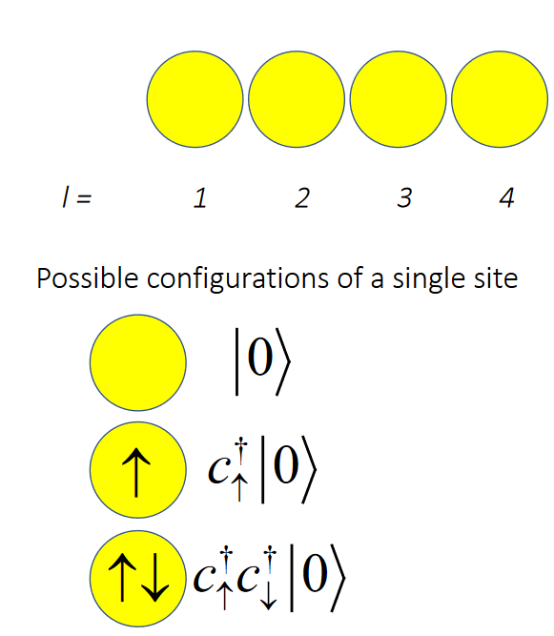
Total spin S=0:

Slide 12
How can we calculate the total spin for our states?
How can we analyze this in second quantization?

Slide 13
How do you calculate total spin in second quantization?
<S_{z}>=1
<S_{z}>=0
<S_{z}>=-1
Need to show that

Slide 14
Remember, we are dealing with two spin ½ particles. For now, label these s_{a} and s_{b}

