Slide 1
PHY 742 Quantum Mechanics II
12-12:50 PM MWF Olin 103
Notes for Lecture 35
Review
Schedule
Correction to Hubbard model notes
Time for filling out course evaluations

Slide 3
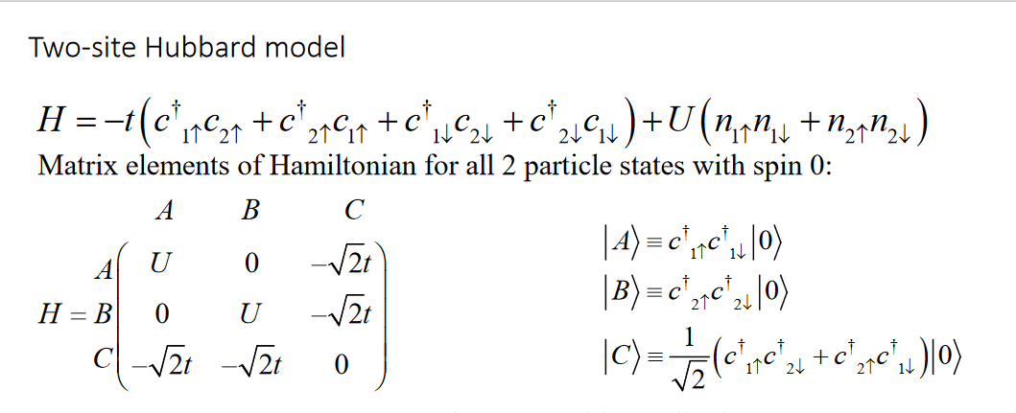
More comments on the 2-site Hubbard model
Note that this is corrected from the original slides
We claim that these states correspond to a total spin S=0; how can we analyze this?

Slide 4
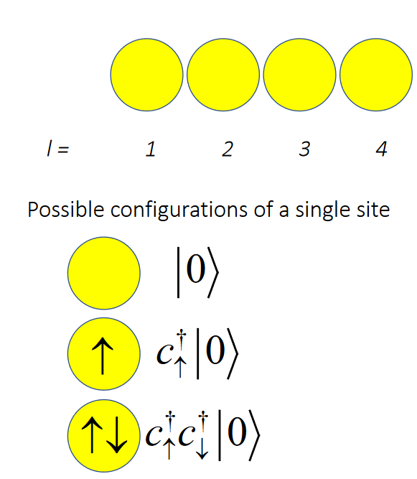
Total spin S=0:

Slide 5
How can we calculate the total spin for our states?
How can we analyze this in second quantization?

Slide 6
Total spin S=0
Total spin S=1
How do you calculate total spin for these second-quantized basis states?
Answer thanks to Professor William C. Kerr and his student Professor Will Hodge (Ph. D. 2008, currently a physics professor at Stevenson University in Maryland)

Slide 7
Famous Kerr-Hodge formula --

