Slide 1
PHY 742 Quantum Mechanics II
12-12:50 PM MWF Olin 103
Plan for Lecture 3
Approximate solutions for stationary states
Perturbation theory (Chap. 12 C & D)
Summary of results for non-degenerate problem
Perturbation theory for the case of degenerate zero order eigenvalues
Examples

Slide 2
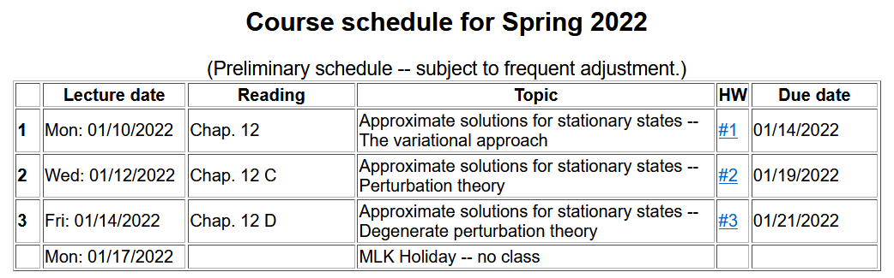

Slide 3
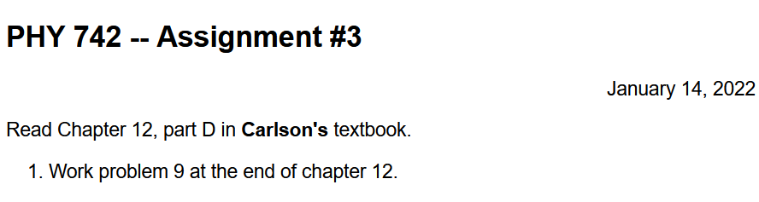
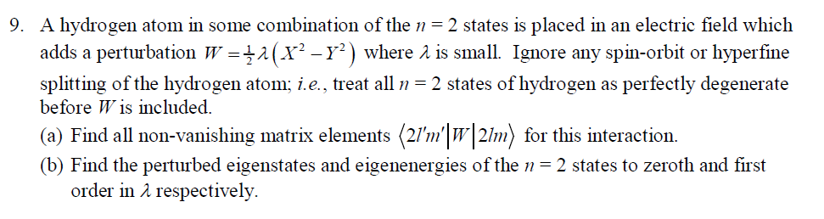

Slide 4
Methods for finding approximate solutions to the time-independent Schrödinger equation
Review of non-degenerate perturbation formalism --
Problem to solve –
For a Hamiltonian of the form

Slide 6
First order formula --
Second order formula --

Slide 7
Qualitative behavior of non-degenerate perturbation theory
E⁰_{n} E⁰_{n}+ E¹_{n} E⁰_{n}+ E¹_{n} + E²_{n}

Slide 8
Perturbation theory in the case that the zero states are degenerate
Cannot use non-degenerate formalism because even in first order, the expressions diverge.
First order formula --

Slide 9
Approximation schemes for solving the time-independent Schrödinger equation

Slide 11
H⁰ H⁰+H¹
For the moment, we will focus on one degenerate zero order state

Slide 12
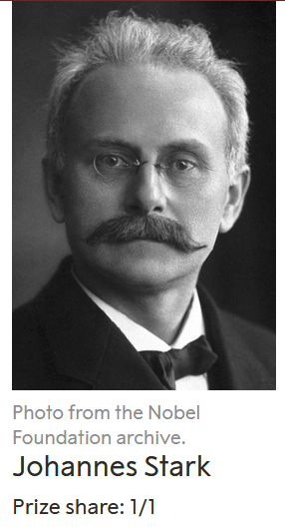
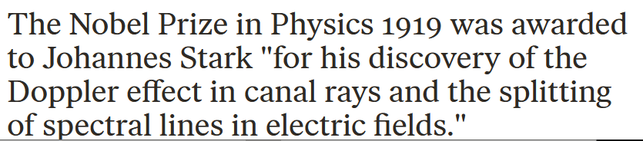

Slide 13
Example of degenerate perturbation theory for a H atom in the degenerate states

Slide 14
Degenerate perturbation theory example for the Stark effect -- continued

Slide 15
Degenerate perturbation theory example for the Stark effect -- continued
F

Slide 16
Note that the treatment in the previous slides is called the linear Stark effect. (why?)
What happens when you apply an electrostatic field to a H atom in its ground state?
  No effect
  Small effect
  Large effect

Slide 17
Degenerate perturbation theory example for effects of a constant magnetic field B on an atom

Slide 18
Degenerate perturbation theory example for effects of a constant magnetic field B on an atom -- continued
Paschen-Back effect

Slide 19
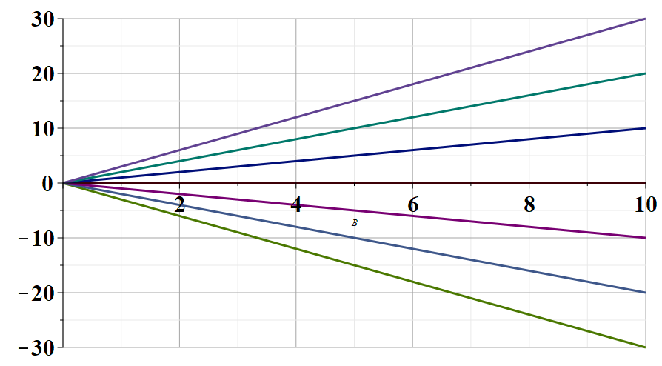
Energy eigenvalues of L=1,S=1 atom (without spin-orbit interaction) in a magnetic field
M M_{s}
1 1
0 1
-1 1 or 1 0
0 0
1 -1 or -1 0
0 -1
-1 -1
B field strength

Slide 20
Example of degenerate perturbation theory in the treatment of the term values of multi-electron atoms:
single electron terms
electron-electron interaction

Slide 21
Example of degenerate perturbation theory in the treatment of the effects of spin-orbit interaction:
J=l+1/2:
J=l-1/2:

Slide 22
Degenerate perturbation theory example for effects of a constant magnetic field B on an atom – including the effects of spin-orbit interaction

