Slide 1
PHY 742 Quantum Mechanics II
12-12:50 PM MWF Olin 103
Plan for Lecture 4
Approximate solutions for stationary states
Perturbation theory (Chap. 12 C & D, 13*) –
Some additional tricks and famous results
Summary of basic formalism for non-degenerate problem
Polarizability of H atom
Summation tricks
More examples
* WKB method will be discussed after completing Chap. 13

Slide 2
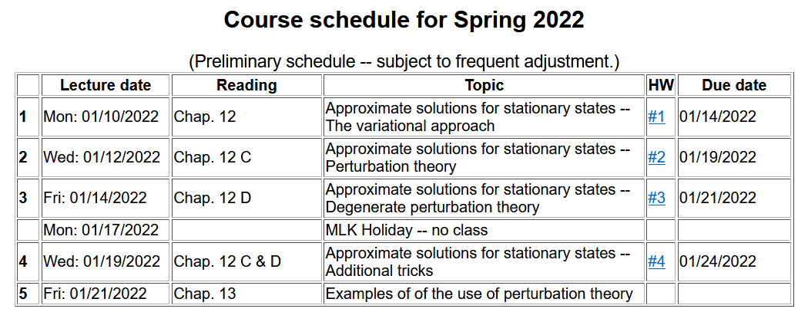
Note that we will come back to the WKB method after completing the perturbation theory examples presented in Chap. 13

Slide 3
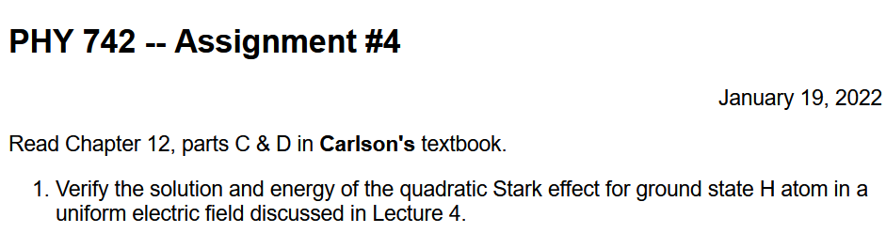

Slide 4
Review of non-degenerate perturbation formalism --
Problem to solve –
For a Hamiltonian of the form

Slide 6
First order formula --
Second order formula --
Note that this approach involves a lot of computation

Slide 7
The following approach is adapted from the textbook by Schiff --

Slide 8
➔In some cases, this inhomogeneous differential equation can be solved directly. Note that the equation has a singularity and it is essential to enforce the condition
Do you think that this is a good idea?
  Yes
  No
  Yes, if someone else does the hard work….

Slide 9

Example – hydrogen atom in its ground state perturbed by a uniform electric field (note that this is the quadratic Stark effect we mentioned last time)
(nlm)

Slide 10
Hydrogen atom in its ground state perturbed by a uniform electric field -- continued

Slide 11
Hydrogen atom in its ground state perturbed by a uniform electric field -- continued

Slide 12
Hydrogen atom in its ground state perturbed by a uniform electric field -- continued

Slide 13
Additional “tricks” for evaluating second order energy (Ref. L. Schiff, Quantum Mechanics)

Slide 14
Generalization of second order Stark effect calculation discussed previously.

Slide 15
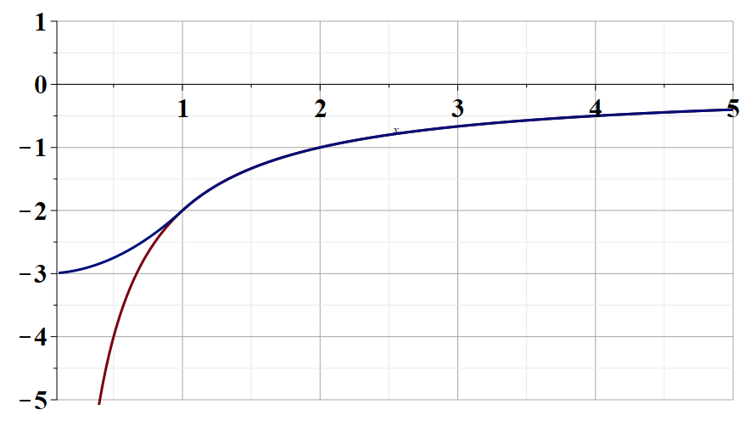
More examples of perturbation theory estimates from Chap. 13 of your textbook
Finite size of the nucleus
Bohr radius a₀=0.529 x 10⁻¹⁰ m
Nuclear radius R ≈ 10⁻¹⁵ m
r/R →
Scale ≈ 70000 eV
V_{finite nucleus}(r/R)
V_{point nucleus}(r/R)

Slide 16
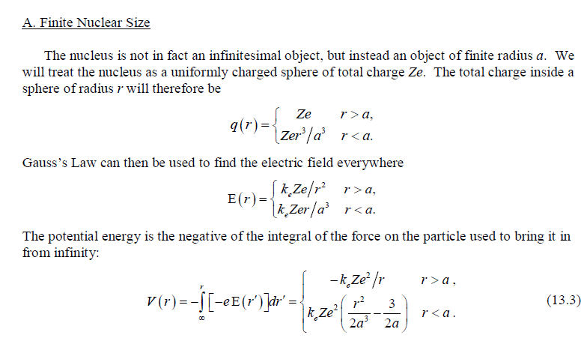
Finite nucleus model used in textbook

Slide 17
More convenient notation –
Bohr radius a₀=0.529 x 10⁻¹⁰ m
Nuclear radius R ≈ 10⁻¹⁵ m

Slide 18
Correction for ground state of H atom --
More significant corrections for larger Z.

