Slide 1
PHY 742 Quantum Mechanics II
12-12:50 PM MWF Olin 103
Plan for Lecture 5
Approximate solutions for stationary states
Perturbation theory examples (Chap. 13) –
The Van der Waals interaction
The Zeeman and Paschen-Back effects
The hyperfine interaction

Slide 2
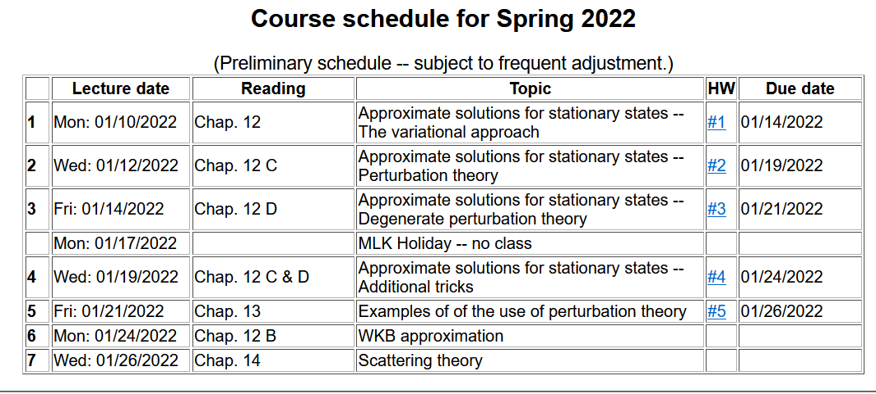

Slide 4
The Van der Waals interaction –
➔The dominant interaction between two neutral but polarizable systems

Slide 5
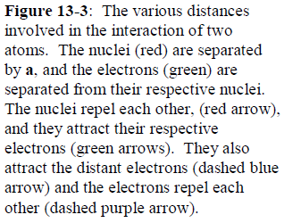

Slide 6
Zero order Hamiltonian
Perturbation Hamiltonian

Slide 7
Leading contributions to perturbing Hamiltonian

Slide 9
Your textbook uses several approximations to estimate
HW #5 involves examining this result

Slide 10
Now consider the effects of a uniform magnetic field on atom which has angular momentum and spin --

Slide 11
Degenerate perturbation theory example for effects of a constant magnetic field B on an atom

Slide 12
Degenerate perturbation theory example for effects of a constant magnetic field B on an atom – including the effects of spin-orbit interaction

Slide 13
Perturbation theory treatment of uniform and constant magnetic fields on atomic states -- continued

Slide 14
l=0
l=1

Slide 17
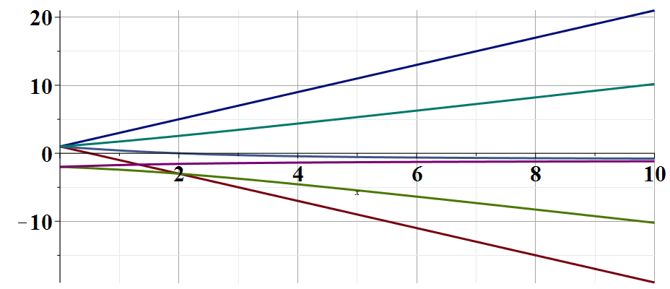
E/γ

Slide 18
Now consider internal magnetic fields within an atom
In PHY 712 we will derive the famous hyperfine interaction potential --

