Slide 1
PHY 742 Quantum Mechanics II
12-12:50 PM MWF Olin 103
Plan for Lecture 5
Approximate solutions for stationary states
Perturbation theory examples (Chap. 13) –
The Van der Waals interaction
The Zeeman and Paschen-Back effects
The hyperfine interaction

Slide 2
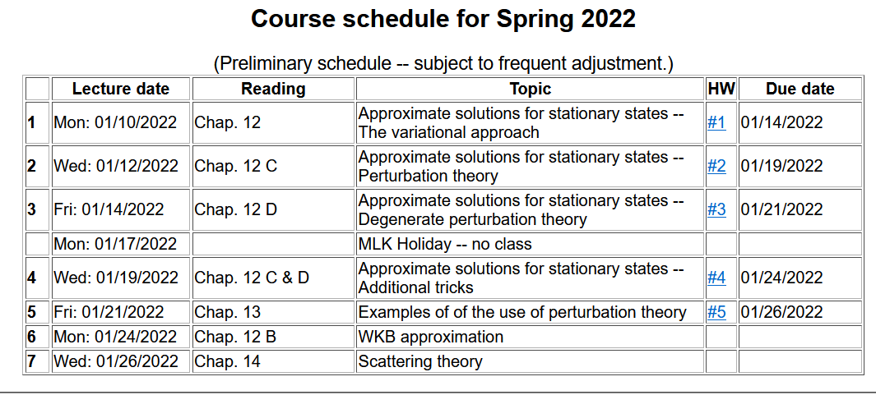

Slide 3
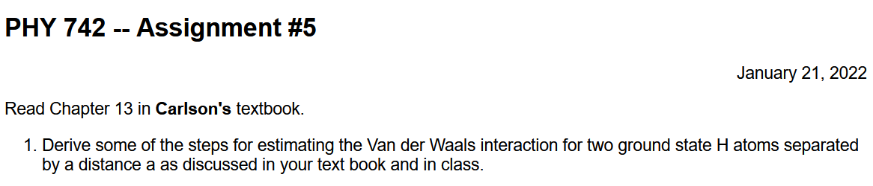

Slide 4

The Van der Waals interaction –
➔The dominant interaction between two neutral but polarizable systems

Slide 5

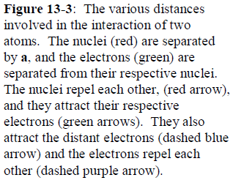

Slide 6


Zero order Hamiltonian
Perturbation Hamiltonian

Slide 7

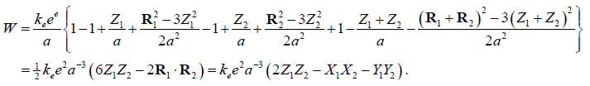
Leading contributions to perturbing Hamiltonian

Slide 9
Your textbook uses several approximations to estimate
HW #5 involves examining this result

Slide 10
Now consider the effects of a uniform magnetic field on atom which has angular momentum and spin --

Slide 11
Degenerate perturbation theory example for effects of a constant magnetic field B on an atom
What is missing from the total perturbation?

Slide 12
Degenerate perturbation theory example for effects of a constant magnetic field B on an atom – including the effects of spin-orbit interaction
Where:
J=L+S

Slide 13

Note that, as will be discussed in more detail in a later lecture and mentioned in Chap. 13, the coefficient G(r) in the expression for the spin-orbit interaction is given by:
G(r) =

Slide 14
Perturbation theory treatment of uniform and constant magnetic fields on atomic states -- continued

Slide 15
l=0
l=1

Slide 18
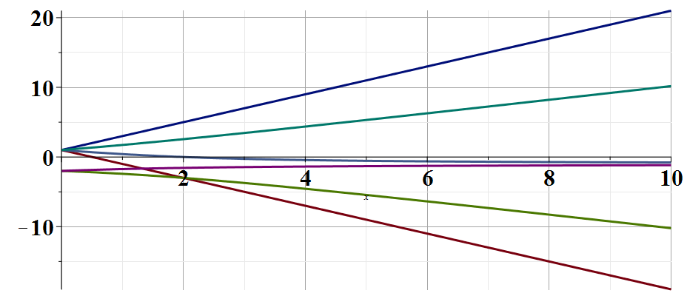
6 distinct states
E/γ

Slide 19
Now consider internal magnetic fields within an atom
In PHY 712 we will derive the famous hyperfine interaction potential --

Slide 21

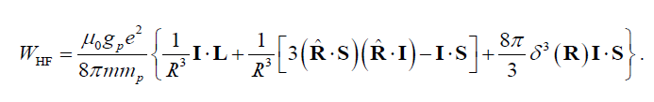
Notation in your textbook:
⬅➔ μ_{N}
Here the quantum operator I references the nuclear spin
Hyperfine Hamiltonian discussed in your textbook
To be continued on Monday --

