Slide 1
PHY 742 Quantum Mechanics II
12-12:50 PM MWF Olin 103
Plan for Lecture 6
Approximate solutions for stationary states
Perturbation theory examples (Chap. 13 and 12 B) –
The hyperfine interaction
The WKB or “quasi-classical” approximation

Slide 2
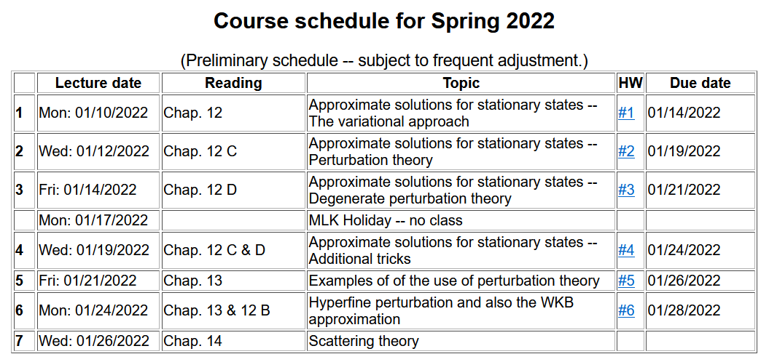

Slide 4
Now consider internal magnetic fields within an atom –
These are produced by:
The magnetic dipole moment of the electron
The magnetic field produced by the charge of the electron
The magnetic dipole moment of the nucleus
In PHY 712 we will derive the famous hyperfine interaction potential which arises from the interactions of the magnetic fields and moments

Slide 6
Notation in your textbook:
Here g_{p} denotes the g-factor for a proton
m_{p} denotes the proton mass; other
nuclei can be similarly analyzed
⬅➔ μ_{N}
Here the quantum operator I references the nuclear spin
m ⬅➔ μ_{e}
Hyperfine Hamiltonian discussed in your textbook (approximating g=2)

Slide 7
Hyperfine Hamiltonian discussed in your textbook (approximating g=2)
Here, R denotes the distance of the electron from the nucleus.
Now, consider the effects of this perturbation on the
ground state of a hydrogen atom where the spacial
part of the electron wave function is
For this case, the first two terms of W_{HF} do not contribute and the zero order wavefunction must include multiplicative contributions from eigenstates of electron and nuclear spin

Slide 8
Since s=1/2 and I=1/2, then there are 4 combinations of m_{s} and m_{I}

Slide 10
Is this consistent with the results from your textbook?

Slide 11
New topic -- WKB or “quasi-classical” approximation
Developed by Wentzel, Kramers, and Brillouin and several others
First consider exact solution to a convenient reference system --

Slide 12
Example of particle interacting with an electromagnetic field
U(x)
E
Energy
x
a

Slide 13
One dimensional Schrödinger equation for charged particle in an electrostatic field
U(x)
E
Energy
x
a

Slide 14
Digression – library of solutions to differential equations
http://dlmf.nist.gov/

Slide 15
http://store.doverpublications.com/0486612724.html

Slide 16
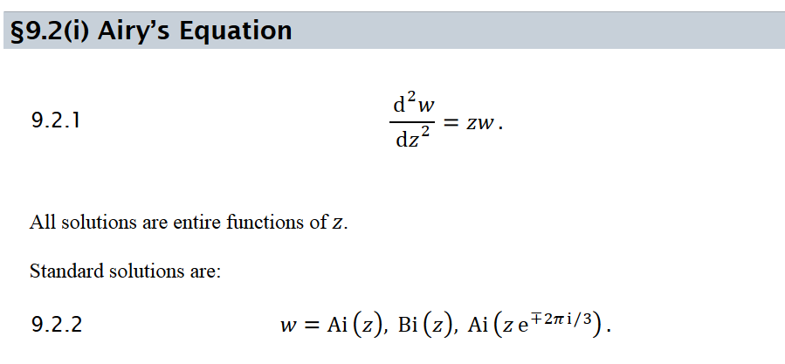

Slide 17
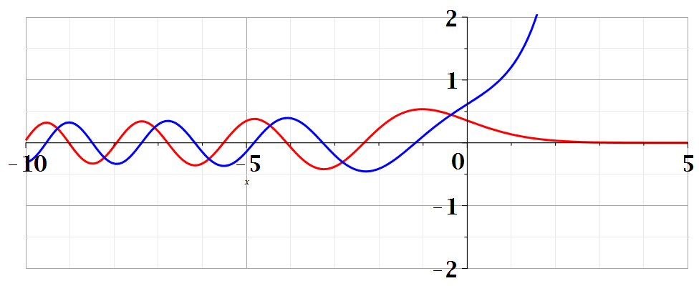
Bi(z)
Ai(z)

Slide 18
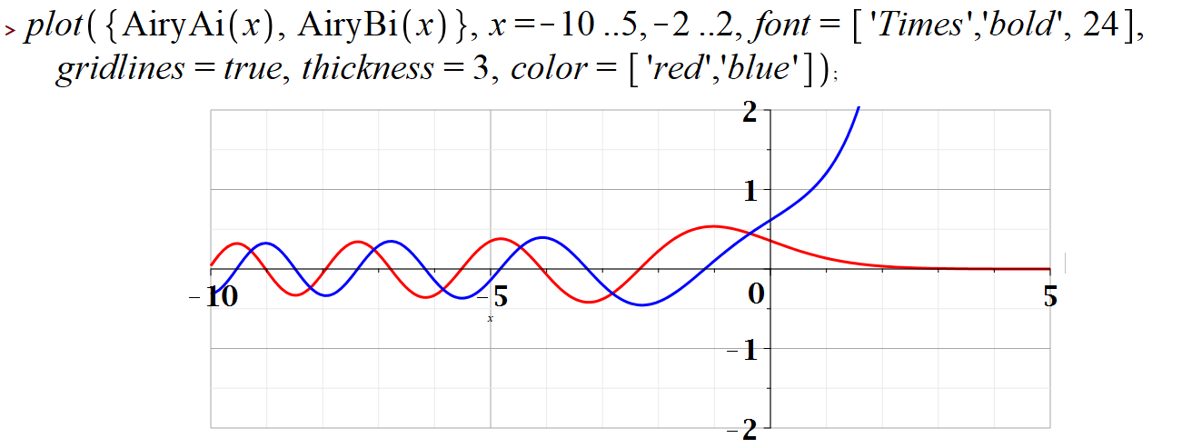
Example Maple input --

Slide 19
⬅normalization constant

Slide 20
Some properties of Airy functions –
Integral form:

Slide 21
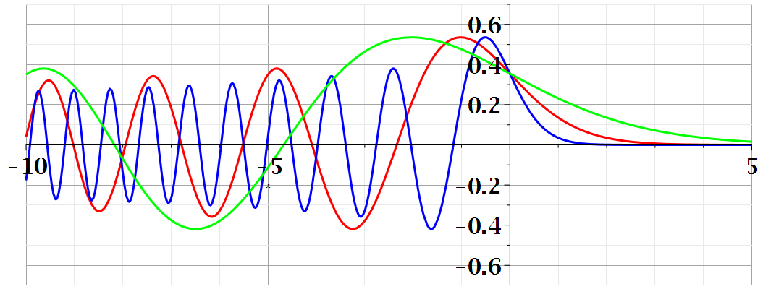
Summary of results
Note that in this case, physical solutions exist for all energies E; the wavefunction oscillates for
x<a+E/qF and decays for x>a+E/qF .

Slide 22
Summary of results
Note that in this case, physical solutions exist for a continuous range of energies E; the wavefunction oscillates for
x<a+E/qF and decays for x>a+E/qF .

Slide 23
Related example with bound stationary state solutions --
Discrete energy levels
U(x)
x

Slide 24
U(x)
x

Slide 25
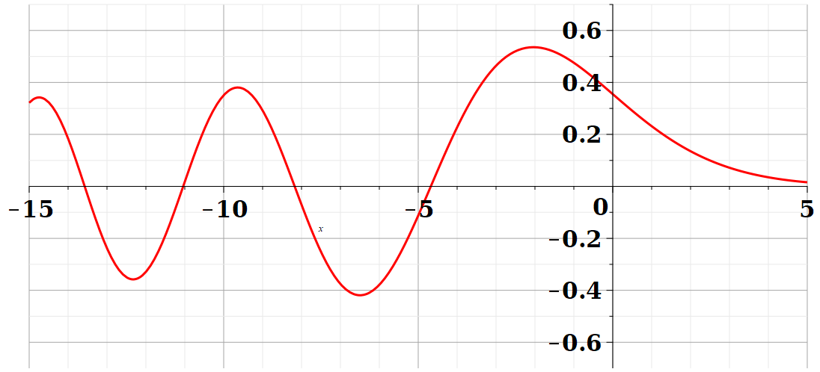
Possible discrete energies

Slide 26
Back to the WKB or quasi classical approximation

Slide 27
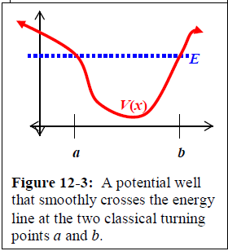
Classical turning points
Your textbook shows that when V(x) is a harmonic oscillator potential, this formula gives the exact energy eigenvalues.

