Slide 1
PHY 742 Quantum Mechanics II
12-12:50 PM MWF Olin 103
Plan for Lecture 7
Scattering theory (Chap. 14) –
  Introduction and geometry
  Scattering from spherically symmetric target
  Scattering phase shifts

Slide 2
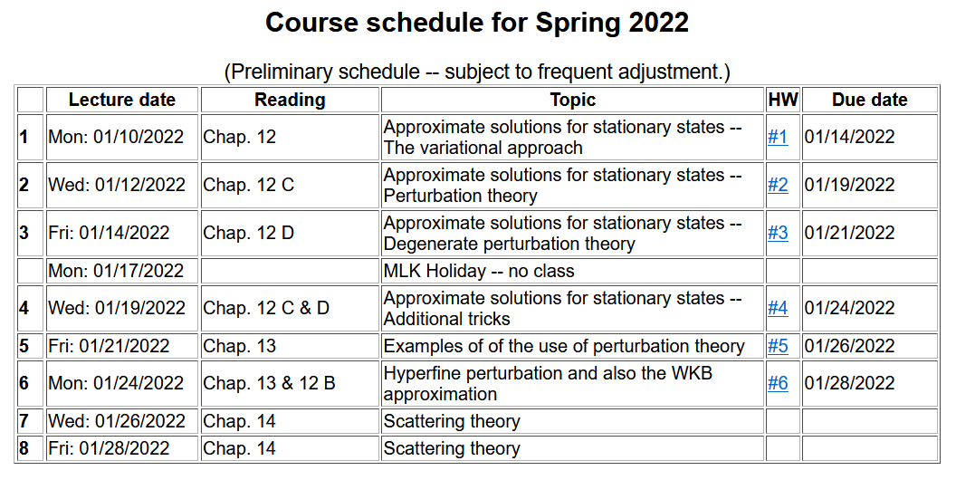

Slide 3
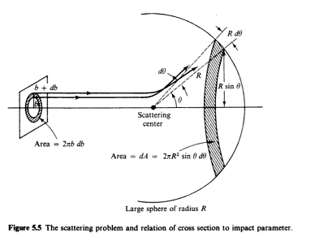
Introduction to scattering theory for quantum particles -- Chap. 14 of textbook; also see other quantum textbooks
detector
Geometry of ideal scattering measurement
This geometry can also be used for quantum systems ..

Slide 4
In classical mechanics, for an isotropic target, it is possible to calculate the cross section in terms of the impact parameter b:
In quantum mechanics, the same phenomenon is formulated in terms of the probability amplitudes. We will specifically focus on free particles scattering from a spherically symmetric target.

Slide 5
Representation of a free particle in quantum mechanics --
Continuum solutions of the time independent Schrödinger equation.
z
r
ö
y
x

Slide 7
Free particle partial waves -- continued
≥

Slide 8
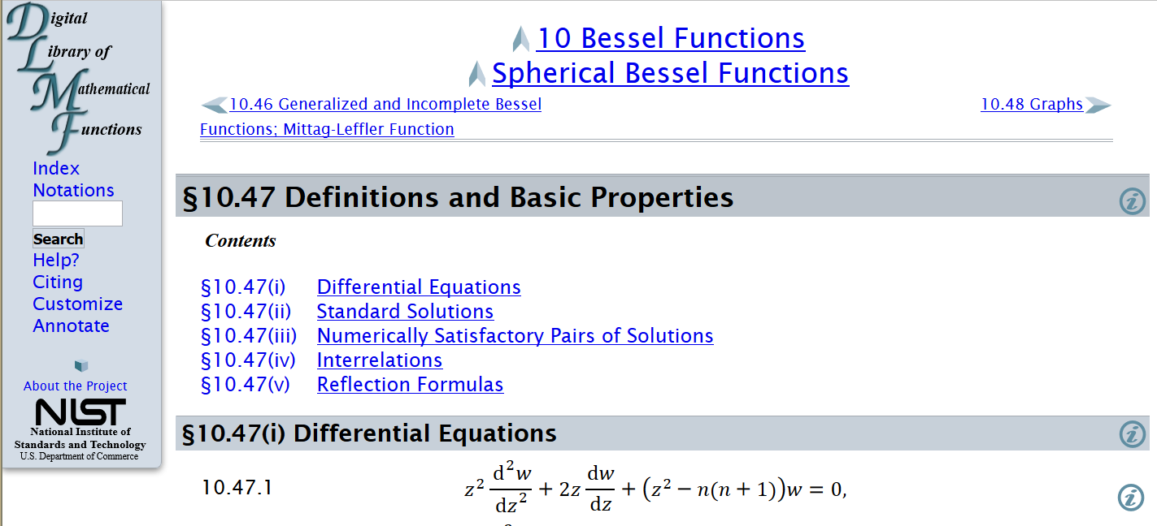
Properties of spherical Bessel functions
http://dlmf.nist.gov/10.47

Slide 9
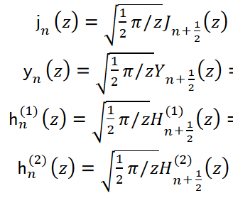
Spherical Bessel functions of order n
Cylindrical Bessel functions of order n+1/2

Slide 10
Forms of spherical Bessel and Hankel functions: (also see Jackson ≥ 426)

Slide 11
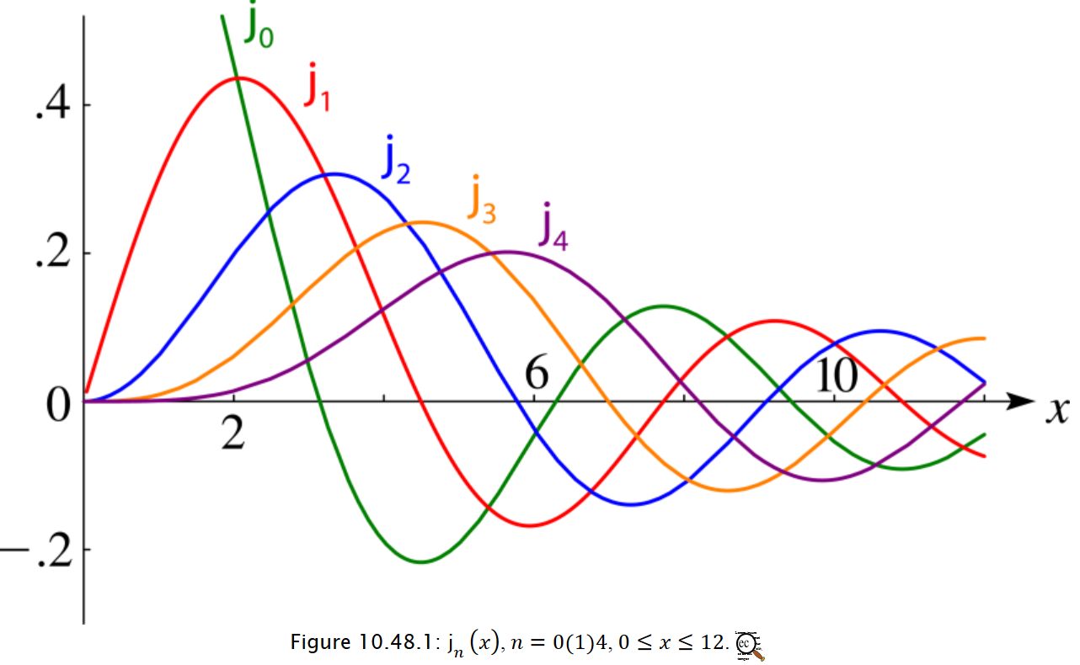

Slide 12
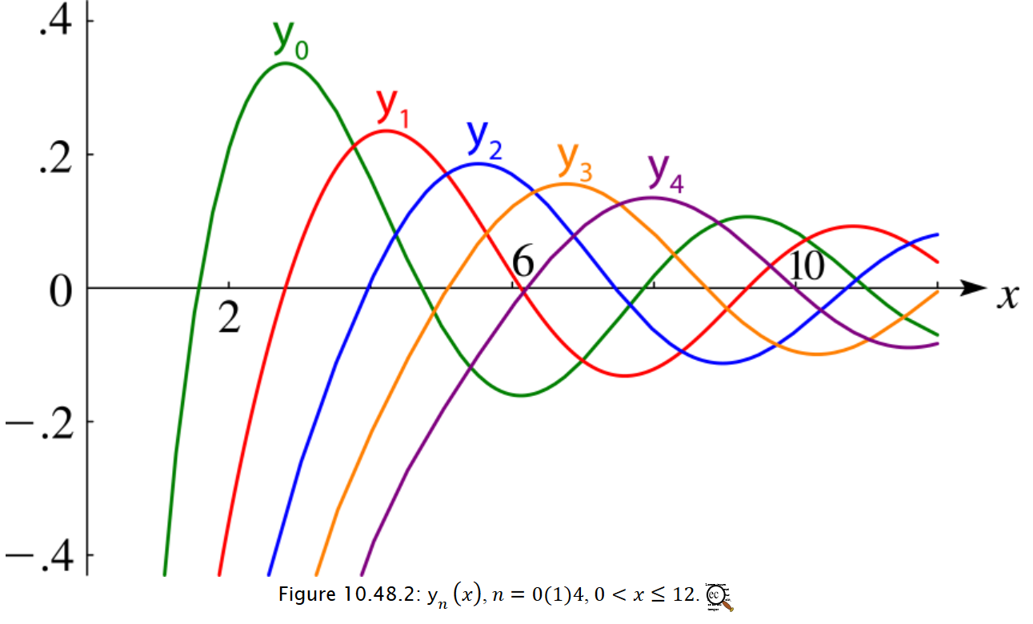

Slide 15
Why use term “phase shift”?

Slide 16
For hard sphere potential

Slide 17
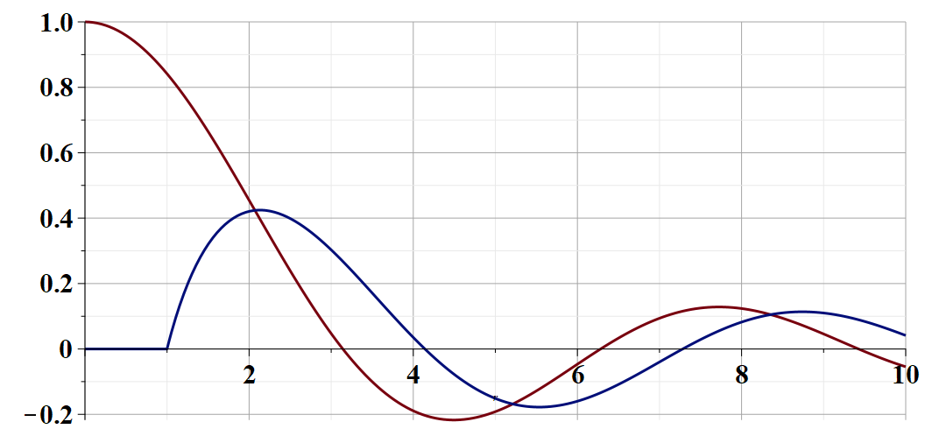
Illustration of phase shift for l=0 and infinite wall potential
gg
➔Phase shift is a measure of scattering strength

Slide 18
We can show that the scattering phase shift is a measure of the quantum mechanical scattering cross section:
➔More details on Friday

