Slide 1
PHY 742 Quantum Mechanics II
12-12:50 PM MWF Olin 103
Plan for Lecture 7
Scattering theory (Chap. 14) –
  Introduction and geometry
  Scattering from spherically symmetric target
  Scattering phase shifts

Slide 2
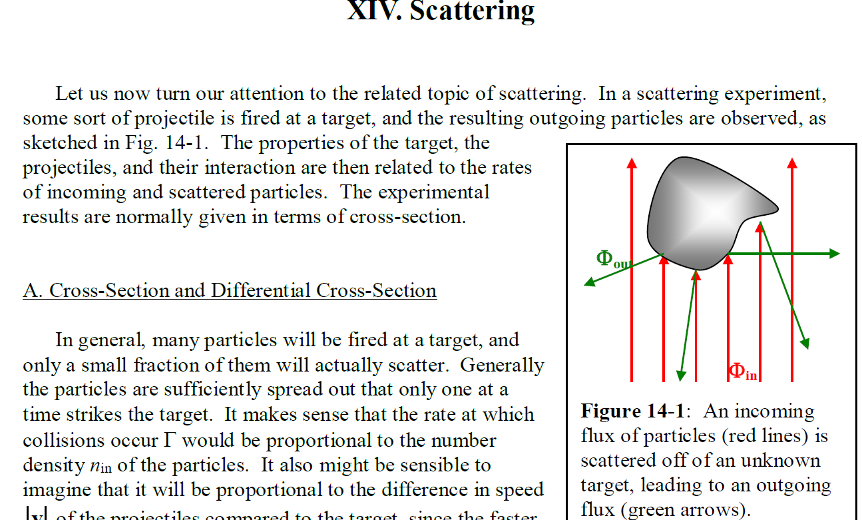

Slide 3
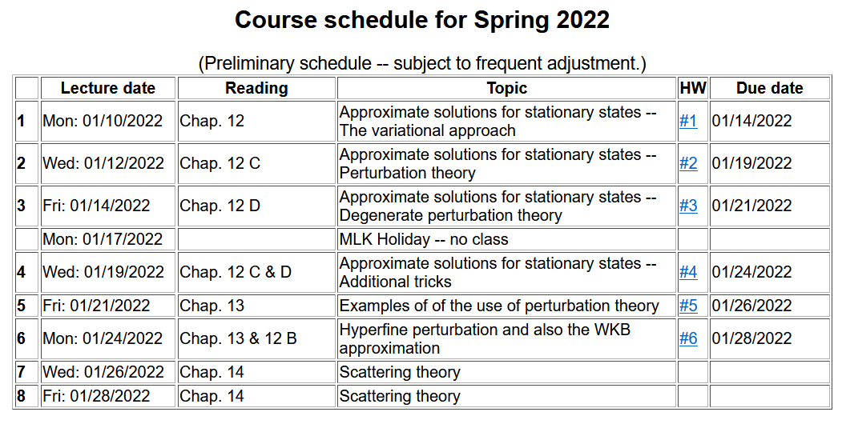

Slide 4
Your questions –
From Can: On page 13， the first equation is R (r)= A j (kr)+ B y (kr)，can any function be written into
A j (kr)+ B y (kr)？ Or just some special aspects in this problem so that we can write in this way.
Comment: When solving a second order differential equation, there are two independent solutions and a linear combination of the two is also a solution. In this case (outside the range of the potential V(x)) the two independent solutions are j_{l}(kr) and y_{l}(kr).

Slide 5
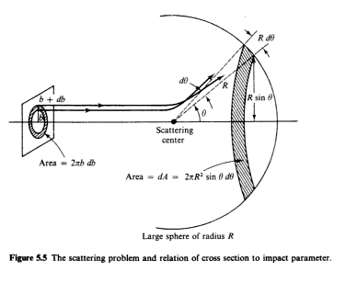
Introduction to scattering theory for quantum particles -- Chap. 14 of textbook; also see other quantum textbooks
detector
Geometry of ideal scattering measurement
This geometry can also be used for quantum systems ..

Slide 6
In classical mechanics, for an isotropic target, it is possible to calculate the cross section in terms of the impact parameter b:
In quantum mechanics, the same phenomenon is formulated in terms of the probability amplitudes. We will specifically focus on free particles scattering from a spherically symmetric target. The same parameters are still relevant except for the notion of impact parameter b.

Slide 7
Representation of a free particle in quantum mechanics --
Continuum solutions of the time independent Schrödinger equation.
z
θ
r
ö
y
φ
x

Slide 9
Free particle partial waves -- continued
≥

Slide 10
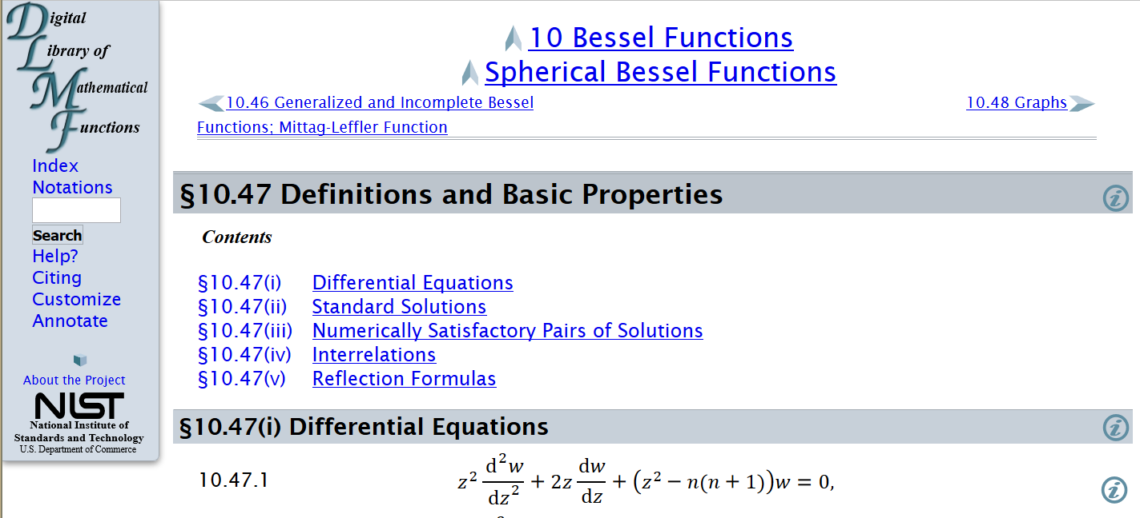
Properties of spherical Bessel functions
http://dlmf.nist.gov/10.47

Slide 11
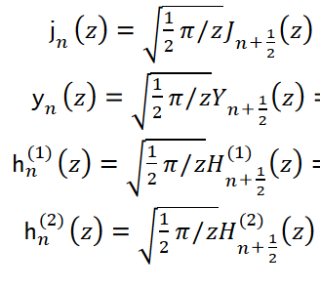
Spherical Bessel functions of order n
Cylindrical Bessel functions of order n+1/2

Slide 12
Forms of spherical Bessel and Hankel functions: (also see Jackson ≥ 426)

Slide 13
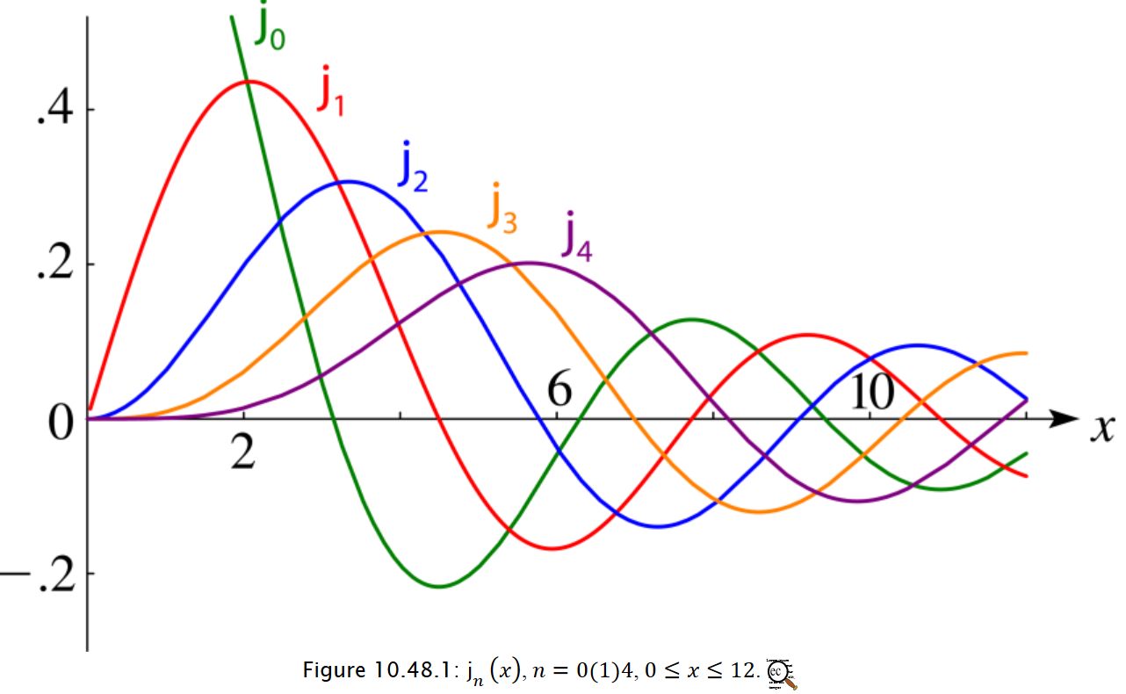
All j_{l}(x) are well behaved for x=0

Slide 14
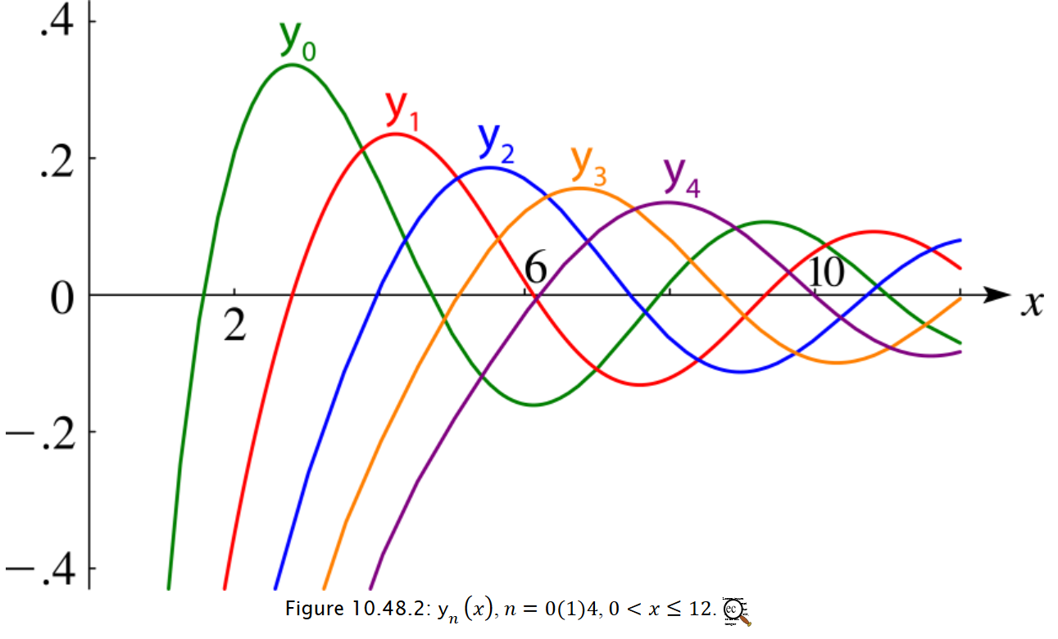
All y_{l}(x) diverge for x=0

Slide 17
Why use term “phase shift”?

Slide 18
For hard sphere potential

Slide 19
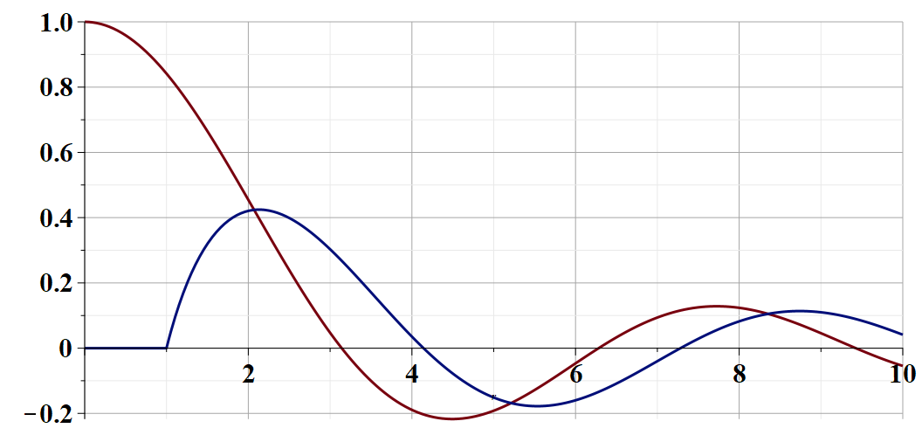
Illustration of phase shift for l=0 and infinite wall potential
➔Phase shift is a measure of scattering strength

Slide 20
Illustration of phase shift for l=0 and infinite wall potential
For l>0, the relationships are similar when kr→ꝏ

Slide 21
We can show that the scattering phase shift is a measure of the quantum mechanical scattering cross section:
➔More details on Friday

