Slide 1
PHY 742 Quantum Mechanics II
12-12:50 PM MWF Olin 103
Plan for Lecture 8
Continue reading Chapter 14 – Analysis of scattering phenomena
Notion of scattering phase shifts
Relationship of scattering phase shifts to differential and total scattering cross sections
Examples

Slide 2
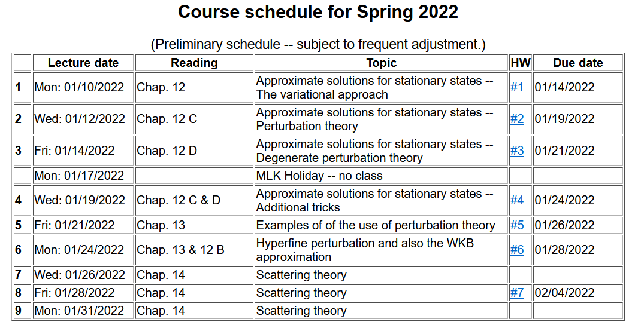

Slide 4
Introduction to scattering theory for quantum particles -- Chap. 14 of textbook;
detector
Geometry of ideal scattering measurement

Slide 5
Basic idea of scattering theory
➔ Output measured at angle θ
➔ Well defined input; beam of independent particles of energy E moving toward target

Slide 6
Quantitative measure – assumed to give information about the interaction between particle and target systems.
In quantum mechanics, the beam of incident particles can be characterized in terms of its probability current:

Slide 7
Representation of scattering in terms of probability amplitude
Scattering geometry

Slide 8
Scattering geometry
What we will show for spherical target

Slide 9
Representation of a free particle in quantum mechanics --
Continuum solutions of the time independent Schrödinger equation.
z
r
ö
y
x
Potential interaction due to spherical target for 0 ≤ r ≤ D

Slide 13
What we want to show, is that the scattering phase shift is a measure of the quantum mechanical scattering cross section:

Slide 14
Some details: Note that this is also covered in Jackson in Sec. 10.3

Slide 15
More details:

Slide 16
More details:

Slide 17
More details:

Slide 18
More details:

Slide 19
When the dust clears:
Imaginary part of forward scattering is proportional to the total scattering cross section.
Imaginary part of forward scattering is proportional to the total scattering cross section.

Slide 20
Example – scattering from an impenetrable spherical hard wall of radius a

Slide 21
Example – scattering from an impenetrable spherical hard wall of radius a
Different from classical case!

Slide 22
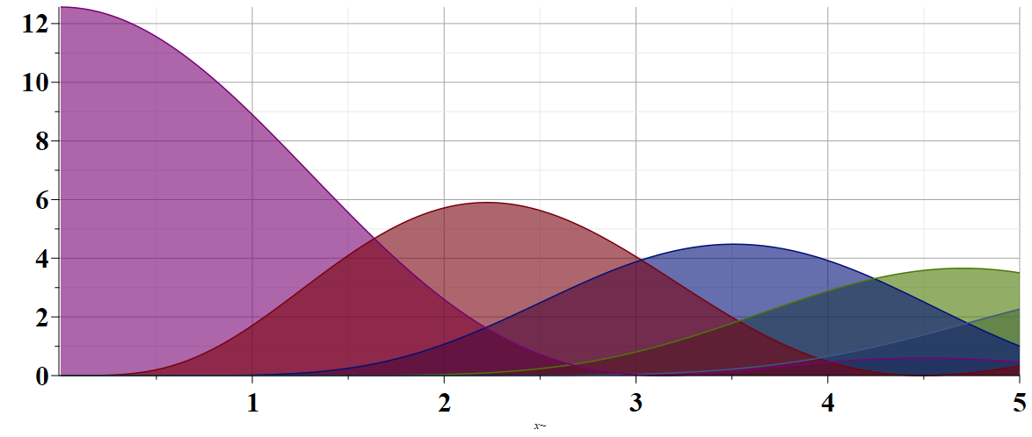
Example – scattering from an impenetrable spherical hard wall of radius a
Partial wave contributions to cross section
l=0
l=1
l=2
l=3
ka

Slide 23
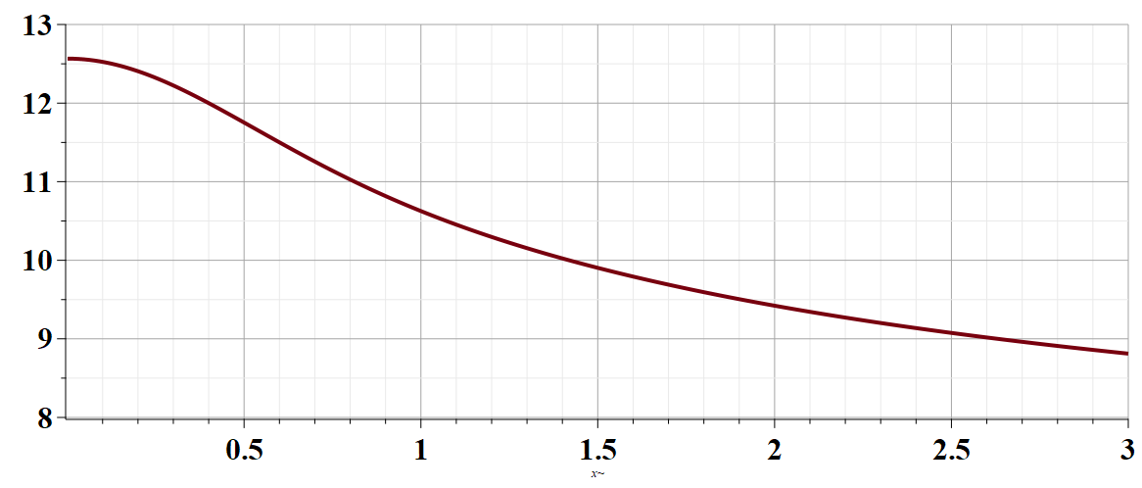
Total cross section as a function of ka
ka

