Slide 1
PHY 742 Quantum Mechanics II
12-12:50 PM MWF Olin 103
Plan for Lecture 9
Continue reading Chapter 14 – Analysis of scattering phenomena
Summary of phase shift analysis and examples
Approximate treatments of scattering – Born approximation

Slide 2
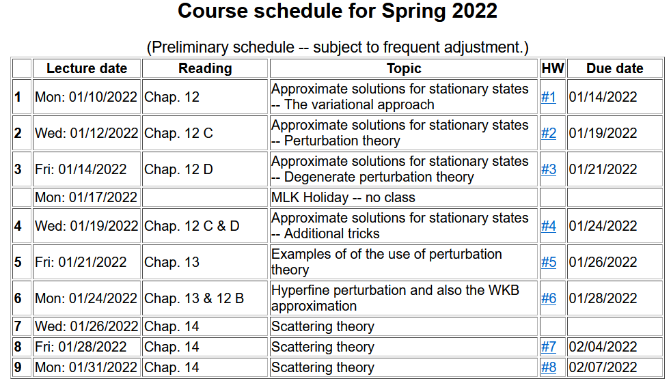

Slide 4
Representation of scattering in terms of probability amplitude
Scattering geometry

Slide 5
Summary of analysis for spherical target in terms of scattering phase shifts:
Imaginary part of forward scattering is proportional to the total scattering cross section.

Slide 6
Summary of analysis for spherical target in terms of scattering phase shifts -- continued:
Spherical Neumann function
Spherical Bessel function

Slide 7
Slight simplification in functions --

Slide 8
Slight simplification in functions – continued (Note: This notation is not standard.)
Scaled Bessel and Neumann functions:
Similarly, we have scaled modified Bessel and Neumann functions

Slide 9
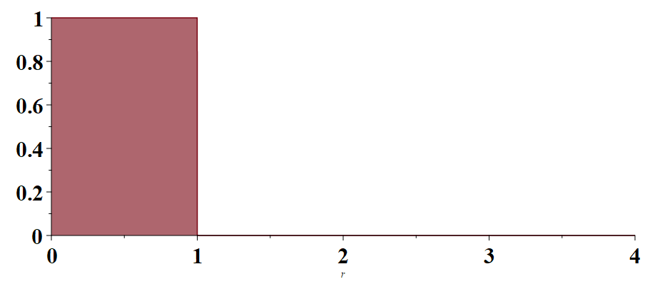
Example --
V(r)/V₀
r/a

Slide 10
Example -- continued

Slide 11
Example -- continued
Even more generally, this approach can be used to determine the exact cross section for this model from scattering amplitude:

Slide 12
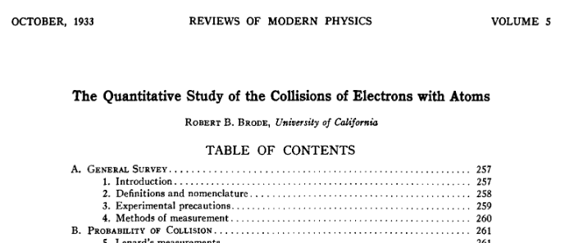
Some famous examples and extensions of phase shift analysis
Ramsauer-Townsend effect -- scattering of electrons from spherical atoms
Xray absorption fine structure
Ramsauer-Townsend effect -- Review article: https://doi.org/10.1103/RevModPhys.5.257

Slide 13
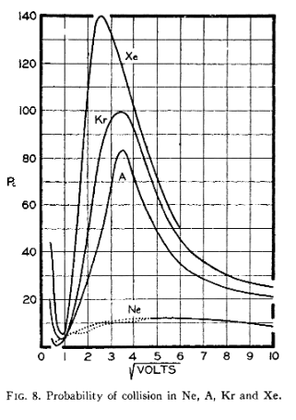
Unusual effect caused by interaction potential
➔scattering cross section
Unusual behavior
➔increasing electron energy

Slide 14
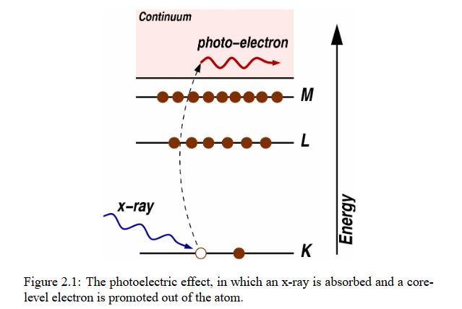
Extended X-ray fine structure absorption spectroscopy (XAFS or EXAFS)
See for example: https://www.lehigh.edu/imi/teched/GlassCSC/SuppReading/Tutorials.pdf
X-ray causes excitation of core electron which scatters from neighboring atoms causing absorption spectrum to show interference pattern related to local structure.

Slide 15
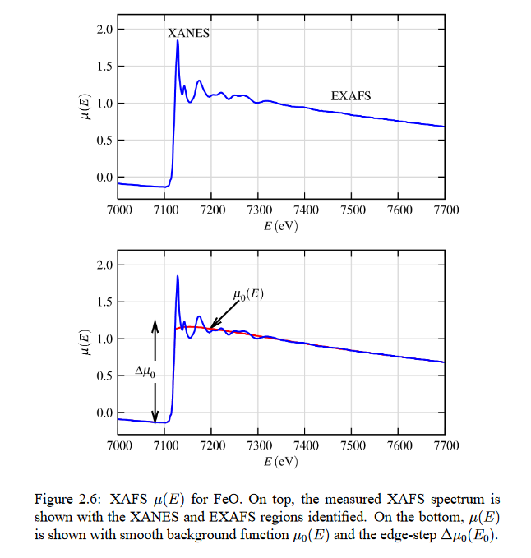

Slide 16
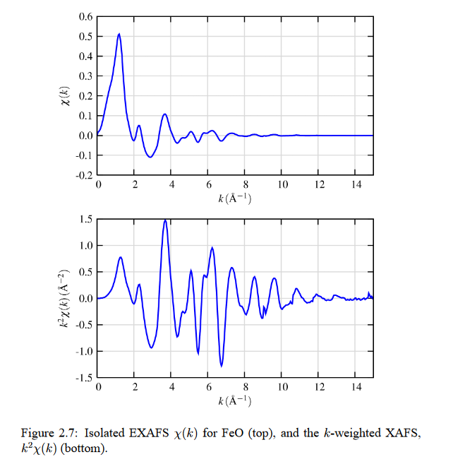
Spectra fit to scattering theory based expression for neighboring atoms at R_{j}

Slide 17
Approximate treatment of scattering – Born approximation

Slide 20
Example – screened Coulomb interaction

Slide 21
Example – screened Coulomb interaction -- continued

Slide 22
Example – screened Coulomb interaction -- continued

Slide 23
Example – spherical well

Slide 24
Example – spherical well – continued

Slide 25
Example – spherical well – continued
(Ref. Landau and Lifshitz)
(Not generally consistent with phase shift analysis.)

Slide 26
Beyond the Born approximation

