Slide 1
PHY 712 Electrodynamics
10-10:50 AM MWF in Olin 103
Notes for Lecture 10:
Reading Chapter 4 in JDJ -- Dipolar fields and dielectrics
Electric field due to a dipole
Electric polarization P
Electric displacement D and dielectric functions

Slide 2
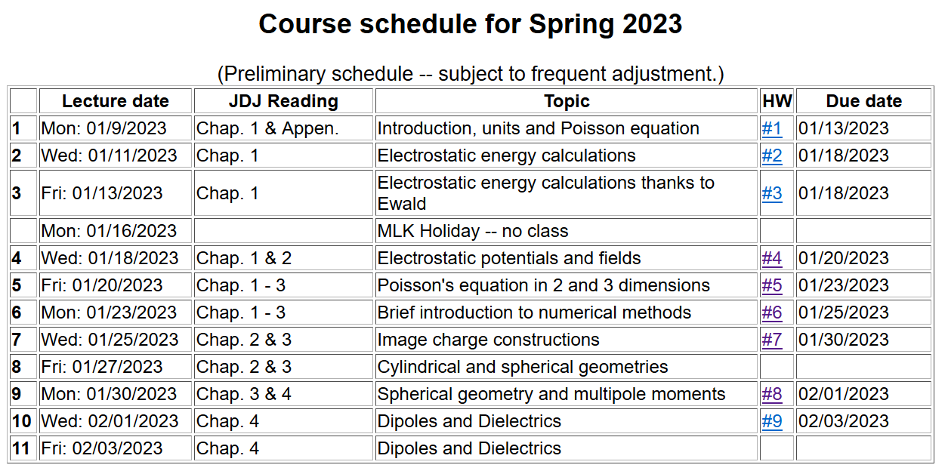

Slide 5
Review: General results for a multipole analysis of the electrostatic potential due to an isolated charge distribution:
q_{lm}

Slide 6
Comment --
Acts like a projection operator

Slide 7
The the multipole analysis has the following general behavior for r→infinity:
Here q, p_{i}, and Q_{ij} are linearly proportional to the q_{lm} multipole values.

Slide 8
The multipole analysis also can be used to analyze the the electrostatic fields for r→0 as needed in the following example involving a very localized charge density ρ(r) in a electrostatic field Φ(r) (such as a nucleus in the field produced by electrons in an atom).
charge density within nucleus
electrostatic potential due to electrons near the nucleus.

Slide 9
The following results were mentioned on Monday and are presented here with greater detail.

Slide 10
Writing out the details of the potential from evaluating integrals

Slide 11
More details continued --

Slide 12
Example of multipole distribution continued --
Here q stands for the elementary charge
q=e=1.602176634x10⁻¹⁹C
This result is discussed in Jackson’s problem #4.7. In that example Q is approximately 10⁻²⁸ m² as a result of the internal structure of the nucleus.

Slide 13
Summary -- Notion of multipole moment:

Slide 14
General form of electrostatic potential in terms of multipole moments:

Slide 15
Focus on dipolar contributions:

Slide 16
“Justification” of surprising δ-function term in dipole electric field -- Assuming dipole is located at r=0, we need to need to evaluate the electrostatic field near r=0:

Slide 17
Some details -- amplifying discussion in JDJ:

Slide 18
More details

Slide 19
More details continued --

Slide 20
In summary --

Slide 21
Summary of key argument:
z
r₂
r₁
y
x

Slide 22
Coarse grain representation of macroscopic distribution of dipoles:

Slide 23
Coarse grain representation of macroscopic distribution of dipoles -- continued:

Slide 24
Coarse grain representation of macroscopic distribution of dipoles -- continued:

Slide 25
Coarse grain representation of macroscopic distribution of dipoles -- continued:
Boundary value problems in dielectric materials

Slide 26
Boundary value problems in the presence of dielectrics – example:
ε₁
ε₂
E₁
E₂
D₁
D₂
For isotropic dielectrics:

Slide 27
Boundary value problems in the presence of dielectrics – example:
E₀
a
E
θ
z
ε
ε₀

Slide 28
Boundary value problems in the presence of dielectrics – example -- continued:

Slide 29
Boundary value problems in the presence of dielectrics – example -- continued:
Φ(r,θ=0)
ε/ε₀=
10
2
1
r/a

