Slide 1
PHY 712 Electrodynamics
10-10:50 AM MWF in Olin 103
Notes for Lecture 10:
Reading Chapter 4 in JDJ -- Dipolar fields and dielectrics
Electric field due to a dipole
Electric polarization P
Electric displacement D and dielectric functions

Slide 2
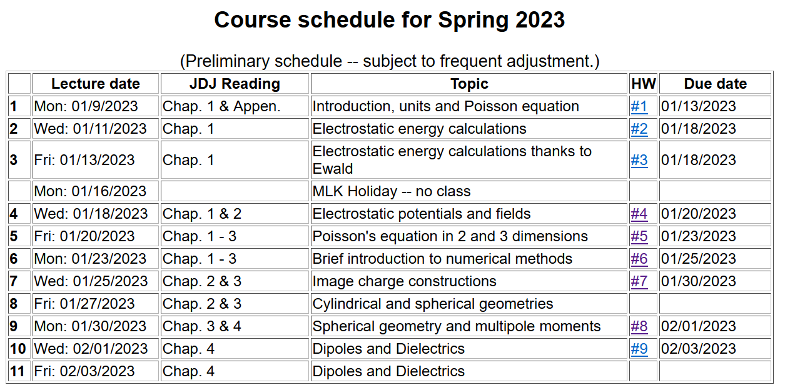

Slide 3
Note that this problem is different from the one posted in the earlier version of these notes.

Slide 5
Coming next week:

Slide 6
Review: General results for a multipole analysis of the electrostatic potential due to an isolated charge distribution:
q_{lm}

Slide 7
Your questions –
From Banasree: Does q_lm have any physical meaning?
Comment – It typically indicates the symmetry of a charge distribution and directly determines the long range form of the electrostatic potential.

Slide 8
Comment --
Acts like a projection operator

Slide 9
The the multipole analysis has the following general behavior for r→infinity:
Here q, p_{i}, and Q_{ij} are linearly proportional to the q_{lm} multipole values.

Slide 10
The multipole analysis also can be used to analyze the the electrostatic fields for r→0 as needed in the following example involving a very localized charge density ρ(r) in a electrostatic field Φ(r) (such as a nucleus in the field produced by electrons in an atom).
charge density within nucleus
electrostatic potential due to electrons near the nucleus.

Slide 11
The following results were mentioned on Monday and are presented here with greater detail.

Slide 12
Writing out the details of the potential from evaluating integrals

Slide 13
More details continued --

Slide 14
Example of multipole distribution continued --
Here q stands for the elementary charge
q=e=1.602176634x10⁻¹⁹C
This result is discussed in Jackson’s problem #4.7. In that example Q is approximately 10⁻²⁸ m² as a result of the internal structure of the nucleus.

Slide 15
Summary -- Notion of multipole moment:

Slide 16
General form of electrostatic potential in terms of multipole moments:

Slide 17
Focus on dipolar contributions:

Slide 18
“Justification” of surprising δ-function term in dipole electric field -- Assuming dipole is located at r=0, we need to need to evaluate the electrostatic field near r=0:

Slide 19
Some details -- amplifying discussion in JDJ:

Slide 20
More details

Slide 21
More details continued --

Slide 22
In summary --

Slide 23
Summary of key argument:
z
r₂
r₁
y
x

Slide 24
Coarse grain representation of macroscopic distribution of dipoles:

Slide 25
Coarse grain representation of macroscopic distribution of dipoles -- continued:

Slide 26
Coarse grain representation of macroscopic distribution of dipoles -- continued:

Slide 27
Coarse grain representation of macroscopic distribution of dipoles -- continued:
Boundary value problems in dielectric materials

Slide 28
Boundary value problems in the presence of dielectrics – example:
ε₁
ε₂
E₁
E₂
D₁
D₂
For isotropic dielectrics:

Slide 29
Boundary value problems in the presence of dielectrics – example:
E₀
a
E
θ
z
ε
ε₀

Slide 30
Boundary value problems in the presence of dielectrics – example -- continued:

Slide 31
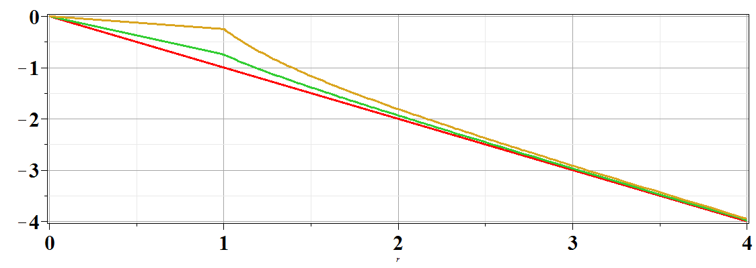
Boundary value problems in the presence of dielectrics – example -- continued:
Φ(r,θ=0)
ε/ε₀=
10
2
1
r/a

