Slide 1
PHY 712 Electrodynamics
10-10:50 AM MWF Olin 103
Notes for Lecture 12:
Start reading Chapter 5
Magnetostatics
Vector potential
Example: current loop

Slide 2
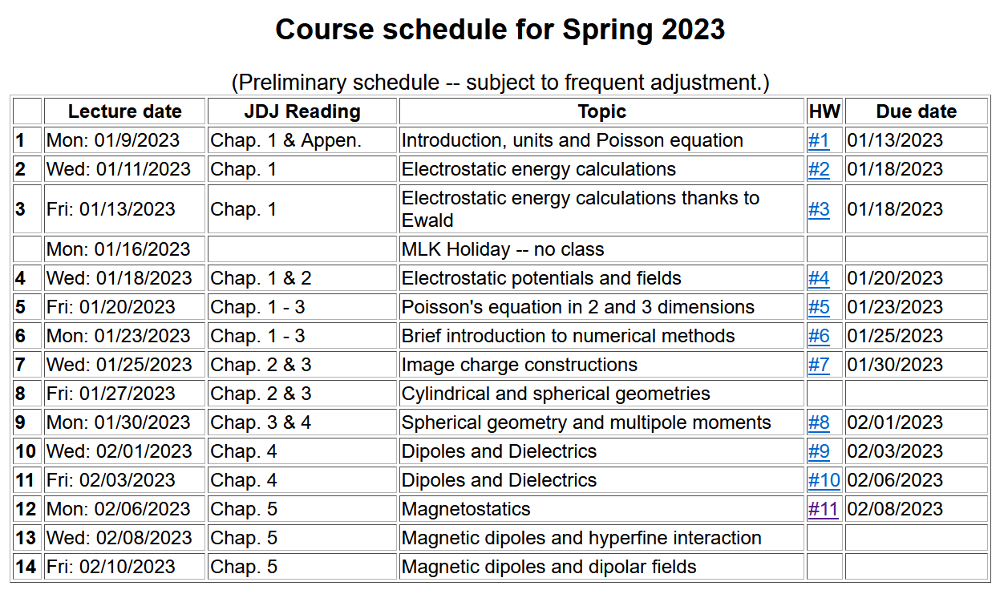

Slide 3
Note that it is possible to solve this problem using ideas learned in beginning physics (such PHY 114).

Slide 4
Your questions:
From Banasree: Why would k^2 go to zero?
Comment – see additional comments for treatment of current loop.

Slide 5
Magnetostatics
Magnetic flux density or magnetic induction field B
Steady state (constant in time) current density J
y
q_{i}
v_{i}
Real life examples:
Steady macroscopic current
Quantum mechanical eigenstates with non-trivial current density.
r_{i}
x

Slide 6
Comparison of electrostatics and magnetostatics

Slide 7
Alternative forms magnetostatic equations

Slide 9
Alternative forms magnetostatic equations -- continued

Slide 10
Differential forms of magnetostatic equations:
Magnetostatic vector potential

Slide 11
Non uniqueness of the magnetostatic vector potential

Slide 12
Differential form of Ampere’s law in terms of vector potential:

Slide 13
Integral form may not be a good idea in this case ---

Slide 14
Further comments about HW #11
Using PHY 114 approach
J₀
Top view

Slide 15
Magnetostatics example: current loop
z
r
Integral form may be OK for this case…
y
x

Slide 16
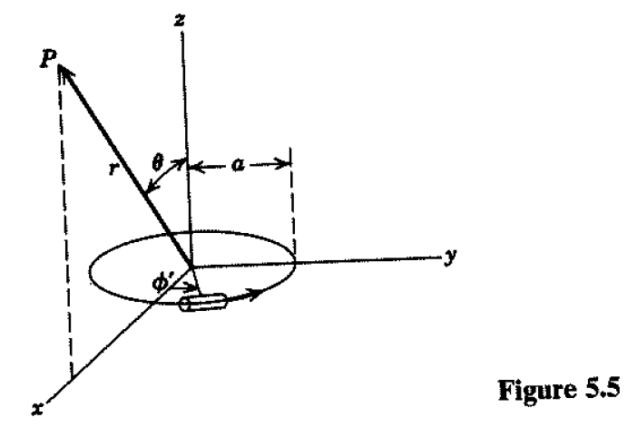
Magnetostatics example: current loop -- continued

Slide 17
Magnetostatics example: current loop -- continued

Slide 18
Examination of k
Note that k=0 when θ=0 and when r →infinity
k=1 when θ=π/2 and r = a

Slide 19
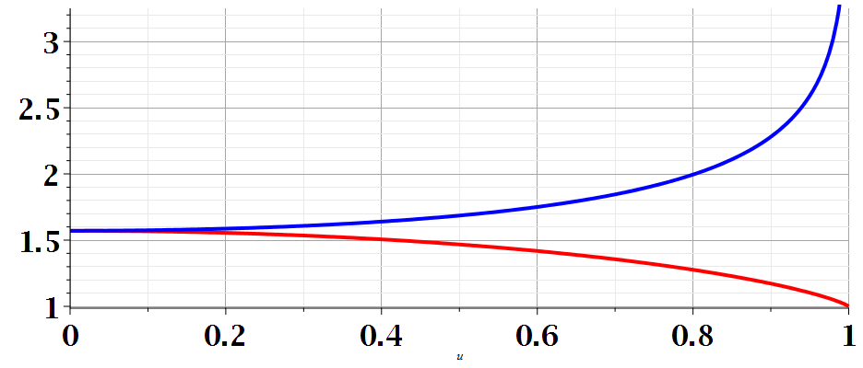
Standard eliptic functions --
m

Slide 20
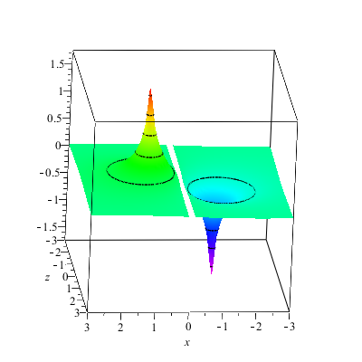
Magnetostatics example: current loop -- continued
A_{y}(x,z)

Slide 21
Magnetostatics example: current loop -- continued
Evaluation for special cases

Slide 22
Evaluation for special case k² → 0

Slide 23
Evaluation for special case k² → 0

Slide 24
Magnetostatics example: current loop -- continued

Slide 25
Other examples of current density sources:

Slide 26
Magnetic vector potential for this case:

Slide 27
Some details -- (note – this case simplifies more quickly than most…)

